Slide 1
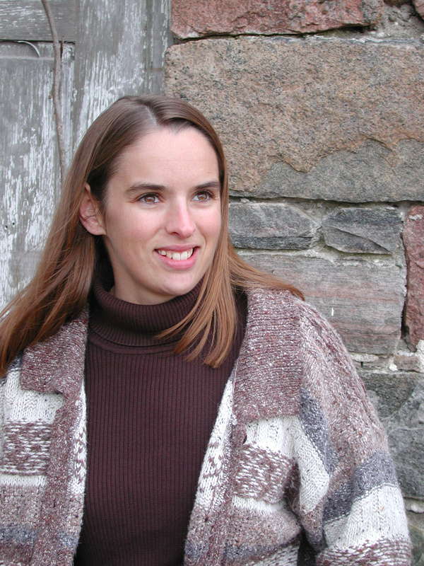
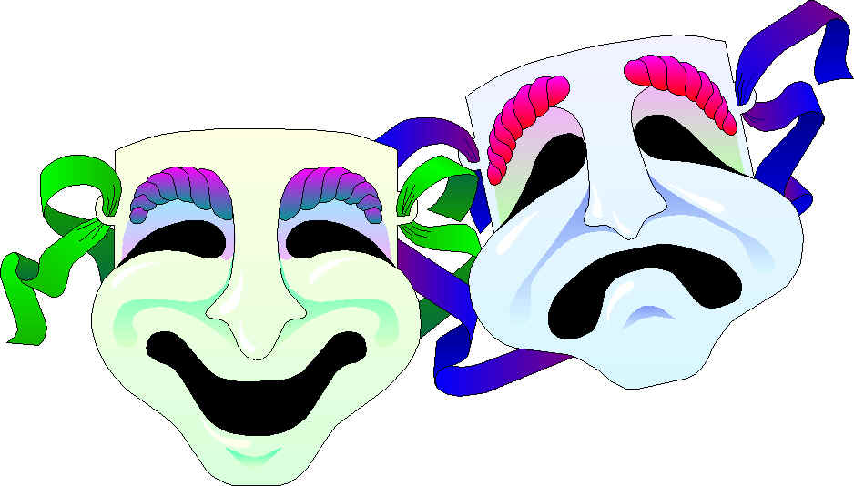

Personality

Slide 2
Personality: The psychological qualities that bring a consistency to an individual’s thoughts and behaviors in different situations and at different times.
Personality is a continuously changing process, shaped by our individual needs and cognitions and by external pressures from the social environment.
It is the thread that consistently runs through our lives.
Two Main Theories
Psychodynamic Theory: Freud’s theory that calls attention to motivation, especially unconscious motives, and the influence of our past experiences.
Humanistic Theory: A theory that emphasizes the present, subjective reality-what we believe is important now, what we think of ourselves in relation to others is important now.

Slide 3
Clinical Perspective
The clinical perspective utilizes a combination of the psychodynamic and humanistic theories. This is most often used by psychologists who are working with people who are seeking counseling.
Social Cognitive Theory
Social-cognitive theory derives from experiments in psychology rather than clinical work.
This theory is based on the idea that personality is a result of learning, perception and social interaction.
Despite what it seems, social-cognitive theory and clinical perspective compliment each other and share some common ideas.

Slide 4
Psychodynamic Theories
Although there are a variety of psychodynamic theories, they originate with Freud’s psychoanalytic theory.
In this theory, Freud said the unconscious, the hidden parts of the mind, was a source of powerful impulses, instincts, motives, and conflicts that energize personality.
Psychoanalysis
Psychoanalysis focuses on how the mind’s energy is exchanged, transformed and expressed.
The “mental stream” of the sex drive was called the Eros, he Greek god for passionate love. The energy behind this drive was called libido, Latin for lust.
The “mental stream” for destruction was Thanatos. Freud called it the “death instinct” that drives aggressive and destructive acts humans commit against each other.

Slide 5
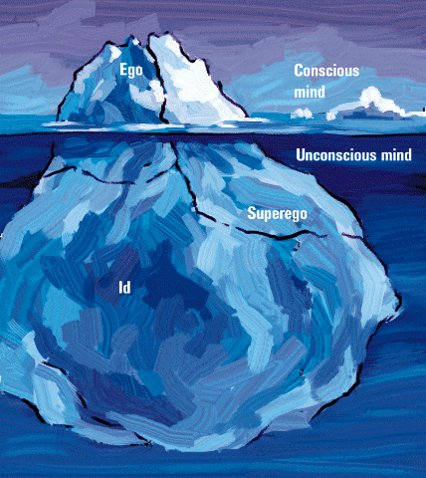
Personality Structure
Freud saw human personality as an iceberg with three parts: the Ego, Superego and Id.
In this model, the superego and the id were antagonist parts, regulated by the ego.
Ego
Conscious mind
Unconscious
mind
Superego
Id

Slide 6
The Id
In Freud’s model, the id is the primitive, unconscious reservoir that houses the basic motives, drives and instinctive desires that determine our personalities.
Always acts on impulse and seeks immediate pleasure
The only part of the personality present at birth
Superego
The superego is the “police” of personality and is responsible for morals and values learned from society.
The superego develops as the child forms an internal set of rules based on external experiences
The inner voice of shoulds and should nots
Often conflicts with the id because the id wants what feels good and the superego wants what is right and moral

Slide 7
The Ego
Regulating the conflict between the id and the superego is the job of the ego-the conscious, rational part of the mind.
The ego must figure out a way to satisfy one’s desires, while not violating one’s moral code.
When this balance becomes upset, conflicted thoughts and behaviors that signify a mental disorder may be the result

Slide 8
Psychosexual Stages
Freud believed that our early experiences stayed with us and affected us throughout our development, especially with regards to sex.
Should something happen in the early years, people will have problems to overcome later in life specifically dealing with sexuality:
    Oedipus complex: boy in love with their mother
    Identification: boys love their mom/identify with their dad
    Penis envy: girls desire to have a penis-attracted to males
    Fixation: occurs when development is stopped at a particular stage

Slide 9
Freud’s Psychosexual Stages
Freud’s Psychosexual Stages
Stage Focus
Oral Pleasure centers on the mouth--
(0-18 months) sucking, biting, chewing
Anal Pleasure focuses on bowel and bladder
(18-36 months) elimination; coping with demands for control
Phallic Pleasure zone is the genitals; coping with
(3-6 years) incestuous sexual feelings
Latency Dormant sexual feelings
(6 to puberty)
Genital Maturation of sexual interests
(puberty on)

Slide 10
Ego Defense
Ego defense is the largely unconscious mental strategy to reduce anxiety or conflict.
Repression: the ego defense that excludes unacceptable or inappropriate thoughts and feelings from our awareness.
***A complete list of ego defenses is on page 416, be able to identify what these are.***
Assessing the Unconscious
Projective Test: a personality test, such as the Rorschach or TAT, that provides ambiguous stimuli designed to trigger projection of one’s inner dynamics
Thematic Apperception Test (TAT): a projective test in which people express their inner feelings and interests through the stories they make up about ambiguous scenes

Slide 11
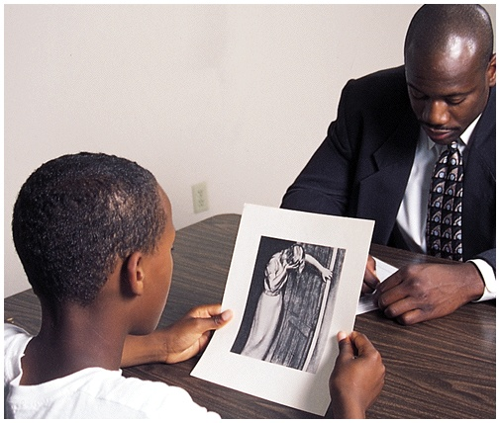
Assessing the Unconscious--TAT

Slide 12
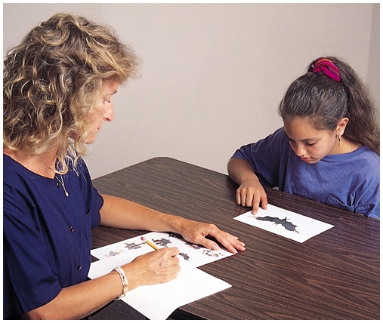
Rorschach Inkblot Test
  the most widely used projective test
  a set of 10 inkblots designed by Hermann Rorschach
  Seeks to identify people’s inner feelings by analyzing their interpretations of the blots
  They are of questionable validity
  http://en.wikipedia.org/wiki/Rorschach_test

Slide 13
Criticism of Freud
While Freud is still wildly popular in media and culture, it has lost most of it support in the psychology field.
Many Freudian concepts (libido, repression) are vague
The focus is on retrospective explanation
Only looks back, doesn’t give credit to the present or future
No thought given to women
The unconscious mind is not as smart/purposeful as Freud would like us to believe

Slide 14
Neo-Freudians
Freud was a controversial figure, and many of his collogues broke away from his view, but still maintained a psychodynamic aspect to their theories
Alfred Adler
  Importance of childhood social tension
  Believed children often have inferiority complexes
Karen Horney
  Sought to balance Freud’s masculine biases
Carl Jung
  Emphasized the collective unconscious
  Concept of a shared, inherited reservoir of memory traces from our species’ history

Slide 15
Humanistic Theories
Humanistic theories are optimistic about the core of human nature.
Personality is driven by needs to adapt and learn, rather than unconscious conflicts or defense mechanisms and anxiety
Mental disorders occur when a person is in an unhealthy situation that causes low self-esteem and unmet needs, not from unhealthy individuals.

Slide 16
Abraham Maslow
The most famous humanistic perspective came from Abraham Maslow who created a hierarchy of needs (chapter 8).
He said we needed something that described good mental health as more than just the absence of illness.
Maslow saw a group of people in pursuit of “higher ideals” and wanted a way to explain their behavior.
Self-actualizing personalities- healthy individuals who have met their basic needs and are free to be creative and fulfill their potentialities.
Maslow identified Abraham Lincoln as a self-actualizing personality

Slide 17
Carl Rogers
Another famous humanists was Carl Rogers who took a different approach.
He identified healthy personalities as the fully functioning person.
An individual who has a self-concept that is positive and congruent with reality.
Criticism of Humanistic Theories
People criticize humanistic concepts as being fuzzy, for example, what IS self actualization?
For a long time, self-esteem was thought to cause people to act the way they do.
More recently, psychologists have argued that self-esteem isn’t the cause of behavior, but rather a by-product of behavior.

Slide 18
Social-cognitive Theories
Where are the clinical views lack scientific backing, the social-cognitive theories are solidly founded in scientific tradition, with emphasis put on research.
The most well known of these theories is observational learning, supported by Albert Bandura.
Bandura said we are not only driven by innerforces and the environment, but also expectations about how those actions will affect other people, the environment and ourselves.
Observational Learning
In observational learning, we learn new responses by watching each others’ behavior.
Personality, thus, is learned behavior patterns
These cognitive process involve an ongoing relationship between the individual and the environment called reciprocal determinism

Slide 19
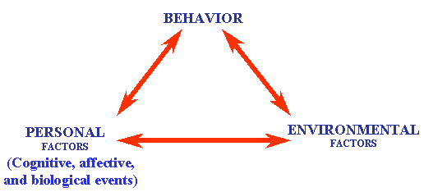

Slide 20
Social-Cognitive Perspective
Locus of Control: Our sense of controlling our environments rather than feeling helpless
External Locus of Control: the perception that chance or outside forces beyond one’s personal control determine one’s fate
Internal Locus of Control: the perception that one controls one’s own fate
Learned Helplessness: the hopelessness and passive resignation an animal or human learns when unable to avoid repeated aversive events

Slide 21
Learned Helplessness
Uncontrollable
bad events
Perceived
lack of control
Generalized
helpless behavior

Slide 22
Personality and Temperament
Temperament is the inherited personality dispositions that are apparent in early childhood and that establish “tempo” and “mood” in the individual’s behaviors.
Biological dispositions affect our basic personalities
Traits and Personality
Traits are stable personality characteristics that are presumed to exist within the individual and to guide his or her thoughts and actions under various conditions
The Five-Factor Theory: A perspective suggesting that personality is composed of five fundamental personality dimensions: openness to experience, consciousness, extraversion, agreeableness and neuroticism (explanation on page 432-433).

Slide 23
Five-Factor Theory
The “Big Five” Personality Factors
Trait Dimension Description
Emotional Stability Calm versus anxious
Secure versus insecure
Self-satisfied versus self-pitying
Extraversion Sociable versus retiring
Fun-loving versus sober
Affectionate versus reserved
Openness Imaginative versus practical
Preference for variety versus preference for routine
Independent versus conforming
Extraversion Soft-hearted versus ruthless
        Trusting versus suspicious
Helpful versus uncooperative
Conscientiousness Organized versus disorganized
      Careful versus careless
Disciplined versus impulsive

Slide 24
Contemporary Research– The Trait Perspective
Trait
  a characteristic pattern of behavior
  a disposition to feel and act, as assessed by self-report inventories and peer reports
Personality Inventory
  a questionnaire (often with true-false or agree-disagree items) on which people respond to items designed to gauge a wide range of feelings and behaviors
  used to assess selected personality traits

Slide 25
The Trait Perspective
UNSTABLE
Moody
Touchy
Anxious
Restless
Hans and Sybil Eysenck use two primary personality factors as axes for describing personality variation
Rigid
Aggressive
Sober
Excitable
Pessimistic
Changeable
Reserved
Impulsive
Unsociable
Optimistic
Quiet
Active
melancholic
choleric
INTROVERTED
EXTRAVERTED
Passive
phlegmatic
sanguine
Sociable
Careful
Outgoing
Thoughtful
Talkative
Peaceful
Responsive
Controlled
Easygoing
Reliable
Lively
Even-tempered
Carefree
Calm
Leadership
STABLE

Slide 26
Visit the link below and read about the Myers-Briggs Type Indicator and then take the short test to determine your personality type. After you take the test and have spent some time reading about the different personality types, answer the following questions. You should also read pages 436-437 for more information regarding the Myers-Briggs Type Indicator.
http://www.personalitypathways.com/type_inventory.html
1. What was your personality type?
2. Do you agree or disagree with the results? Exlpain.
3. Do you believe that this is a valid test? How do psychologists feel about this test? What does the research say?

