Slide 1
Digestion
Topic 6.1

Slide 2
Topic 6.1.1 Explain why digestion of large food molecules is essential.
In order to do all the chemical reactions necessary for life, animals need
Energy is obtained by
In order to obtain nutrients, animals must

Slide 3
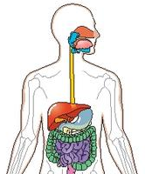
Topic 6.1.1 Explain why digestion of large food molecules is essential.
The role of the digestive system is:
food
Break food down into small molecules that
nutrient molecules
Eliminate non-digestible remains ( )

Slide 4
Topic 6.1.1 Explain why digestion of large food molecules is essential.
Digestion is essential because much of the food consumed is
There are two types of digestion:
digestion: chopping up food and moving it along
digestion: breaking down food molecules with the use of enzymes

Slide 5
Topic 6.1.2 Explain the need for enzymes in digestion.
In order to break down large molecules of food, are needed
These enzymes
Enzymes make
They greatly increase the rate at which these insoluble food substances are broken down

Slide 6
Topic 6.1.3 State the source, substrate, products and optimum pH conditions for one amylase, one protease and one lipase.
Enzyme
Source
Substrate
Products
Optimum pH

Slide 7
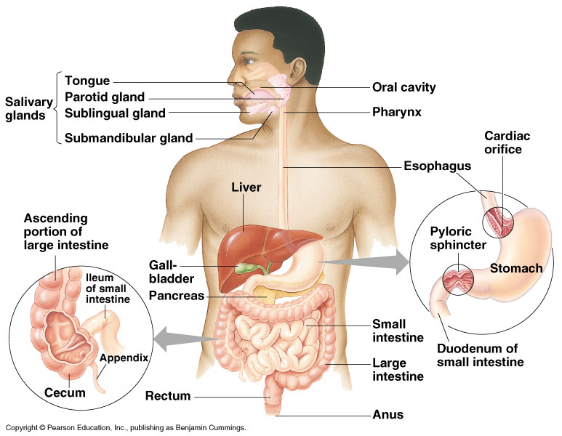
Topic 6.1.4 Draw and label a diagram of the digestive system. (you will be doing this in lab)

Slide 8
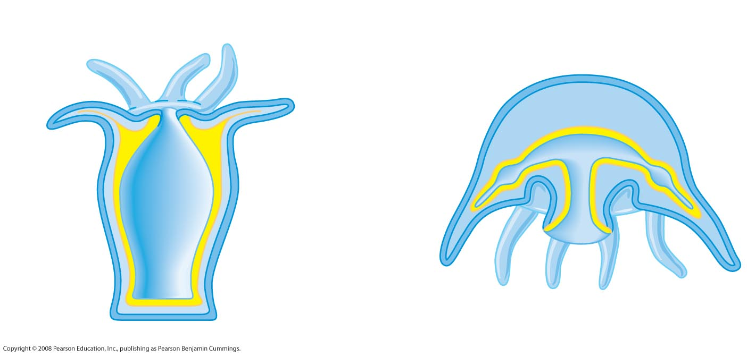
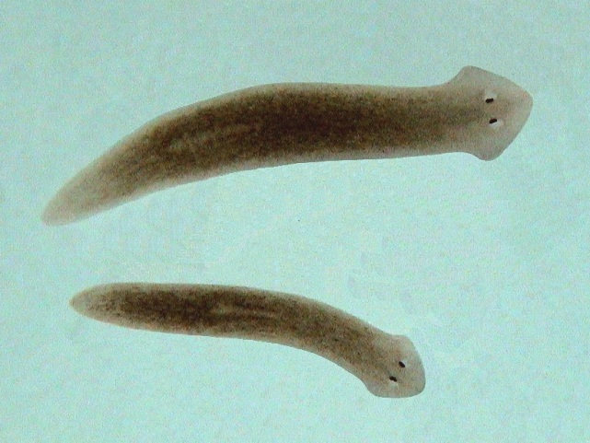
Incomplete vs. Complete Digestive Systems
Incomplete Digestive System:
Have a – mouth
Food and waste
Nutrients are distributed by
Ex.
Mouth/anus
Mouth/anus

Slide 9
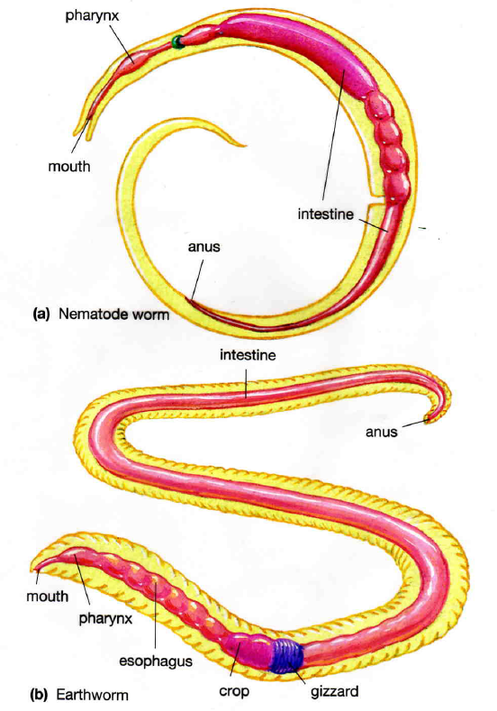
Complete Digestive System
Has a
mouth takes in food
undigested remains leave the body through anus
Ex.

Slide 10
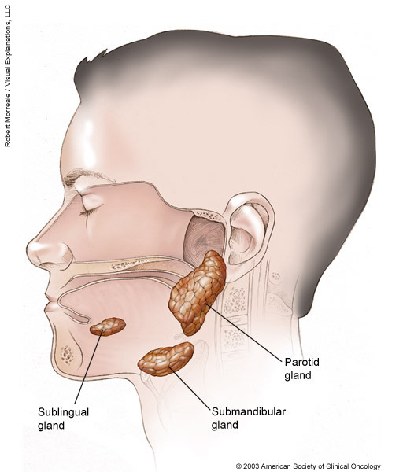
Human Digestive System – tube within a tube body plan
Mouth –
Food is chewed
Food is mixed with made by three major pairs of salivary glands
Saliva is sent to mouth through
Saliva contains
Food mixed with saliva forms a mass called

Slide 11
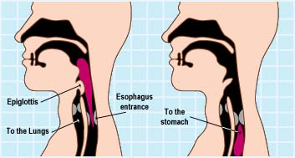
Pharynx –
covers glottis to
Food passes into

Slide 12
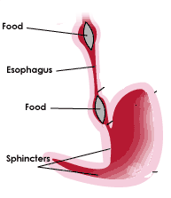
Esophagus –
Peristalsis – (as well as all muscular movement to move food through entire digestive system)
(bolus)

Slide 13
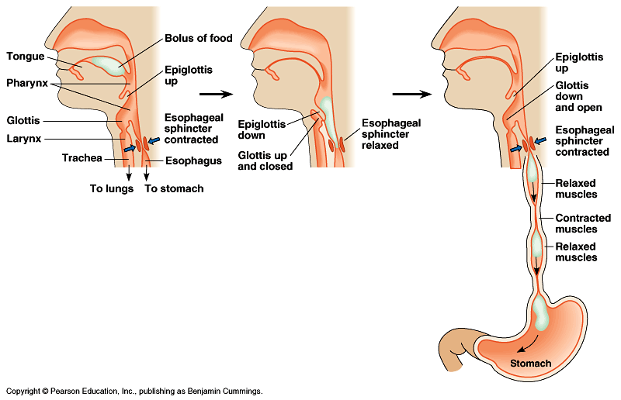

Slide 14
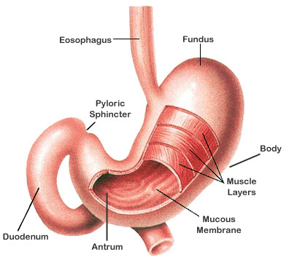
Topic 6.1.5 Outline the function of the stomach, small intestine and large intestine.
Stomach –

Slide 15
Topic 6.1.5 Outline the function of the stomach, small intestine and large intestine.
Epithelial lining of stomach contains millions of gastic pits which lead to gastric glands
Gastric glands produce gastric juices containing:
HCl (pH around 2) – kills bacteria and other microbes, promotes the activation of pepsinogen into pepsin
Pepsinogen – inactive precursor to pepsin – enzyme that breaks down protein

Slide 16
Topic 6.1.5 Outline the function of the stomach, small intestine and large intestine.
Thick layer of protects the stomach
Stomach contents are called
Stomach is closed off by at both ends:
sphincter prevents food from
sphincter controls passage of

Slide 17
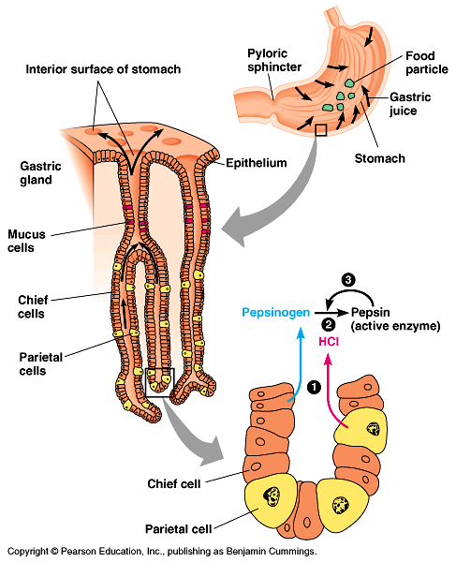

Slide 18
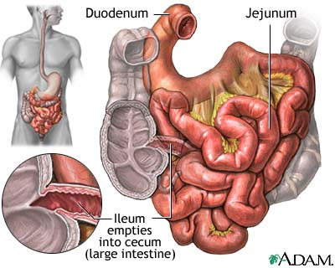
Topic 6.1.5 Outline the function of the stomach, small intestine and large intestine.
Small Intestine –
Digestion in the small intestine is accomplished by digestive secretions from the:
Liver
Pancreas
Cells of small intestine itself

Slide 19
Topic 6.1.5 Outline the function of the stomach, small intestine and large intestine.
The
The liver has many functions
Storage of for energy
Regulation of
Synthesis of blood proteins
Storage of iron and certain vitamins
Conversion of
of other harmful substances

Slide 20
Topic 6.1.5 Outline the function of the stomach, small intestine and large intestine.
In digestion, the liver produces (mixture of bile salts, water, other salts, and cholesterol) – a liquid
Gallbladder has a duct leading to small intestine ( )
Bile acts as an
This

Slide 21
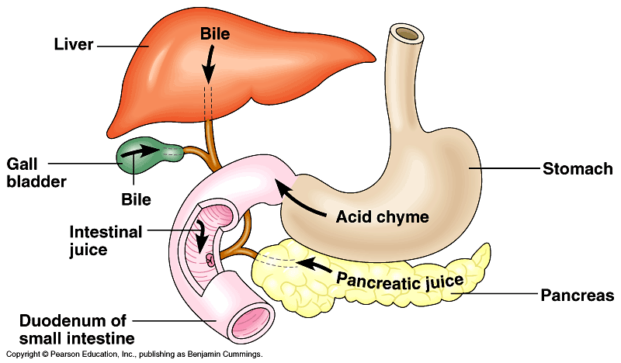

Slide 22
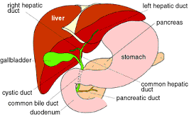
Topic 6.1.5 Outline the function of the stomach, small intestine and large intestine.
Pancreas –
Made of two types of cells:
One produces hormones to regulate blood sugar levels
The other produces pancreatic juice released into small intestine

Slide 23
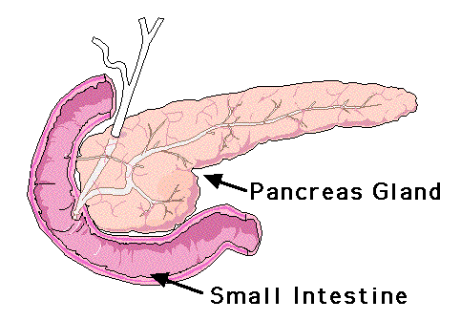
Topic 6.1.5 Outline the function of the stomach, small intestine and large intestine.
Pancreatic juice contains:
Sodium bicarbonate (neutralize stomach acid)
Pancreatic amylase (digests carbohydrates)
Pancreatic lipase (digests lipids)
Pancreatic proteases including trypsin, chymotrypsin, and carboxypeptidase (digests proteins)

Slide 24
Topic 6.1.5 Outline the function of the stomach, small intestine and large intestine.
The small intestine is studded with cells that are specialized to complete digestion and absorb nutrient molecules
Enzymes such as proteases, sucrase, lactase, maltase and lipase are embedded in the membranes of the cells

Slide 25
Topic 6.1.5 Outline the function of the stomach, small intestine and large intestine.
Final stage of digestion occurs as
Fats are absorbed into the

Slide 26
Topic 6.1.7 Explain how the structure of the villus is related to its role in absorption and transport of the products of digestion.
Small intestine wall is highly folded to
Folded surface is covered by tiny fingerlike projections called (0.5 – 1.5 mm in length)
Each individual cell of the villi has further, microscopic extensions called which further increase surface area for absorption
Villi are

Slide 27
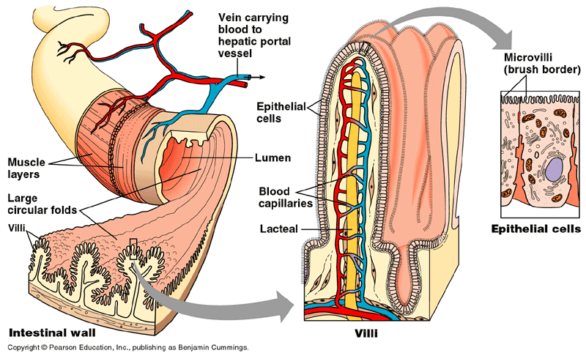
Topic 6.1.7 Explain how the structure of the villus is related to its role in absorption and transport of the products of digestion.

Slide 28
Topic 6.1.6 Distinguish between absorption and assimilation.
Products of digestion are
Absorbed by
Products of digestions include:
Assimilation occurs if (i.e. amino acids used to build a protein)

Slide 29
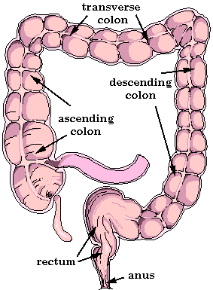
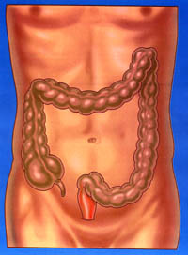
Topic 6.1.5 Outline the function of the stomach, small intestine and large intestine.
Large Intestine –

Slide 30
Topic 6.1.5 Outline the function of the stomach, small intestine and large intestine.
Leftovers of digestion flow into large intestine
Mixture of
Contains that live on unabsorbed nutrients
Synthesizes vitamin B12, thiamin, riboflavin, and vitamin K
Cells that line the large intestine absorb
After absorption of water, waste becomes semisolid
Consists of
Feces is stored in rectum – expansion of rectum stimulates desire to defecate

Slide 31
Nutrition
Animal nutrients fall into five categories:
Vitamins –
Vitamins are essential to cellular metabolism
Water-Soluble vitamins –
Fat-Soluble vitamins –

Slide 32
Nutrition
Vitamin A –
Necessary for proper functioning of eye
found in
Vitamin D –
egg yolk, milk, fish oils
Vitamin E –
Vitamin K –

Slide 33
Nutrition
Minerals –
Calcium is needed for bones and teeth as well as for nerve conduction and muscle contraction
& 4. Carbohydrates and Fats –

Slide 34
Nutrition
Proteins –
Amino acids are used to make
Liver can synthesize amino acids
are those that cannot be synthesized and must be supplied by the diet

