Slide 1
Solutions Chapter 16

Slide 2
Desired Learning Objectives
You will be able to describe and categorize solutions
You will be able to calculate concentrations of solutions
You will be able to analyze the colligative properties of solutions

Slide 3
Solutions
Solute – is the substance that dissolves in the solvent (e.g. sugar, salt, tea)
Solvent – is the dissolving medium (e.g. water)
A solution can exist as a gas, liquid, or solid depending on the state of its solvent.

Slide 4
Soluble, Insoluble, Immiscible, and Miscible
A substance that dissolves in a solvent is said to be soluble in that solvent (e.g. sugar in water).
A substance that does not dissolve in a solvent is said to be insoluble in that solvent (e.g. sand in water).
Oil and vinegar are said to be immiscible. They do not mix with one another.
Liquids that mix with one another are miscible with one another.

Slide 5
Dissolving
Attractive forces exist between the pure solvent particles, and between the solute and solvent particles.
When a solid solute is placed in a solvent, the solvent particles completely surround the surface of the solute.
If the attractive forces between the solute/solvent particles are greater than between those of the solute/solute, the solvent pulls the solute particles apart and surround them (e.g. girl/boy)

Slide 6
“Like dissolves like”
To determine whether dissolving will occur in a specific solvent, one must determine whether a solvent and solute are alike:
What is the bonding of each?
What is the polarity of each?
What are the intermolecular forces between the particles?

Slide 7
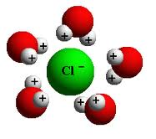
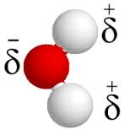
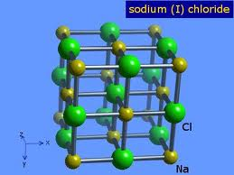
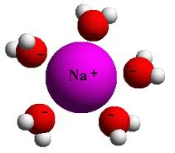
Water and NaCl

Slide 8
Water and NaCl
The attractive forces between the H₂O molecules are stronger than those between the Na-Cl molecules.
The H₂O molecules are polar (O⁻ and H⁺) as are the NaCl molecules that have ionic bonding (ions of Na⁺ and Cl⁻)
Hence, NaCl dissolves pretty readily and completely in water

Slide 9
Factors that affect rate of dissolving
Agitation or Stirring
Increasing the surface area of the solute
Increase the temperature of the solvent

Slide 10
Heat of solution
Energy is required for the solvent molecules to separate from one another
Energy is required for the solute molecules to separate from one another
Both reactions are endothermic
When solute and solvent molecules then form bonds, they give off energy, exothermic
The overall energy change is call the “heat of solution”

Slide 11
Solubility
Only a limited amount of solute can dissolve in a given amount of solvent at a given set of conditions (e.g. temperature, etc.)
Each solute has a characteristic solubility.
Solubility is the maximum amount of solute that will dissolve in a given amount of solvent at a specified temperature and pressure (usually expressed in grams of solute per 100 g of solvent).

Slide 12
Saturated vs. Unsaturated Solutions
In a saturated solution, the maximum amount of dissolved solute for a given amount of solvent at a specific temperature and pressure has been reached at equilibrium
In an unsaturated solution, the solution contains less than the maximum amount of solute for a given temperature and pressure. In other words, more solute could be dissolved in an unsaturated solution.

Slide 13
Supersaturated solutions
A supersaturated solution contains more dissolved solute than a saturated solution at the same temperature.

Slide 14
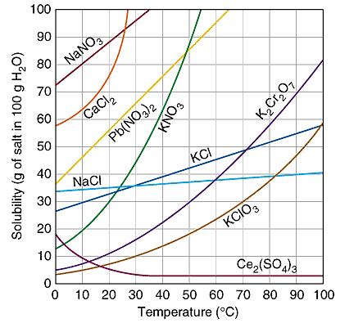
Factors that affect solubility
Temperature and solubility
  Some substances are more soluble at high temperatures than at low temperatures

Slide 16
Henry’s Law
The decreased solubility of the carbon dioxide in a carbonated beverage can be described by Henry’s Law
At a given temperature, the solubility (S) of a gas in a liquid is directly proportional to the pressure (P) of the gas above the liquid.

Slide 17
Henry’s Law
S₁ = S₂
P₁ P₂
S₁P₂ = P₁S₂

Slide 18
Solution Concentrations
Percent by Mass
Percent by Volume
Molarity
Molality
Mole fraction

Slide 19
Solution Concentrations Calculations
Percent by Mass mass of solute x 100 mass of solution
Percent by Volume volume of solute x 100 volume of solution
Molarity moles of solute
liter of solution
Molality moles of solute
kilogram of solvent
Mole Fraction moles of solute
moles of solute + moles of solvent

Slide 20
Diluting Solutions
(Molarity – Concentration)
M₁V₁ = M₂V₂
Where
M₁ = Initial concentration
M₂ = Final concentration (diluted condition)
V₁ = Initial volume
V₂ = Final volume (diluted condition)

Slide 21
Colligative Properties
Colligative properties are those properties that are changed by the number of dissolved particles in a solution, but not necessarily because of the specific solute (colligative means “depending on the collection.”)
Colligative properties include:
  Vapor pressure lowering
  Boiling point elevation
  Freezing point depression

Slide 22
Vapor Pressure Lowering
The greater the number of solute particles in a solvent, the lower the resulting vapor pressure
Thus, vapor pressure lowering is due to the number of solute particles in a solution and is a colligative property of solutions

Slide 23
Boiling Point Elevation
Because a solute lowers a solvent’s vapor pressure, it also affects the boiling point,
Because a liquid boils only when it’s vapor pressure equals the atmospheric pressure,
A solution must be heated to a higher temperature to supply the additional kinetic energy needed to raise the vapor pressure to atmospheric pressure
The difference between a solution's boiling point and a pure solvent’s boiling point is the BOILING POINT ELEVATION, where
ΔT_{b} = K_{b}m

Slide 24
ΔT_{b} = K_{b}m
ΔT_{b} is the change in temperature caused by the solute and is directly proportional to the solute’s MOLALITY
K_{b} is the molal boiling point elevation constant for a 1m nonvolatile solution and a pure solvent.
m is the solution’s molality

Slide 25
Freezing Point Depression
ΔT_{f} = K_{f}m
The freezing point of a solution is always lower that that of a pure solvent
Because the particle's of the solute interfere with the pure solvent’s particles in entering the solid-state, its normal freezing point is lowered

Slide 26
ΔT_{f} = K_{f}m
ΔT_{f} is the change in freezing point
K_{f} is the freezing point constant
m is the molality of the solutions

