Slide 1
Chapter 19
EARLY LATIN AMERICA

Slide 2
Interpreting Graphs: Chart 19.4 Population Decline in New Spain page 430
1. What trends do you notice in the graph?
2. When did the Indian decline bottom out and begin to rise?
3. When did the population of “others” pass 1 million?
4. How would this demographic effect New Spain?

Slide 3
Interpreting Graphs: Chart 19.5
A Comparison of Human & Livestock Populations (page 431)
1. What trends do you notice in the graph?
2. Why would decreases have gradually leveled off?
3. What is the relationship between humans & livestock in central Mexico?
4. How would the rise of ranching have effected central Mexico?

Slide 4
Interpreting Graphs: Chart 19.4
Silver Production in the Americas
(page 434)
1. What trends do you notice in the graph?
2. What is the relationship between royal & total revenues?
3. When does silver production begin to fall off?
4. What might account for the decline of production?
5. How would the export of silver in such quantities effect Europe’s economy?

Slide 5
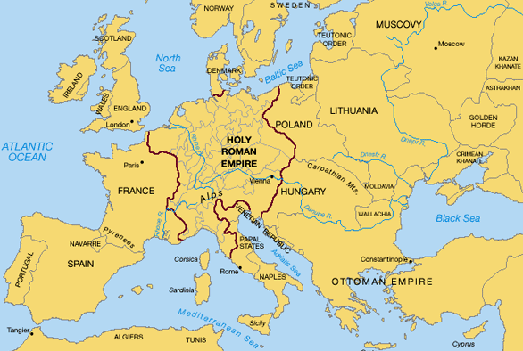
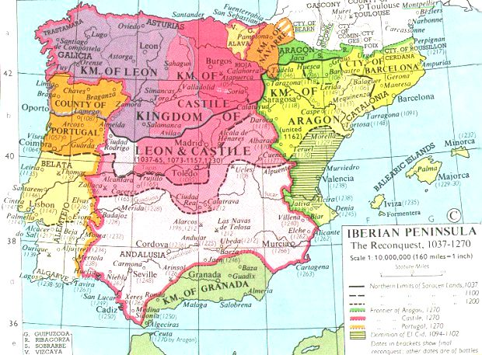
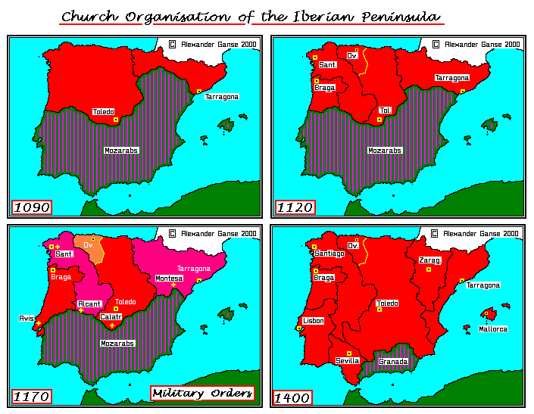
Spaniards & Portuguese
Iberians inhabit area where cultures interact
mid-1400s political unification
Granada falls 1492
– last Muslim kingdom
Castile expels Jewish population

Slide 6
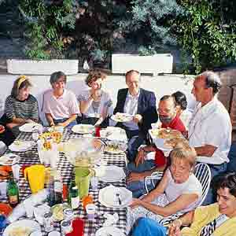
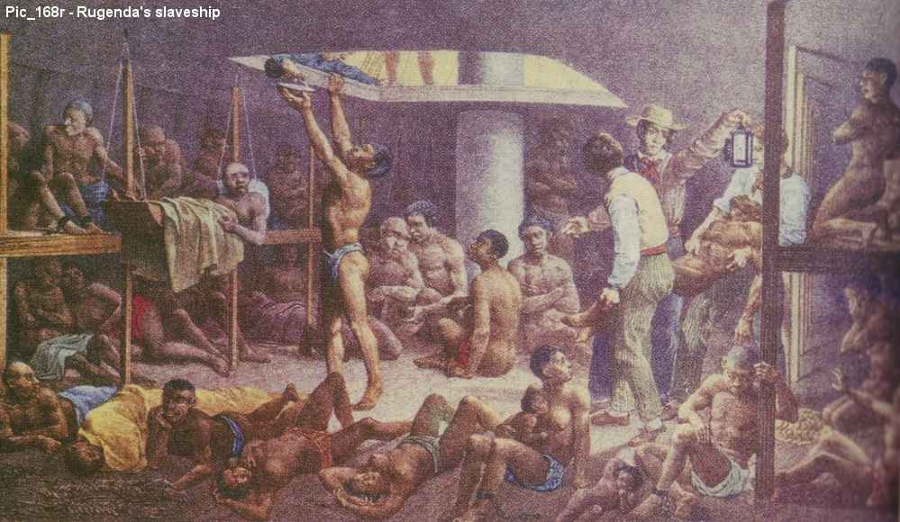
Iberian Society & Tradition
distinctive features become part of American society
heavily urban
strong patriarchal ideas
family life based on encomiendas
slavery was Iberian tradition
professional bureaucracy

Slide 7
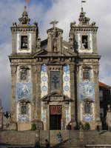
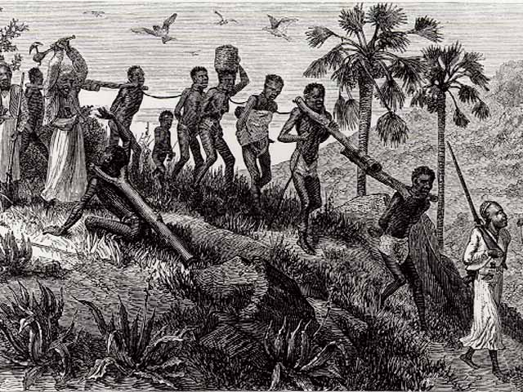
Catholic church closely linked to state
merchants have experience with slaves & plantations
Conquests
1st – 1492-1570 – administration & economy
2nd – til 1700 – institutions & societies
3rd – 1700s – reform & reorganization

Slide 8
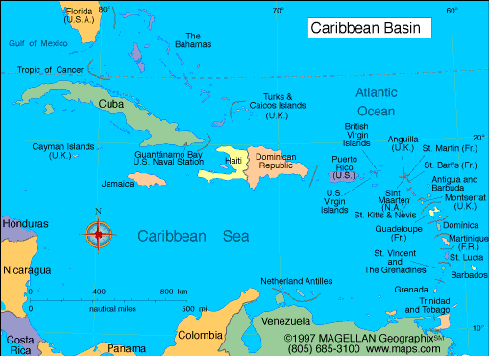
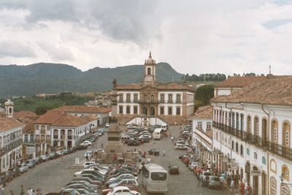
Caribbean Crucible
model for Spanish actions in Latin America
establish colonies
form encomiendas
Indians distributed as laborers
diseases destroy indigenous populations
cities laid out on grid with central square
royal administration included professional magistrates

Slide 9
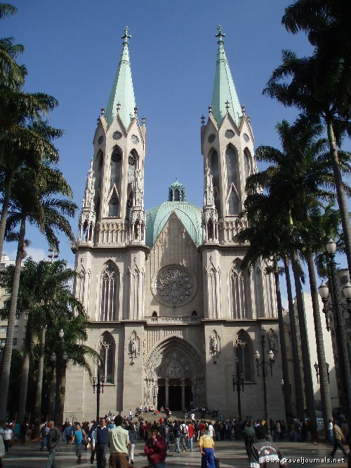
laws incorporate Spanish
& American experience
church builds cathedrals & universities
shift from conquest to settlement
1520s-1530s elements
of Latin America colonial system in place

Slide 10
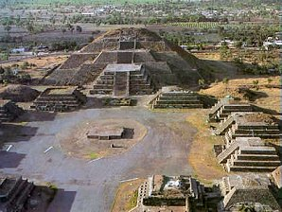
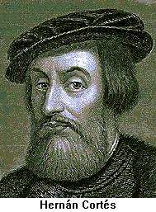
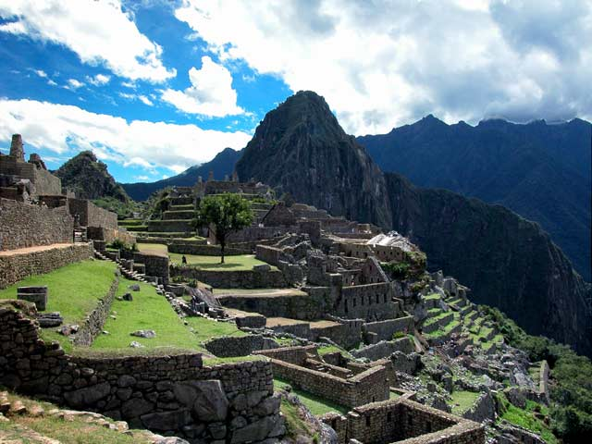
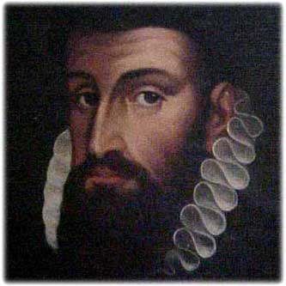
Conquest
series of individual initiatives
Mexico – Cortez - 1519
Kingdom of New Spain – 1535
(central Mexico)
Inca – Pizarro - 1533
1540 Peru under control
1570 – 192 Spanish urban settlements

Slide 11
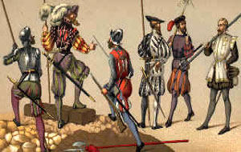
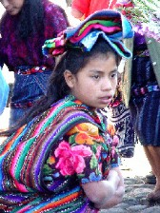
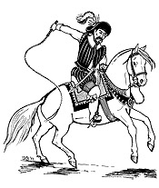
Conquerors
process regulated by
agreements b/t leaders & government
not professional soldiers, wanted glory & fortune
entitled to dominate Indian peasantry
triumphed b/c of horses, weapons, leadership, disease
done by 1570

Slide 12
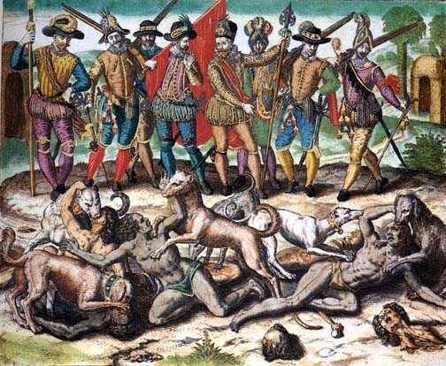
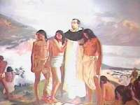
Conquest & Morality
conquest, exploitation & conversion justified?
view that Indians not fully human
converting to Christianity necessary duty
- even forced
Bartolome de Las Casas
Destruction of Indian societies
Indigenous peoples suffered from European conquest
Demographic catastrophe
Concentrate Indians in towns
Different type of society emerges

Slide 13
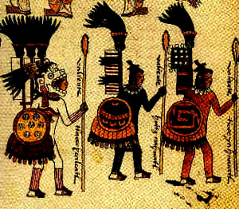
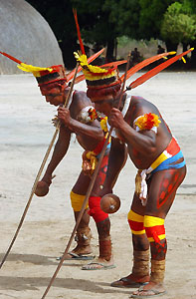
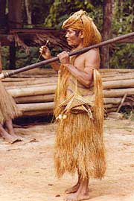
Exploitation of the Indians
Mexico & Peru retain traditional nobility
Enslavement prohibited by mid 1500s
Encomiendas - land grants to conquerors included Indians as source of labor & taxes (done by 1620s)
Indians taxed, forced labor
Indians fled villages to work in cities
yet - Indian culture resilient
- modify Spanish culture to Indian ways

Slide 14
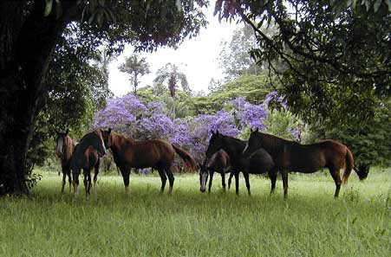
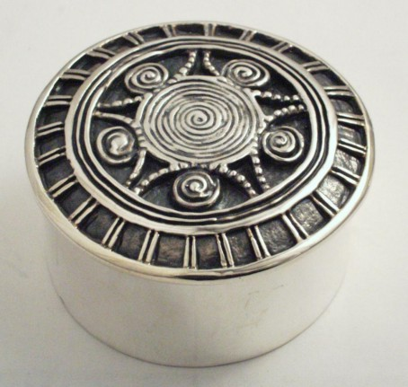
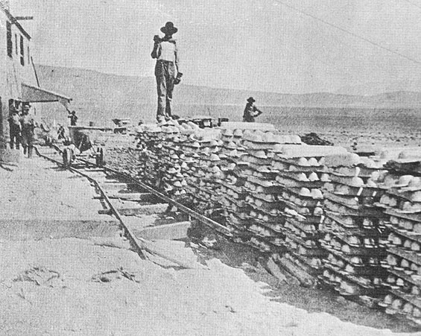
Colonial Economics & Government
Agriculture, ranching & mining
Spanish commercial system organized around exchange of New World metals
- makes Latin America part of World System
Silver - major mines in Mexico, Peru, Bolivia
Industry was stimulus for general economy
Private individuals worked mines in return for giving government 1/5 of production

Slide 15
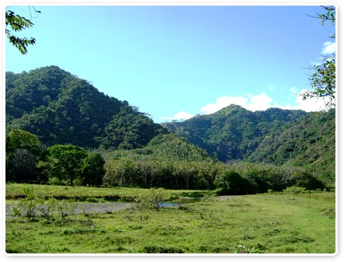
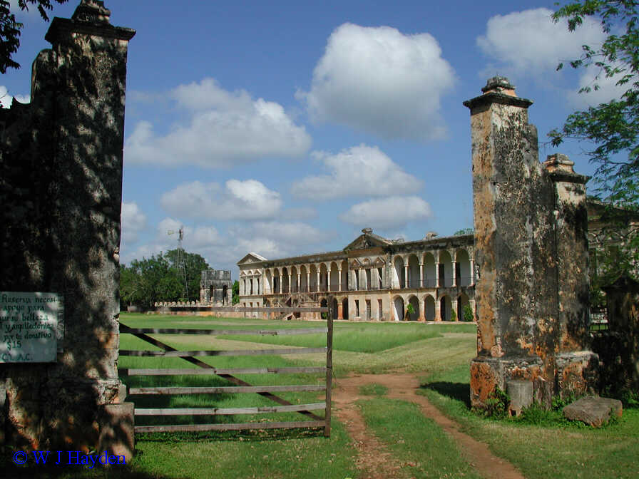
Haciendas & Villages
Indian population dwindles - Spanish rural estates emerge
- grains, fruits, livestock
- basis of wealth & power for local aristocracy
Industry & commerce
Self-sufficient in foodstuffs & material goods
- only needed luxuries from Europe
Silver ruled commercial system
All trade reserved for Spaniards

Slide 16
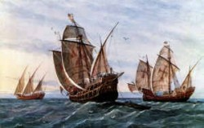
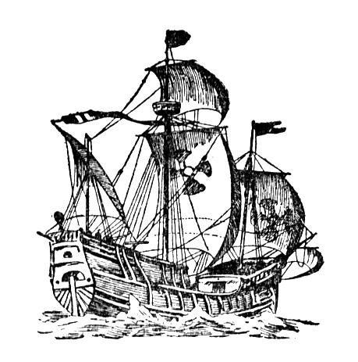
Board of Trade controlled commerce
Merchant guild in Spain had rights over American trade
Convoy system of ships to protect trade
Galleons - heavily armed
- also transported Chinese products from Philippines to Mexico
Silver wealth went to Spain for
state expenses and manufactured goods
Much silver left Spain
and contributed to inflation in Europe
Spain’s wealth depended more on taxes

Slide 17
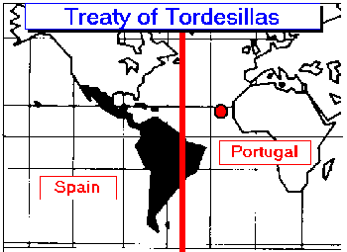
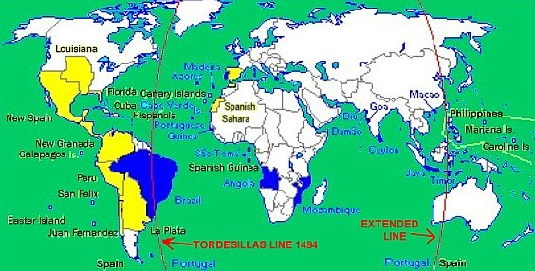
Sovereignty over Empire was with the crown
- based on Papal grant awarding Indies to Castile
(bring lands into Christian community)
Ruling an Empire
Treaty of Tordesillas (1494)
- drew a NS line to separate colonies
Spanish Empire a bureaucratic system built on core of lawyers
- legislative & administrative power
King ruled from Spain
- viceroys represented kings & had extensive military, legislative & judicial powers

Slide 18
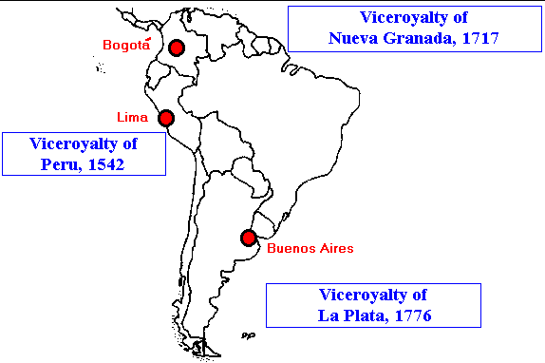
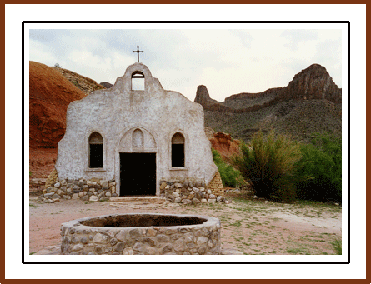
Viceroyalties divided into 10 divisions run by royal magistrates
Local level magistrates often corrupt
Clergy - secular & religious functions
Convert Indians
Some defended Indian rights & studied culture
Core areas –
formal institutional church structure
Church profoundly influenced colonial cultural & intellectual life
- architecture, printing, schools, universities, inquisition (morality)

Slide 19
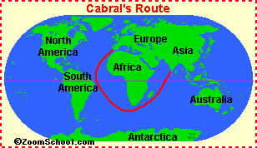
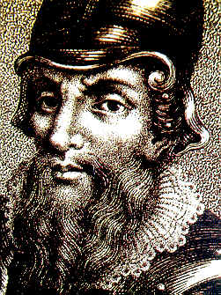
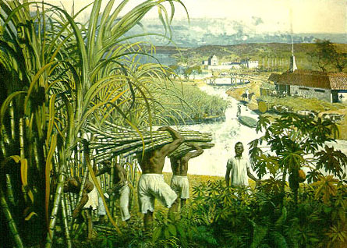
Brazil - plantation economy
1500s Pedro Cabral trying to find India
Little interest in til French merchants wanted dyewood trees
Portuguese nobles given land grants to colonize & develop
Sugar plantations
Jesuit missionaries
Port cities develop to serve sugar plantations

Slide 20
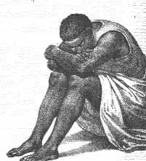
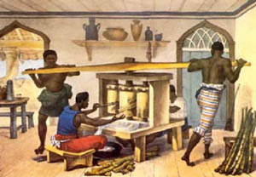
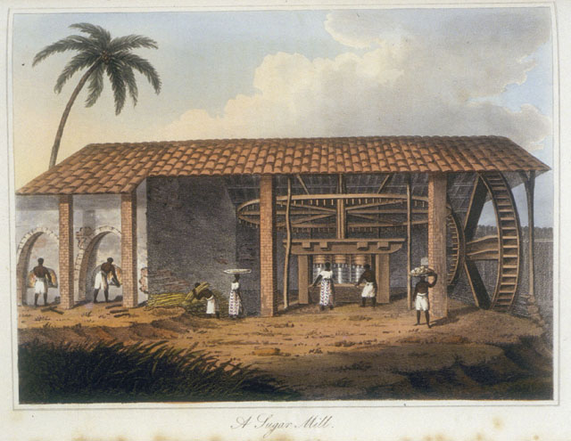
Sugar & Slavery
Becomes world’s largest sugar producer
First plantation colony - slave labor
- white planter families dominate hierarchy
End of 1600s slaves
were 1/2 the population
Inbetween classes were mixed origins, poor whites, Indians, & free Africans
Governor general reports to Lisbon

Slide 21
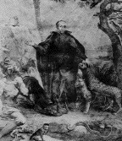
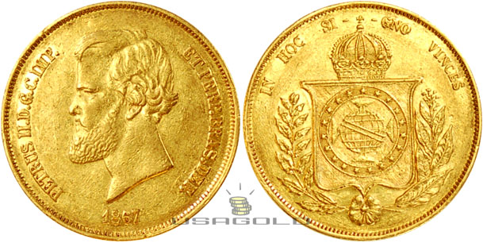
Missionaries important
- ran ranches, mills, schools & church
Closely tied to Portugal
No universities to stimulate independent intellectual life
1600s - Dutch , English, French establish sugar plantations in Caribbean
Competition lowers sugar prices raises slave prices
Gold discovered 1695
Mines worked by slaves

Slide 22
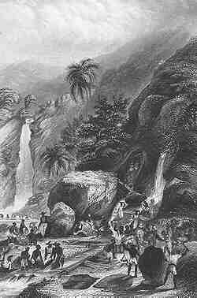
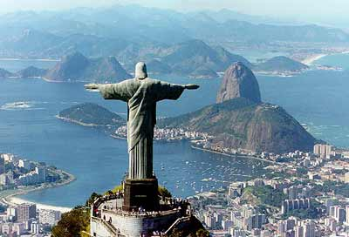
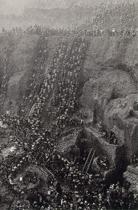
Government controlled production
Gold & diamonds open interior to settlement
-devastate Indian populations
- weaken coastal agriculture
Mines stimulate new ventures
Rio de Janiero - major port & capital 1763
- close to mines
Gold & diamonds not contribute much to Portuguese economic development
Did allow Portugal to import manufactured products instead of creating own industries

Slide 23
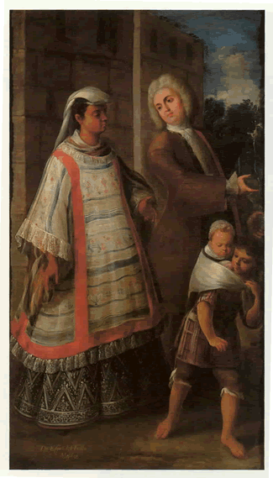
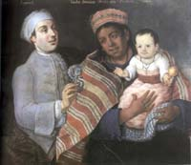
Multiracial societies
Indians, Europeans, Africans
Castas - mixed peoples
- by 1700s major population segment
Society of Castas
- key to societal development was miscegenation
Crown sponsored marriages
(few European women)
Mestizo population had higher status than Indian
Similar process in colonies with
large African slave populations

Slide 24

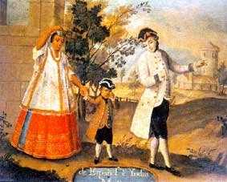
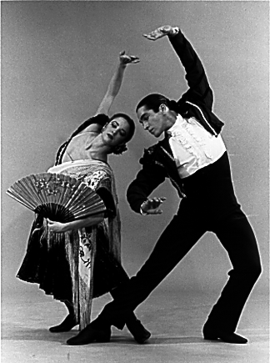
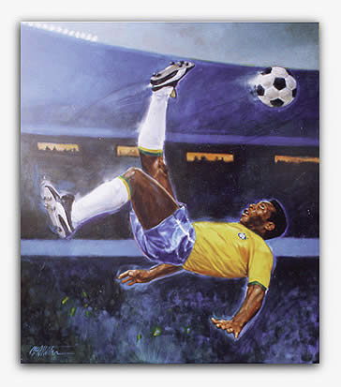
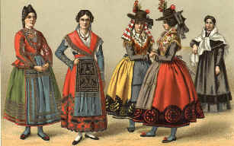
American realities created new social distinctions based on race & place of birth
European
Mestizo
Indian & African
Restrictions placed on mixed-origin people,
yet social mobility not halted
Distinction between Spaniards born in Spain (peninsulares)
& those born in the new world (creoles)
Creoles dominate local economy, strong sense of Identity - will eventually help with independence movements
Patriarchal society - women under male authority

Slide 25

18th century reforms
- European intellectual changes affect colonies
European population growth & 18th c. wars gave colonies new importance
Shifting balance of politics & trade
Spain in 18th c. weakened
- poor rulers
- foreign wars
- internal problems
- Fr, GB & Holland seizing Spanish Caribbean islands
Spanish decline - colonies become self-sufficient
Spanish war over royal succession caused war
- Treaty of Utrecht opens colonies to foreign trade

Slide 26


Bourbon reforms
New dynasty strengthens Spain
Church remains ally
Taxation reformed
Ports open
America - new viceroyalties created
General reforms
- creoles removed from upper government positions
- more efficient rule
Involved in 7 years war as France’s ally

Slide 27

More Spanish troops to Americas
- frontiers expanded
- California settled
Government active in economy
- state monopolies formed, open new regions for development
More liberal trade regulations open up Caribbean commerce
More open trade hurts local industries
Bourbon changes revitalized empire but also stimulated dissatisfaction among colonialists

Slide 28


Brazil
- Marquis of Pombal directing Portuguese affairs 1755-1776
- strengthen economy, not rely on England as much
- Brazilian gold going through London
Suppressed opposition to government
Monopolies formed to stimulate agriculture
New regions flourish - including Amazon
Abolish slavery in Portugal but not Brazil
Increase population growth - mixed marriages encouraged
Colony still based on slavery

Slide 29


Reforms, Reactions, & Revolts
mid - 1700s American Iberian colonies shared world growth in population & productive capacity
Reforms had disrupted old power patterns
- rebellions
Comunero Revolt - New Granada
Tupac Amaru Rising - Peruvian Indians
Brazil escaped serious disturbances

Slide 30
Movements have different social bases
Demonstrate increased local dissatisfaction with Imperial policies
Sharp social divisions among colonial groups hindered revolutionary action
Changes when Spain & Portugal weakened by European political & social turmoil

Slide 31
What aspects of Iberian society were transferred to the New World?
Urban living
Commoners who came as conquerors set themselves up as nobility
Patriarchal society
Tradition of slavery (Iberia different than rest of Europe)
Link of government to church
Strong religion
Professional bureaucracy (trained lawyers & judges)

Slide 32
What model for American colonization was established in the Caribbean?
Beginning of encomienda system (grants of Indians to individual Spaniards)
Iberian style cities adapted to Americas
Used Roman city planning, grids
Conquest implied settlement
Church involvement, universities
Administrative institutions
Settlement included ranches, sugar plantations & Spanish women
Resistance by & de-population of natives leads to African slaves
bartering with Indians replaced by royal control & development of sugar plantations

Slide 33
What was the nature of the exploitation of Indians in the Americas?
Desire to use them as labor & get tribute from them led to some maintaining of Indian culture
Encomiendas - holders of grants could use Indians for labor or tax them - could be arbitrary & excessive - destructive to native societies - ended by 1620s
Mita - forced labor
Switch to wage labor on ranches and in cities - cultural disruption
Learned to use laws & courts - litigation
Indians were selective about adaptation of European culture

Slide 34
Discuss the economy of the American colonies.
Agrarian
Mining essential to Spain - silver “heart”
Spanish maritime commercial system organized around getting silver to Europe
Forced labor to wage labor
1/5th goes to crown
Mining stimulates other parts of economy - mercury, food, clothing
Haciendas (rural estates) wealth & power for local aristocracy
Indian agriculture might compete with haciendas
Small textile industry
Self-sufficient in basic necessities
Only Spanish can trade there
Convoy system with galleons to transport silver

Slide 35
Discuss the nature of the Spanish system of government in the American colonies.
Sovereignty was with the crown based on papal grant awarding America to Spain
Bureaucratic system based on a judicial core and staffed by trained lawyers
Legislative & administrative duties to bureaucrats
Viceroyalties direct representatives of the king, divided into 10 regions run by magistrates
Local magistrates applied laws & collected taxes (corruption)

Slide 36
How did the discovery of gold and diamonds change the economic organization of Brazil?
Economy had decline b/c of competition in sugar market & increase in slave prices
Gold found 1695
Boom in economy - gold rush
Labor in mines mostly slaves
1730s-1760 Brazil was greatest gold producer
Opens interior to settlement
Disastrous effects on native population & expansion of slavery
Open new areas of ranching & farming
Allowed Portugal to continue buying manufactured goods and not produce their own.

Slide 37
Describe the social hierarchy of the American colonies?
Hierarchy of Europeans (conquerors & immigrants, Indians (conquered) & Africans as slaves
Masters & servants, Christians & pagans
Some Indian nobility stays (Mexico)
Miscegenation - mixed marriages & unions
Growth of large population of mixed offspring - more acculturated than Indians
European categories survived of noble, priest, commoner & based on wealth & occupation
Society of Castas - based on racial origin
Social mobility for mixed origin people
Pseudoracial hierarchy
Peninsulares (born in Spain), Creoles (born in New World)
Creaole eventually lead revolts & revolutions
Patriarchal, women sub-ordinate, yet full rights to inheritance

Slide 38
What was the nature of the 18th c. reforms in Portuguese and Spanish colonies?
Bourbon dynasty founded in Spain
Desire for strong centralized government, nationalism
Revive Spain using French bureaucratic models
Taxation tightened, ministers take direct responsibility
Commercio libre opens Spanish ports to trade from other countries
New viceroyalties created to provide better administration & protection
Creoles eliminated from upper bureaucracy (corruption)
Reforms linked to defense & military
Create militia w/ Creoles as officers
frontiers expanded
Strengthen colonies
Government takes an active role in economy
State monopolies created
commerce expands under liberal trading policies

Slide 39
Discuss why it can be said that the Spanish & Portuguese colonists were extensions of the global network of the West and also discuss their intermediary role.
Mixed economies initially based on estate agriculture (sugar), staffed by African slaves.
Mining (silver, gold, and diamonds) added later
Ranching developed to supply local demands
Economy typical of dependent economic zone in global trade network
Iberian nations were conduit of American goods to core regions
Both nations failed to develop banking systems or industrial capacity
Negative balance of trade let to outflow of bullion from New World to core economic region

Slide 40
Discuss the difference in social organization between the Americas & Europe, & explain why the differences in social hierarchy contributed to a sense of self-identity in the colonies.
Great difference was significance of color & existence of miscegenation
Presence created a social hierarchy based on color (in Europe based on wealth & prestige)
Whites(peninsulares & creoles), mixed races (castas) and African & Indian
Distinct social system gave rise to sense of self-identity, especially creoles & castas
Created a sense of difference from Europeans, contributes to rebellions & eventually stimulates independence movements

