Slide 1
Ch 12- War of 1812
and Era of Good Feelings- Federalist Party dies, only 1 political party
Objectives
Identify the causes of the 2nd war against England (War of 1812)
Analyze why Americans had different reactions towards going to war against England.
Identify 4 examples of the Federal Government becoming more powerful or active in it’s role as leader of the nation and …
3a. Explain the reason/motivation the government is seeking to expand it’s power or responsibility

Slide 2
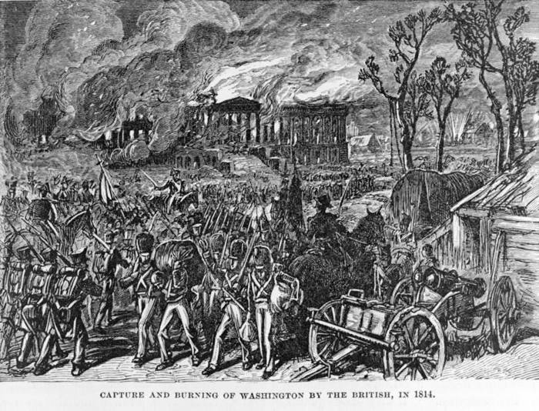
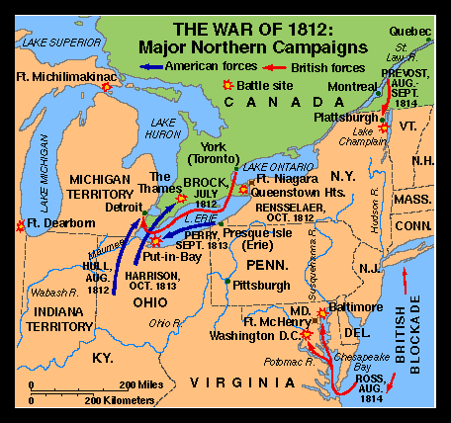
War of 1812- second war with England
  Impressments- England capturing and forcing US sailors into Br. Navy (to fight against Napoleon/France)
  England never really accepted American Independence (no respect!)
  Embargo Act- Jefferson refuses to sell US goods to England and Fr.
    Result- US exports fall from $120 mil. to $19 mil.
      *Biggest failure of Jefferson’s Presidency
Players
  President Madison- weak President
    Leadership switched to Congress
  Federalists (New England)- against war w. Eng
    ?Why would the Feds. be against a war with England?
  War Hawks- politicians from Ky and Tn (nationalistic) that want war with England
      ?Should the US go to war against England again?

Slide 3
ID-The Fall of Washington (236)
Summary 1- What city is on fire and who set the fire?
Washington DC, British forces
OI-Washington Burned and New Orleans Defended
1) What two key government buildings were burned?
White House, Capital
2) How was the battle in Baltimore different? Or Why was the battle at Baltimore significant?
US won (Star Spangled Banner was written about the Battle at Ft. McHenry)
3) How many British and Americans suffered casualties in the Battle of New Orleans?
2,000 British, 70 American
4) Who was the hero of New Orleans?
Gen. Andrew Jackson (became most popular American)

Slide 4
ID- Mass, CT, and RI Contemplate Abandoning the Union (238)
Summary 2- What is England offering the Federalists if they pledge allegiance to England?
Bribes (food, titles, smuggled goods-alcohol)
OI- Federalist Grievances and the Hartford Convention
5) What region of the country was most supportive of the Federalists?
New England
6) Identify 2 demands in the Hartford Convention.
-$ from Washington for lost trade due to the Embargo with England
-2/3’s majority to declare war, admit new states, declare an embargo
Federalists threatened to have New England secede from the Union if the Us lost the War of 1812
7) What was the significance/impact of the Hartford Convention on the Federalists?
Caused the death of the Federalist Party (Feds. were against the War of 1812, War of 1812 a success for US, Feds. backed a loser)

Slide 5
ID- Henry Clay (241)
Summary 3- What is Henry Clay’s American System?
Using the Federal Government to help the economy and country to grow (into a manufacturing and trading nation)
OI-“The American System”
8) Think -Define Nationalism
Love for your country
9) Think- define Tariff
Tax on imported goods
10) What were the three parts of the American System
a. Banking system- provide credit and money to start business
b. Protective Tariff- tax imported goods to encourage Americans to buy American
c. Transportation- Gov. builds roads and canals to move goods around country
11) Think- How does the American System change the role of government at that time?
Gov. is now actively involved in the economy and helping business/people make money (Gov.’s purpose is not simply to protect your Natural Rights)

Slide 6
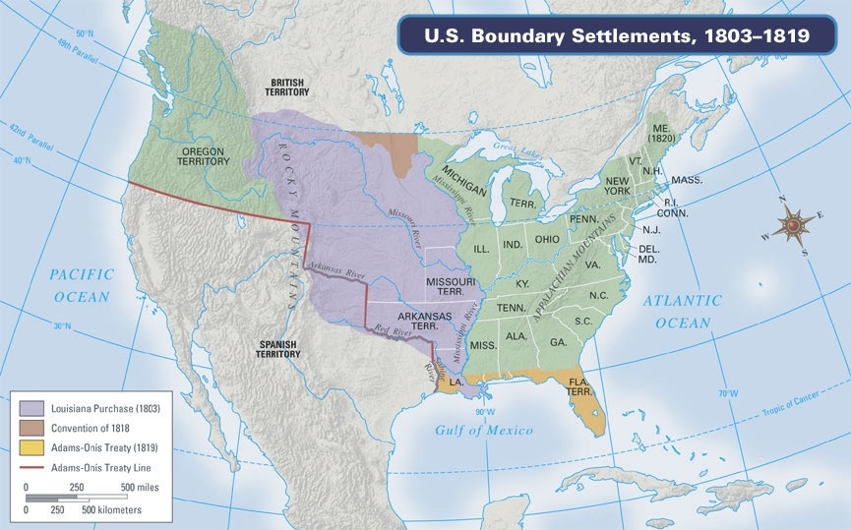
Supreme Court- 3rd branch of government, make sure laws are fair (at first weakest branch)
John Marshall- 1st S.C. Chief Justice, Federalist
  His decisions help create a strong Federal Gov. and the S.C. equal in power
Marbury v. Madison
  “Judicial Review”- states that the S.C. has final say on laws
    ? Republicans believed that who should have final say on laws?
      Dem/Rep. believed states had final say
      What has Marbury vs. Madison set up a showdown between
        Federal vs. State Government

Slide 7
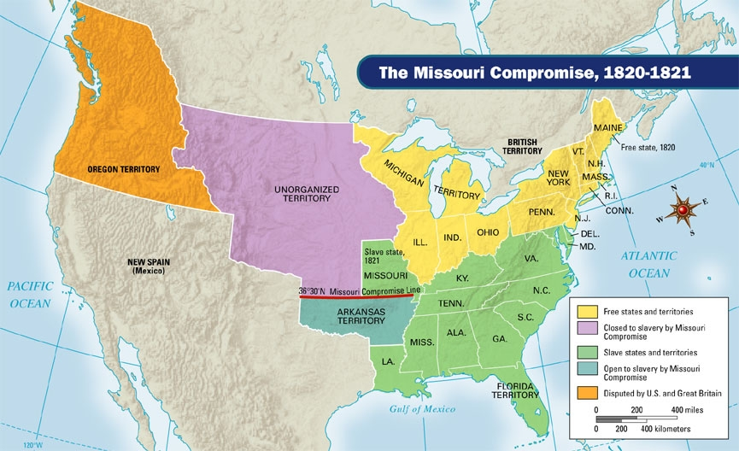
ID- The Missouri Compromise and Slavery (247)
Summary 4-What two states entered the Union in 1820/1821 and ID if they were slave or free
Maine (free), Missouri (slave)
OI- The Uneasy Missouri Compromise
12) What was the provision/law attached to 36 30’
No slavery north of S. border of Mo. in La. Territory
13) Why were northern states supportive of the Compromise?
They gained land/free states (political power) that would not be open to slavery/slave power

Slide 8
14) Why did Southern states give up so much land to slavery?
Slavery would not work in the area it was banned by Mo. Compromise
Is there anywhere else the South could make up the land lost to the N. in the Mo. Compromise?
S. felt US would invade Mex. And turn those areas into slave states

Slide 9
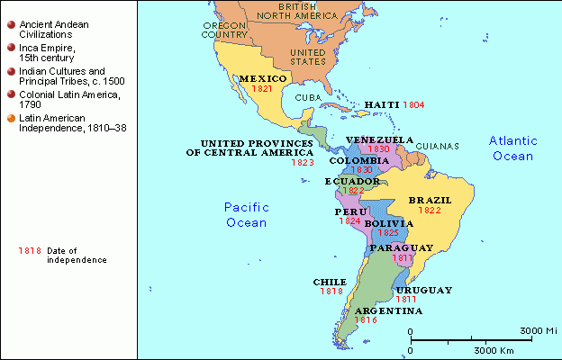
Monroe Doctrine- establishes US as the policeman in the Americas
ID- The West and Northwest (254)
Summary 5- What new country appears on this map?
Mexico
Why should Mexico be afraid? (of Europe)
ID- Monroe and His Doctrine
15) What was Britan’s fear of America?
Afraid US would attack Spanish colonies (Cuba) and control Caribbean Sea
16) What was J.Q. Adams fear that the European countries might do in Americas?
Invade newly freed countries (Mexico) that were too weak to defend themselves from European powers

Slide 10
17) What was the Monroe Doctrine? (or Define 1) Non-colonization and 2) Nonintervention in your own words)
Monroe Doctrine- No new European colonization in Latin America
Non-Colonization- free countries, no colonies
Non-Intervention- (Europe) stay out of Latin America
Could the US enforce the Monroe Doctrine?\
Only with England’s help (navy) (but America is making a claim to become the most powerful country and top cop in the Western Hemisphere)

