Slide 1
Reading Poetry
Anne Bradstreet & Sor Juana Ines De La Cruz

Slide 2
Read straight through to get a general sense of the poem. Try to understand the poem’s meaning and organization, studying these elements:
Title
Speaker
Meanings of all words
Poem’s setting and situation
Poem’s basic form and development
Poem’s subject and theme

Slide 3
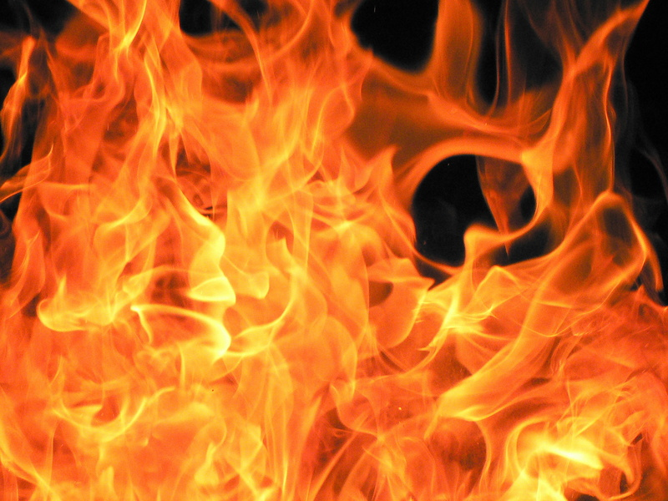

Upon the Burning of Our House-
What poetic devices are used?
What effect is created by the poetic device?
Explain what is happening in this stanza.
In silent night when rest I took,
For sorrow near I did not look,
I wakened was with thund’ring noise
And Piteous shrieks of dreadful voice.
5 That fearful sound of fire and fire,
Let no man know is my desire.
I, starting up, the light did spy,
And to my God my heart did cry
To strengthen me in my distress
10 And not to leave me succourless.
Then coming out beheld a space,
The flame consume my dwelling place.

Slide 4
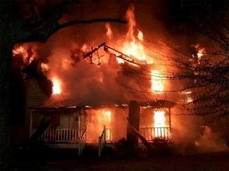
Upon the Burning of Our House-Anne Bradstreet
And, when I could no longer look,
I blest his Name that gave and took,
15 That laid my goods now in the dust:
Yea so it was, and so 'twas just.
It was his own: it was not mine;
Far be it that I should repine.
What is the speaker doing in line 14?
Why does the speaker say the fire was just?
Who is the speaker referring to?

Slide 5
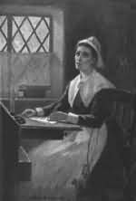
Upon the Burning of Our House-Anne Bradstreet
He might of All justly bereft,
20 But yet sufficient for us left.
When by the Ruins oft I past,
My sorrowing eyes aside did cast,
And here and there the places spy
Where oft I sate, and long did lye.

Slide 6
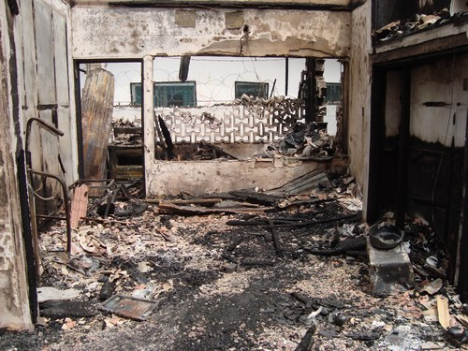

Upon the Burning of Our House-Anne Bradstreet
25 Here stood that Trunk, and there that chest;
There lay that store I counted best:
My pleasant things in ashes lie,
And them behold no more shall I.
Under thy roof no guest shall sit,
30 Nor at thy Table eat a bit.

Slide 7

Upon the Burning of Our House-Anne Bradstreet
No pleasant tale shall 'ere be told,
Nor things recounted done of old.
No Candle 'ere shall shine in Thee,
Nor bridegroom's voice ere heard shall bee.
35 In silence ever shall thou lye;
Adieu, Adieu; All's vanity.

Slide 8
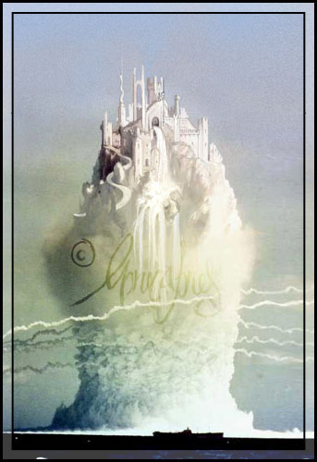
Upon the Burning of Our House-Anne Bradstreet
Then straight I gin my heart to chide,
And didst thy wealth on earth abide?
Didst fix thy hope on mould’ring dust,
40 The arm of flesh didst make thy trust?
Raise up thy thoughts above the sky
That dunghill mists away may fly.
Thou hast an house on high erect
Framed by that mighty Architect,
45 With glory richly furnished,
Stands permanent though this be fled.
It's purchased, and paid for too
By him who hath enough to do.
What is he house on high erect?

Slide 9

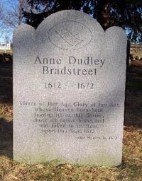
Upon the Burning of Our House-Anne Bradstreet
A Price so vast as is unknown,
50 Yet, by his Gift, is made thine own.
There’s wealth enough, I need no more;
Farewell my Pelf, farewell my Store.
The world no longer let me Love,
My hope and Treasure lies Above.

Slide 10

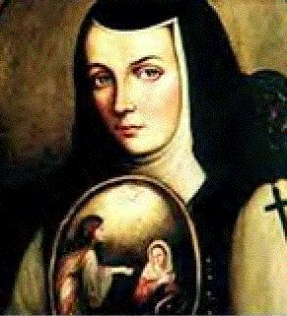
"World In Hounding Me”
Sor Juana Ines De La Cruz
World in hounding me, what do you gain?
How can it harm you if I choose, astutely;
rather to stock my mind with things of beauty,
than waste its stock on every beauty's claim?

Slide 11
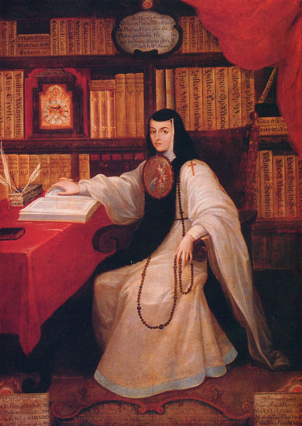
"World In Hounding Me”
Sor Juana Ines De La Cruz
Costliness and wealth bring me no pleasure;
the only happiness I care to find
derives from setting treasure in my mind,
and not from mind that's set on winning treasure.

Slide 12
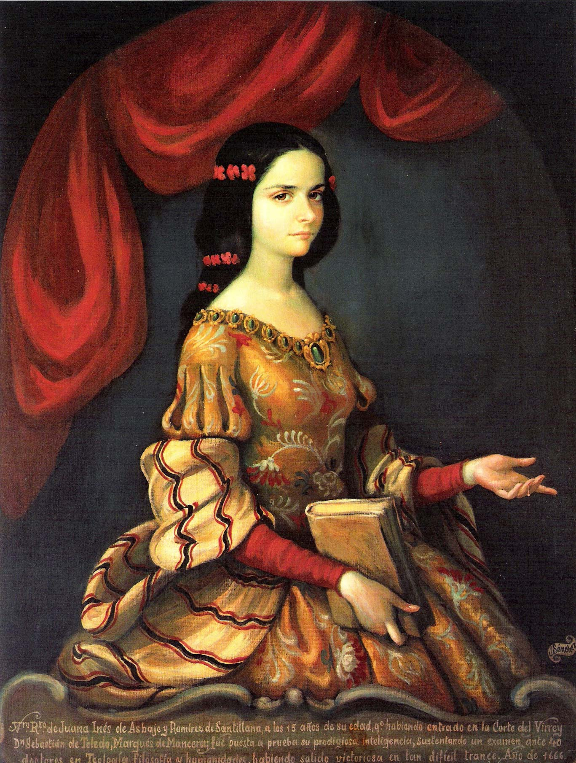
"World In Hounding Me”
Sor Juana Ines De La Cruz
I prize no comeliness. All fair things pay
to time, the victor, their appointed fee
and treasure cheats even the practiced eye.

Slide 13
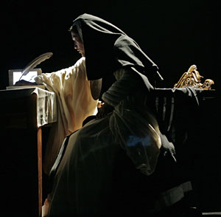
"World In Hounding Me”
Sor Juana Ines De La Cruz
Mind is the better and the truer way;
to leave the vanities of life aside,
not throw my life away on vanity.

Slide 14
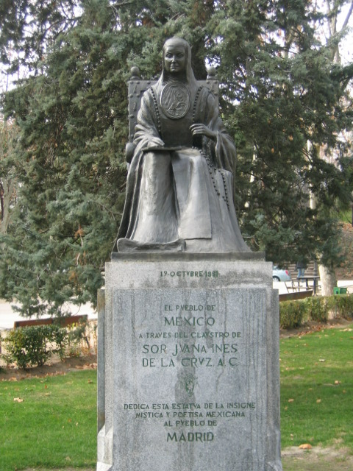
"World In Hounding Me”
Sor Juana Ines De La Cruz
¿En perseguirme, mundo…
¿En perseguirme, mundo, qué interesas?
¿En qué te ofendo, cuando sólo intento
poner bellezas en mi entendimiento
y no mi entendimiento en las bellezas?
Yo no estimo tesoros ni riquezas,
y así, siempre me causa más contento
poner riquezas en mi entendimiento
que no mi entendimiento en las riquezas.
Y no estimo hermosura que vencida
es despojo civil de las edades
ni riqueza me agrada fementida,
teniendo por mejor en mis verdades
consumir vanidades de la vida
que consumir la vida en vanidades

