Slide 1
Mendelian Genetics
Topics 4.1 and 4.3
IB Biology SL
Mrs. Milam
By PresenterMedia.com

Slide 2
4.1.1 – State that eukaryote chromosomes are made of DNA and proteins.
Genetics is the study of inheritance and the variation of inherited characteristics.
The traits we inherit are controlled by our chromosomes.
Chromosomes are made of
What do we call the process where chromatin shortens and thickens to form chromosomes?
Supercoiling

Slide 3
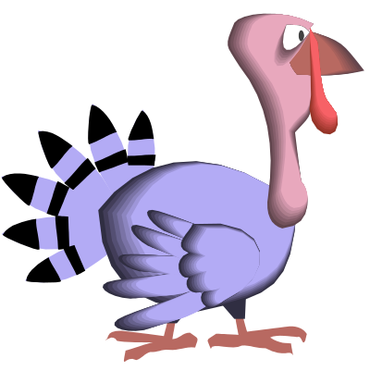
4.1.1 – State that eukaryote chromosomes are made of DNA and proteins.
The number of chromosomes in each species is fixed.
  For example:
    Humans = 46
    Fruit Flies = 8
    Turkeys = 82

Slide 4
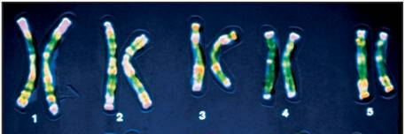
4.1.1 – State that eukaryote chromosomes are made of DNA and proteins.
Each chromosome has a specific and specific
Chromosomes occur in . Each chromatid in a homologous pair contains the same genes in the same location, but they may or may not code for the same version of a trait.
Why aren’t they always identical? Where do we get our homologous pairs of chromosomes?
Half comes from mom and half comes from dad

Slide 5
4.1.2 – Define gene, allele and genome.
The coded instructions of chromosomes are in the form of genes.
A gene is a .
All of the genes on all of the chromosomes of an individual make up that person’s .

Slide 6
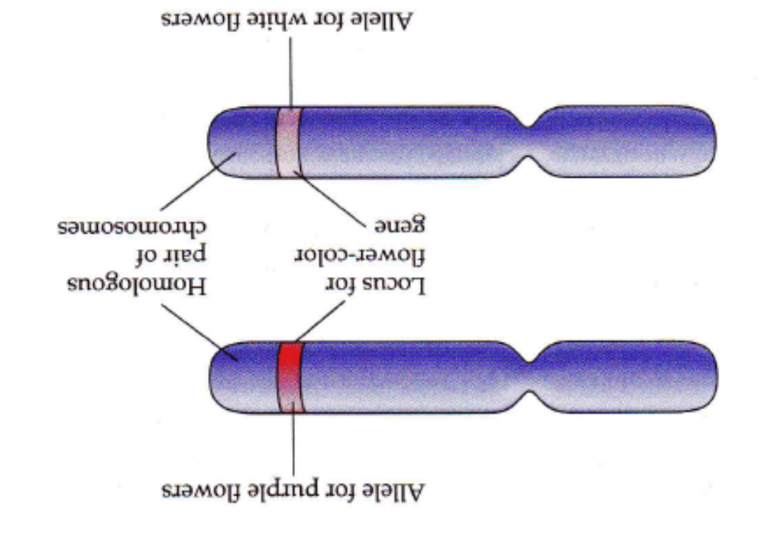
4.1.2 – Define gene, allele and genome.
Alternative versions of genes account for variations in inherited characteristics
  These alternate versions are called .
  An allele is , differing from other alleles by one or a few bases only and occupying the same position, called a locus, as other alleles of the gene.
Allele for purple flower
Locus for flower-color gene
Homologous pair of chromosomes
Allele for white flower

Slide 7
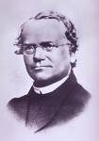
4.3.1 – Define genotype, phenotype, dominant allele, recessive allele, codominant alleles, locus, homozygous, heterozygous, carrier and test cross
Gregor Mendel (1822 – 1884)
  Austrian monk who first discovered the basic rules of inheritance
  His work was rediscovered in 1900 and he came to be known as the Father of Genetics

Slide 8
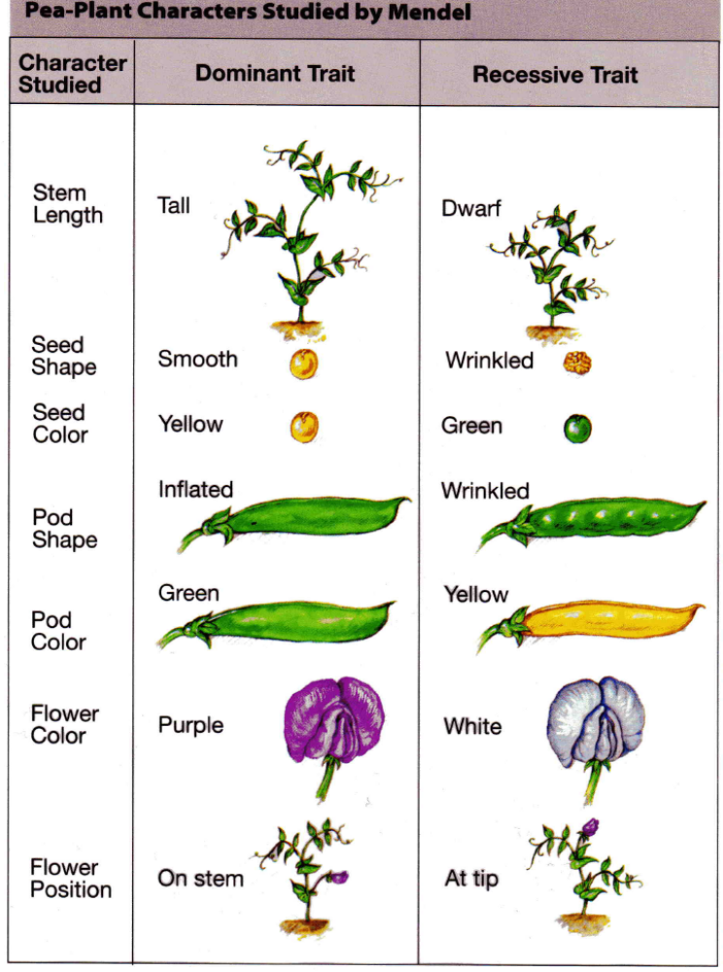
Mendel’s experiments:
  Worked with pea plants – advantages:
    easy to grow
    many contrasting traits to study
    easy to control pollination
    Mendel chose to study seven clearly contrasting inherited traits and subjected the results to mathematical analysis
Contrasting = different

Slide 9
4.3.1 – Define genotype, phenotype, dominant allele, recessive allele, codominant alleles, locus, homozygous, heterozygous, carrier and test cross
  Mendel began by crossing true-breeding plants with purple flowers to true-breeding plants with white flowers
  True-breeding plants .
Purple x White = Purple
P generation (parental) F₁ Generation
  F₁ generation (first filial) all had purple flowers
  Mendel said that the purple trait was – it covered up the white trait
  he said the white trait (the one hidden) was .

Slide 10
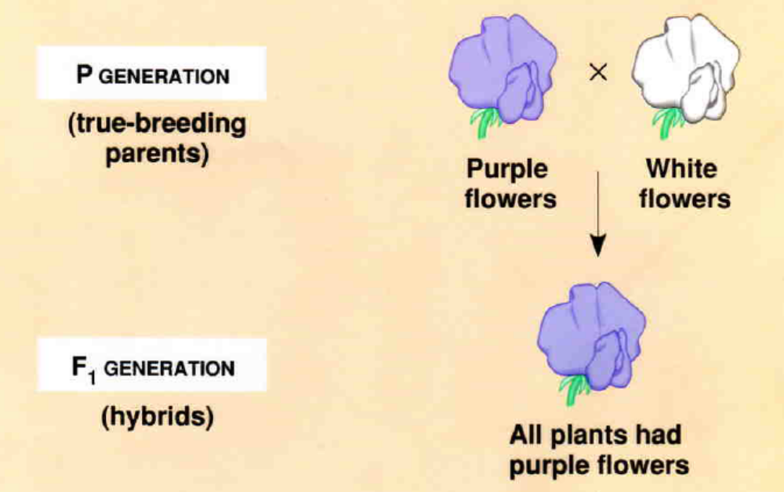

Slide 11
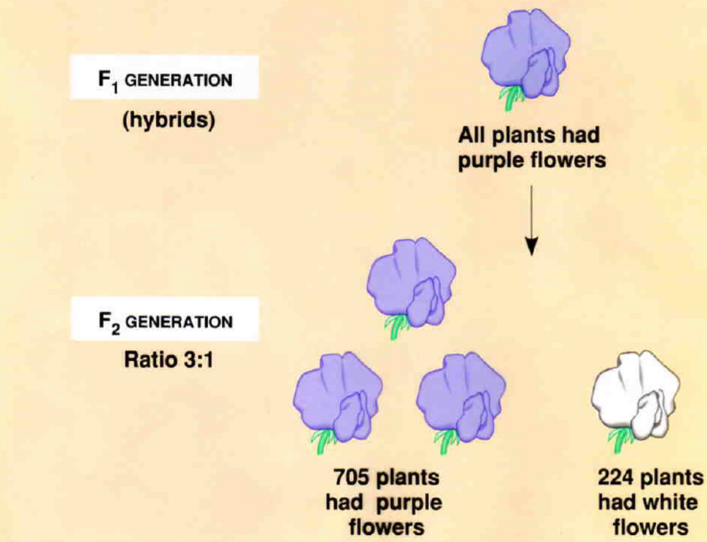
Mendel then crossed the F₁ generation
Purple x Purple = Purple & White
F1 Generation F2 Generation
F₂ generation (second filial) were a

Slide 12
y
Mendel’s Findings:
  Each trait is .
  Mendel’s Law (Principle) of Segregation –
    Each gamete receives only one copy of each gene.
y
Y
y
Y
y
y
Y
Y
Meiosis I & Meiosis II
Interphase
Y
F₁ hybrid

Slide 13
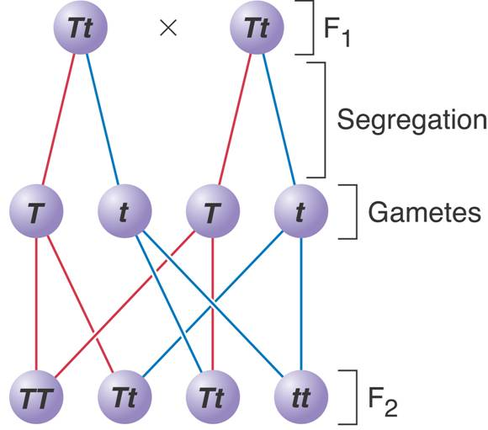
4.3.1 – Define genotype, phenotype, dominant allele, recessive allele, codominant alleles, locus, homozygous, heterozygous, carrier and test cross
    When a sperm fertilizes an egg, the offspring receives one allele from mom and one from dad.
    When two alternative forms of a gene are inherited, .
    The unchanged recessive allele may be passed to offspring in the individual’s gametes

Slide 14
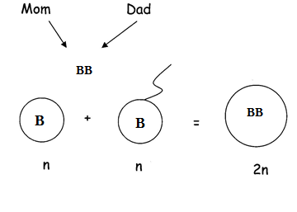
4.3.1 – Define genotype, phenotype, dominant allele, recessive allele, codominant alleles, locus, homozygous, heterozygous, carrier and test cross
Letters are used to represent alleles:
  Dominant alleles are always a capital letter
  Recessive alleles are always a lower case letter
  *The same letter is always used for a single trait
Combination of these letters make up the genotype
  Ex: B and b
  can be:
  1) BB ( )
2) bb ( )
3) Bb ( )
  Homozygous =
  Heterozygous =

Slide 15
4.3.1 – Define genotype, phenotype, dominant allele, recessive allele, codominant alleles, locus, homozygous, heterozygous, carrier and test cross
Phenotype =
  B = brown eye (dominant);
  b = blue eye (recessive)
BB =
bb =
Bb =

Slide 16
4.3.2 – Determine the genotypes and phenotypes of the offspring of a monohybrid cross using a Punnett grid.
4.3.11 - Predict the genotypic and phenotypic ratios of offspring of monohybrid crosses involving any of the above patterns of inheritance.
A monohybrid cross is .
A punnett grid (square) is .

Slide 17
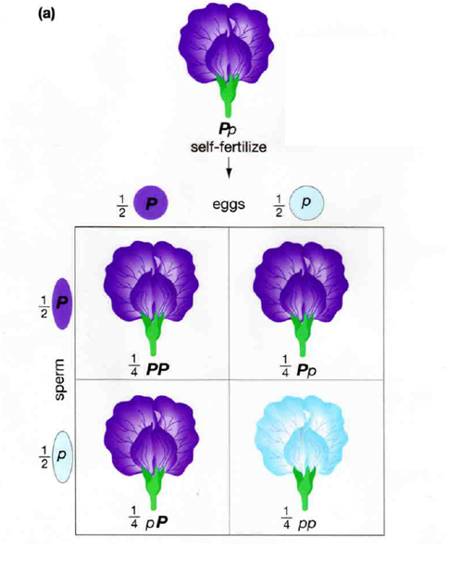
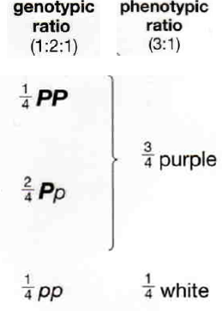

Slide 18
Steps to figuring out Monohybrid Crosses:
  Write down all information given
  Write down phenotypes & genotypes of parents
  Figure out gametes
  Draw punnett grid & fill in
  Determine the genotypic and phenotypic ratio for offspring

Slide 19
4.3.2 – Determine the genotypes and phenotypes of the offspring of a monohybrid cross using a Punnett grid.
4.3.11 - Predict the genotypic and phenotypic ratios of offspring of monohybrid crosses involving any of the above patterns of inheritance.
Practice Problem:
  In guinea pigs, black fur is dominant to white fur. Cross a heterozygous black guinea pig with a white guinea pig. Give the genotypes and phenotypes of the offspring. Black is dominant to white.
  Solution: Bb (Black) x bb (white)
  Genotypic ratio:
  Phenotypic ratio:
*Do on board

Slide 20
4.3.11 - Predict the genotypic and phenotypic ratios of offspring of monohybrid crosses involving any of the above patterns of inheritance.
Ratios for a Monohybrid Cross:
  Anytime you cross 2 heterozygotes you always get:
Genotypic ratio =
Phenotypic ratio =
  Anytime you cross a homozygote with a heterozygote you get:
Genotypic ratio =
  These ratios can also be expressed as percentages:
3:1 →
1:2:1 →

Slide 21
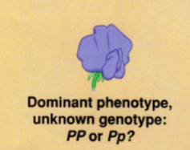
4.3.1 – Define genotype, phenotype, dominant allele, recessive allele, codominant alleles, locus, homozygous, heterozygous, carrier and test cross
Phenotype does not always reveal the genotype
For example, an individual that is heterozygous has the dominant phenotype but will have both the dominant and recessive allele.
To determine genotype a may be done.
In a test cross,

Slide 22
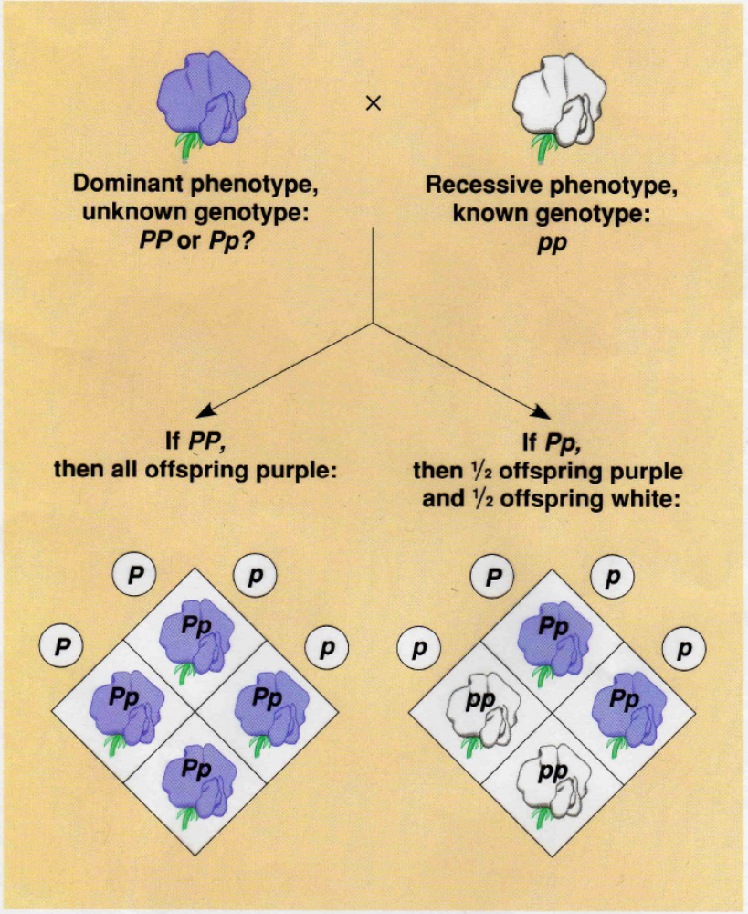

Slide 23
4.3.5 – Explain how the sex chromosomes control gender by referring to the inheritance of X and Y chromosomes in humans
Sex Determination:
  Most animals have a special pair of (all other chromosomes are )
  Members of one sex are – have a pair of similar sex chromosomes and produce only one type of gamete
    Females of many species (including humans) have two X chromosomes –
    Genotype =

Slide 24
4.3.5 – Explain how the sex chromosomes control gender by referring to the inheritance of X and Y chromosomes in humans
  Members of the other sex are – have two different sex chromosomes
    Males of many species (including humans) have one X chromosome and one Y chromosome –

Slide 25
4.3.5 – Explain how the sex chromosomes control gender by referring to the inheritance of X and Y chromosomes in humans
All individuals require at least one X chromosome and the Y is the male-determining chromosome
X and Y chromosomes are not truly homologous
  Different in
Male determines the sex of the baby
  ½ the sperm are Y and ½ are X
  All of the eggs are X
  If an X sperm fertilizes the egg, the baby is XX and is a girl
  If a Y sperm fertilizes the egg, the baby is XY and is a boy

Slide 26
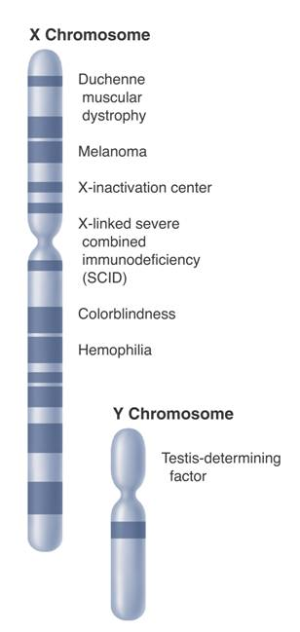
4.3.6 – State that some genes are present on the X chromosome and absent on the shorter Y chromosome in humans.
X Chromosome
Duchenne muscular dystrophy
The Y chromosome is much smaller than the X chromosome.
It appears to contain
X chromosome bears (has genes for color vision and blood clotting)
Melanoma
X-inactivation center
X-linked severe combined immunodeficiency (SCID)
Colorblindness
Hemophilia
Y Chromosome
Testis-determining
factor

Slide 27
4.3.7 – Define sex linkage.
4.3.9 – State that a human female can be homozygous or heterozygous with respect to sex-linked genes.
Sex linkage occurs (usually the X → ).
Recessive sex-linked traits are more likely to be passed on to . Why?
  Females have 2 X chromosomes
  Possible genotypes: X^{H}X^{H}, X^{H}X^{h}, X^{h}X^{h}
  Phenotype: dominant dominant recessive
  Females can either be

Slide 28
4.3.7 – Define sex linkage.
4.3.9 – State that a human female can be homozygous or heterozygous with respect to sex-linked genes.
  Males have only 1 X chromosome
  Possible genotypes: X^{H}Y, X^{H}Y
  Phenotype: dominant recessive

Slide 29
4.3.1 – Define genotype, phenotype, dominant allele, recessive allele, codominant alleles, locus, homozygous, heterozygous, carrier and test cross
4.3.10 - Explain that female carriers are heterozygous for X-linked recessive alleles.
  A carrier is an individual that is .
  Therefore, only .

Slide 30
4.3.7 – Describe the inheritance of color blindness and hemophilia as examples of sex linkage.
Color blindness and hemophilia are .
  X^{B} = normal vision X^{b} = colorblindness
  X^{H} = normal clotting X^{h} = hemophilia
Who is more likely to inherit these disorders?
Think – Pair – Share: Explain why using what we just learned.

Slide 31
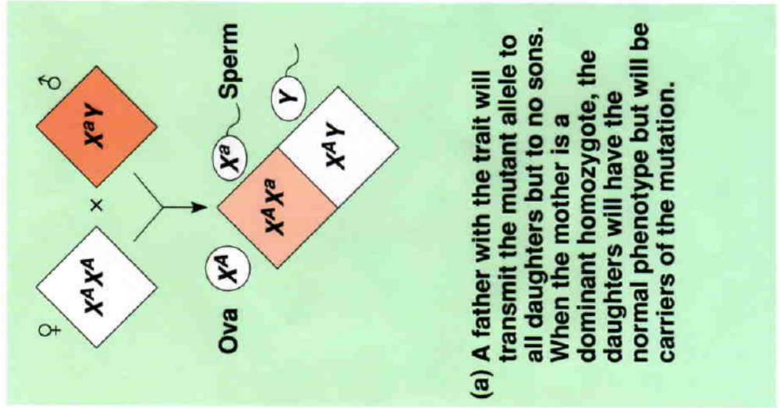
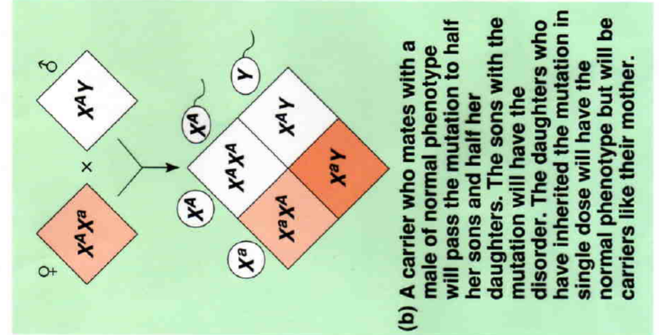
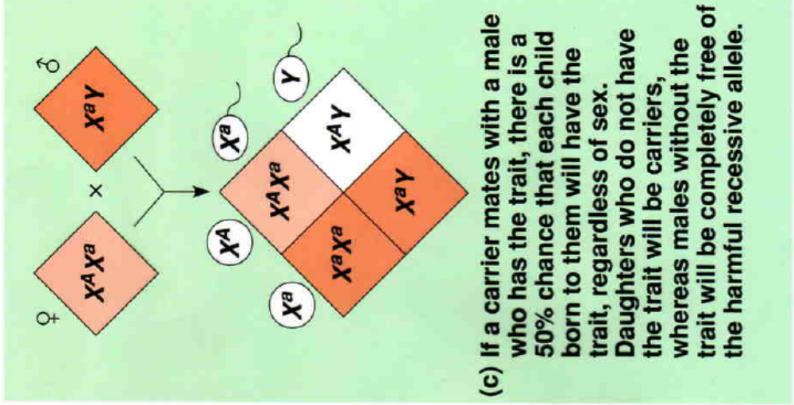

Slide 32
4.3.3 – State that some genes have more than two alleles (multiple alleles).
Exceptions to Mendel’s Laws:
  Many traits are not just controlled by one pair of genes that are dominant or recessive
  Many traits are controlled by many pairs of genes cooperating to control the expression of a single trait

Slide 33
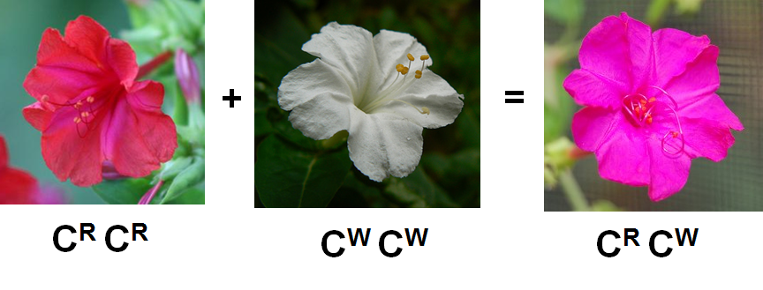
4.3.3 – State that some genes have more than two alleles (multiple alleles).
Incomplete dominance –
  Ex: Snapdragons
  C^{R} = red, C^{W} = white
  C^{R} C^{R} = Red, C^{W} C^{W} = White
  Hybrid: C^{R} C^{W} = Pink (in between)

Slide 34
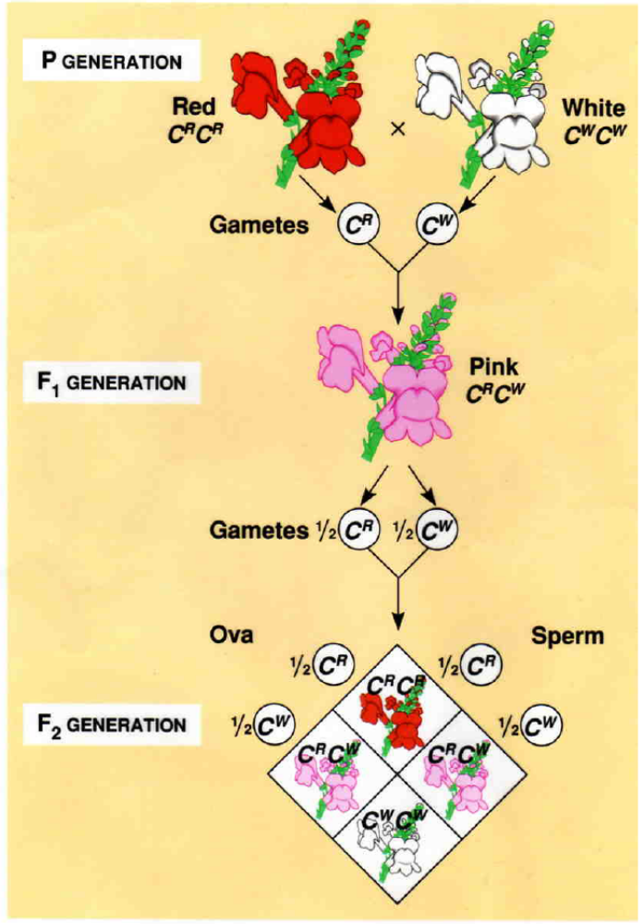

Slide 35
4.3.3 – State that some genes have more than two alleles (multiple alleles).
4.3.4 - Describe ABO blood groups as an example of codominance and multiple alleles.
Codominance –

Slide 36
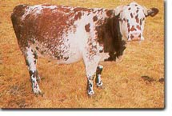
  Example – Roan coat in cattle
    Alleles: R – red, W – white
    RR = Red, WW = White, Hybrid (RW) – Roan coat: equal amounts of red and white hair

Slide 37
4.3.3 – State that some genes have more than two alleles (multiple alleles).
4.3.4 - Describe ABO blood groups as an example of codominance and multiple alleles.
Multiple alleles –
    Any one individual can have only up to two alleles for each gene.

Slide 38
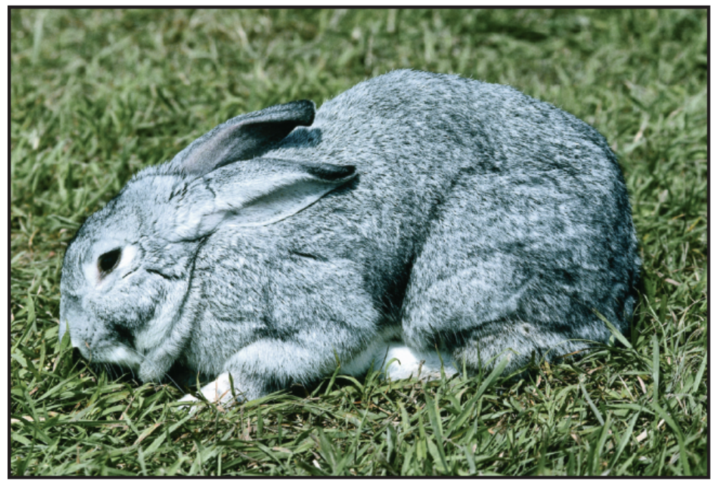
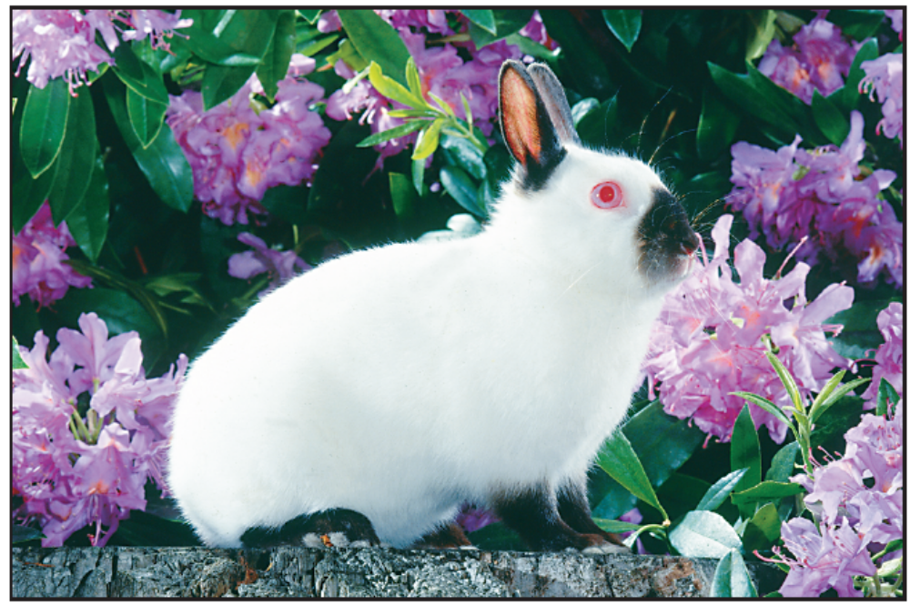
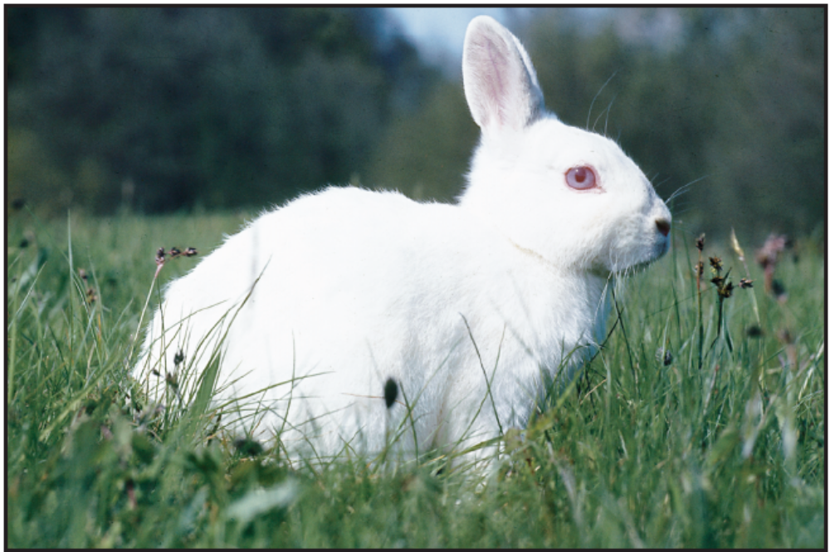
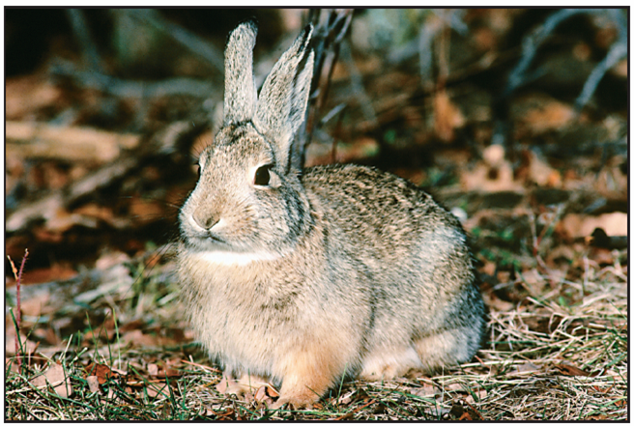
Different combinations of alleles result in the colors shown here.
KEY
C = full color; dominant
to all other alleles
c^{ch} = chinchilla; partial
defect in pigmentation;
dominant to
c^{h} and c alleles
c^{h} = Himalayan; color in
certain parts of the
body; dominant to
c allele
c = albino; no color;
recessive to all other
alleles
Full color: CC, Cc^{ch}, Cc^{h}, or Cc
Chinchilla: c^{ch}c^{h}, c^{ch}c^{ch}, or c^{ch}c
Himalayan: c^{h}c, or c^{h}c^{h}
AIbino: cc
Notes:
Coat color in rabbits is determined by a single gene that has at least four different alleles. Different combinations of alleles result in the four colors you see here. photo credits: 1. ©John Gerlach/Visuals Unlimited 2.Animals Animals/©Richard Kolar 3. ©Jane Burton/Bruce Coleman, Inc. 4. ©Hans Reinhard/Bruce Coleman, Inc.

Slide 39
4.3.3 – State that some genes have more than two alleles (multiple alleles).
4.3.4 - Describe ABO blood groups as an example of codominance and multiple alleles.
Blood Types:
  There are 3 different alleles for human blood types (multiple alleles) →
  Blood types are based on ( ) on the red blood cells
  Four Blood Types:

Slide 40
4.3.3 – State that some genes have more than two alleles (multiple alleles).
4.3.4 - Describe ABO blood groups as an example of codominance and multiple alleles.
Genotypes for Blood Types:
  Type A blood –
  Type B blood –
  Type AB blood –
  Type O blood –
Both I^{A} and I^{B} are dominant to i^{O} and are codominant to each other

Slide 41
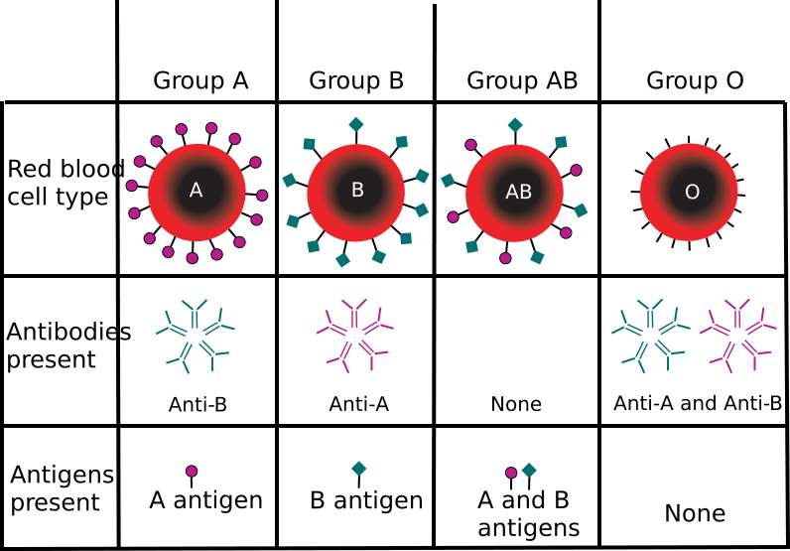
4.3.3 – State that some genes have more than two alleles (multiple alleles).
4.3.4 - Describe ABO blood groups as an example of codominance and multiple alleles.
Type A blood has A antigens
Type B blood has B antigens
Type AB blood has both A and B antigens
Type O blood has no antigens

Slide 42
Exposure to an antigen causes an immune response – the body produces antibodies to destroy the antigen
Immune system of each person is insensitive to the surface proteins (antigens) of its own cells
blood type antigens plasma antibodies
A A anti-B
B B anti-A
AB A and B none
O none anti-A and B
If a person receives the wrong blood type in a transfusion,

Slide 43
Type A can receive
Type B can receive
Type AB can receive
Type O can receive

Slide 44
Practice Problem:
A woman with type A blood marries a man with type AB blood. What blood types could you expect to find among their children?
What is the woman’s genotype if the couple produces children with type B blood?
woman I^{A}I^{A} or I^{A}i^{O}
man I^{A}I^{B}
I^{A} I^{B}
I^{A} I^{B}
I^{A}
I^{A}
I^{A}
i^{O}

Slide 45
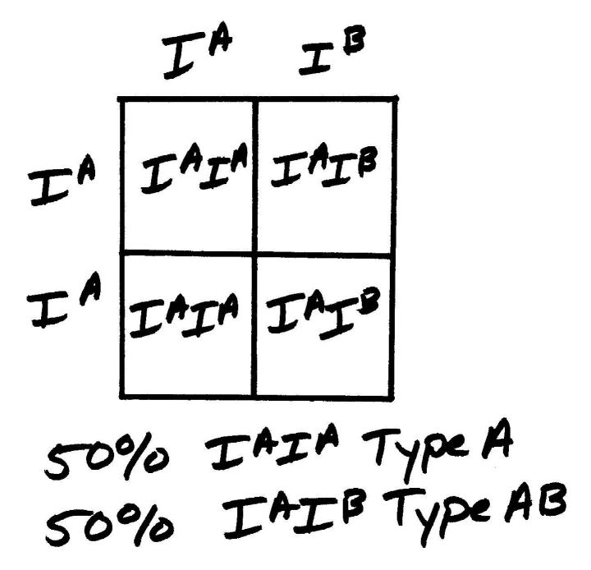
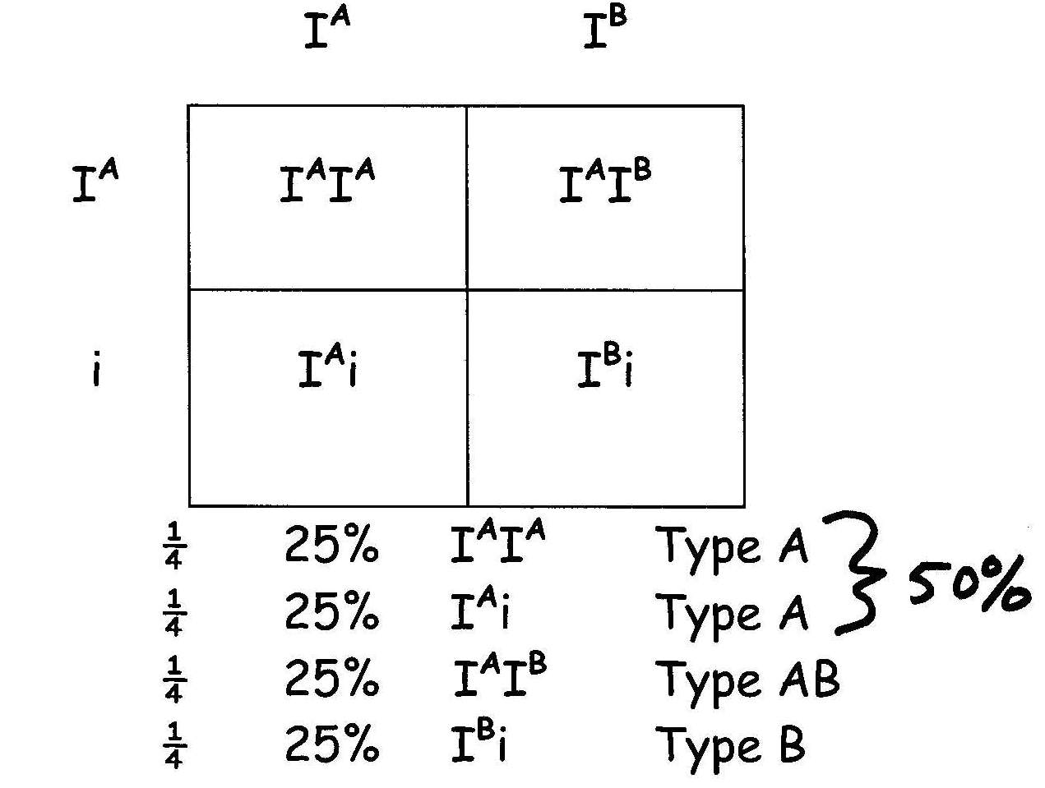
The woman’s genotype must be I^{A}i^{O}

