Slide 1
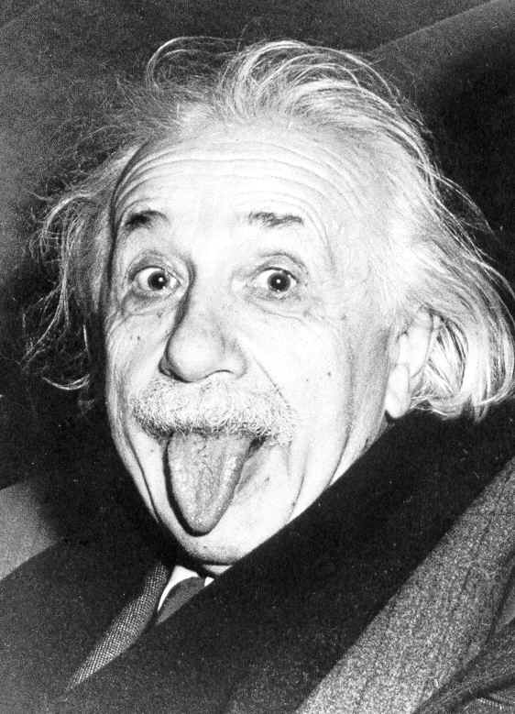

Slide 2
genius

Slide 3
someone who has exceptional intellectual ability and originality

Slide 4
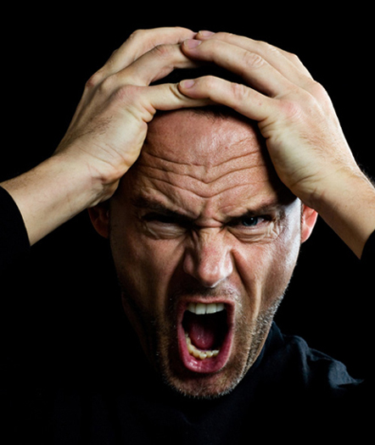

Slide 5
obscurity

Slide 6
the quality of being unclear and hard to understand.

Slide 7
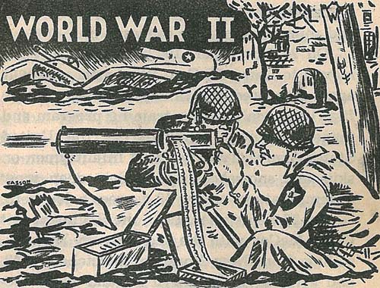

Slide 8
fate

Slide 9
an event that will inevitably happen in the future

Slide 10
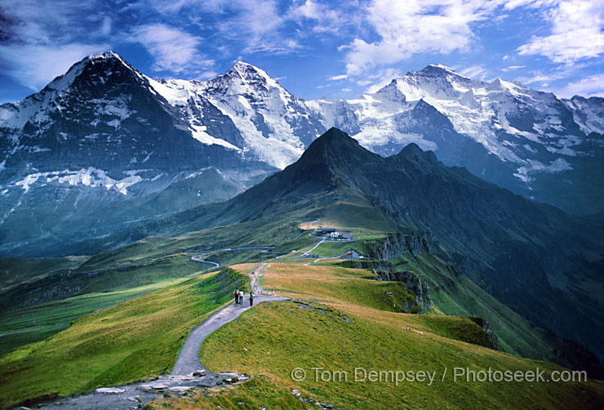

Slide 11
Alps

Slide 12
a large mountain system in south-central Europe

Slide 13
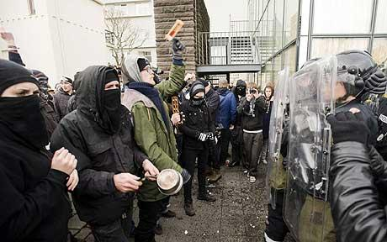

Slide 14
disrupt

Slide 15
interfere in someone else's activity

Slide 16
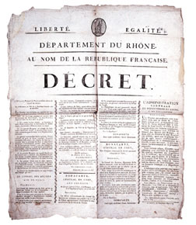

Slide 17
Coup d’État

Slide 18
A sudden seizure of power

Slide 19
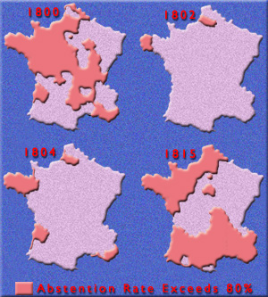

Slide 20
plebiscite

Slide 21
A direct vote in which a country’s people have the opportunity to approve or reject a proposal

Slide 22
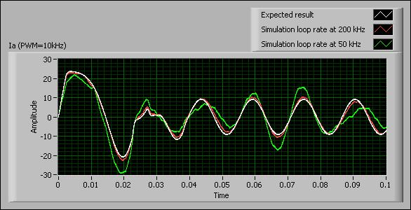

Slide 23
sound

Slide 24
stable; sensible, correct and likely to produce the correct results

Slide 25
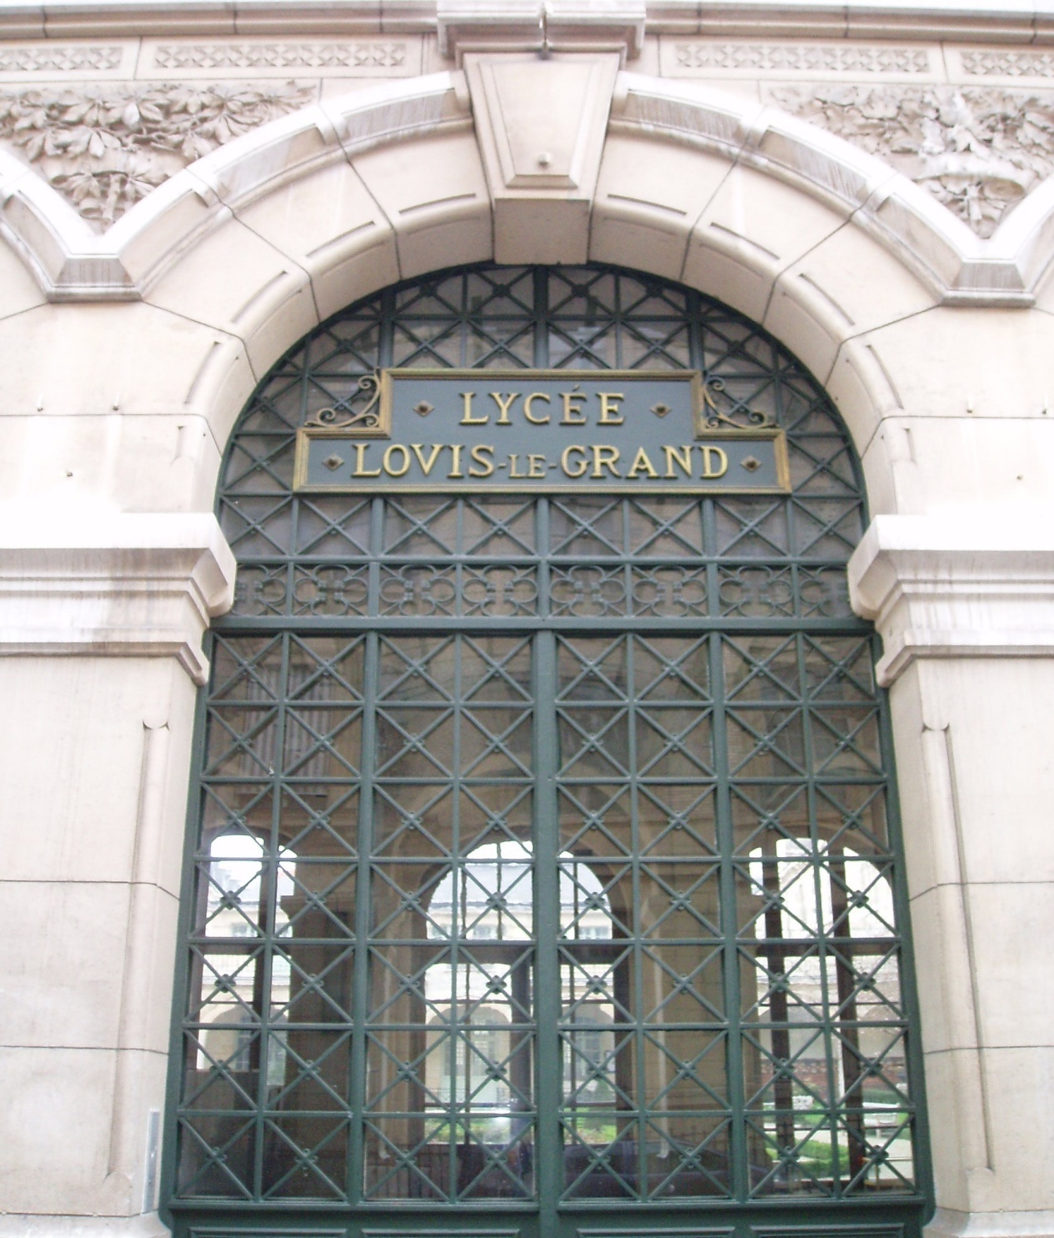

Slide 26
lycées

Slide 27
a government run public school in France

Slide 28
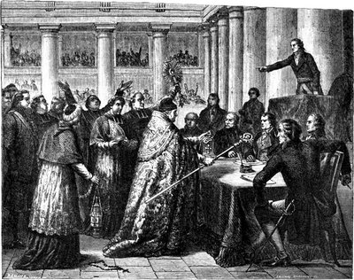

Slide 29
concordat

Slide 30
A formal agreement, especially between the church and the government

Slide 31
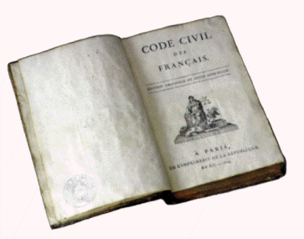

Slide 32
Napoleonic Code

Slide 33
A system of laws established for France by Napoleon

Slide 34
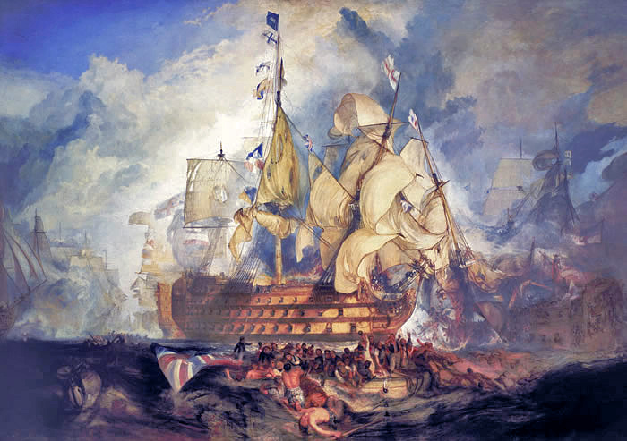

Slide 35
Battle of Trafalgar

Slide 36
an 18-5 battle naval battle in which Napoleon’s forces were defeated by a British fleet under the command of Horatio Nelson

Slide 37
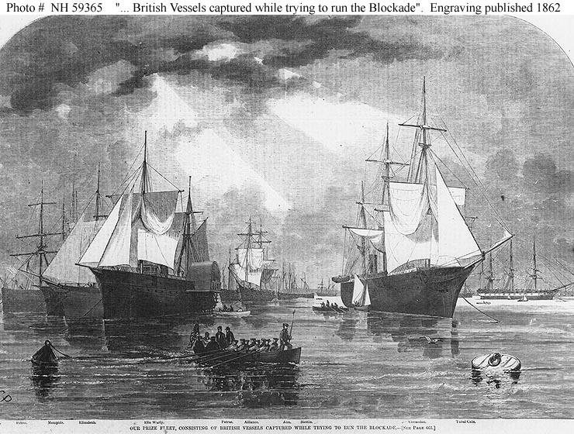

Slide 38
blockade

Slide 39
The use of troops or ships to prevent traffic from entering a region

Slide 40
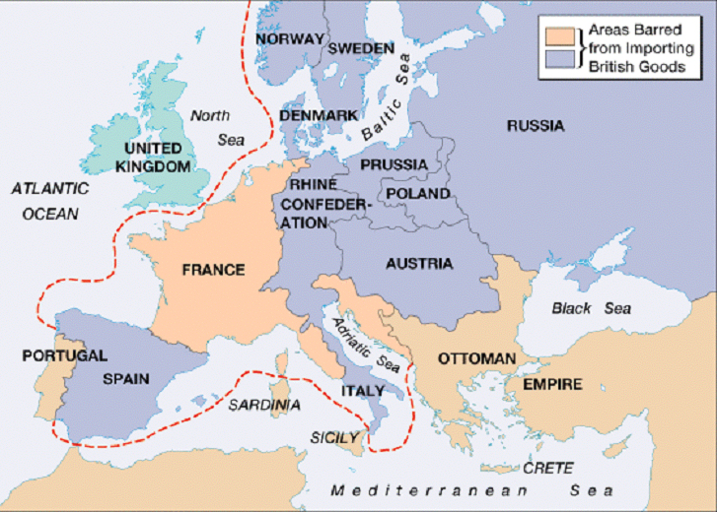

Slide 41
Continental System

Slide 42
Napoleon’s policy of preventing trade between Great Britain and the rest of Europe

Slide 43
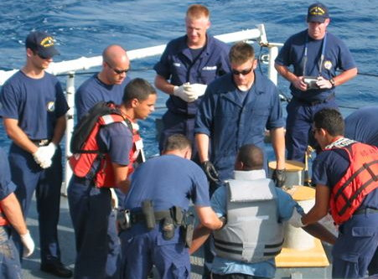

Slide 44
smuggler

Slide 45
someone who imports or exports without paying duties

Slide 46
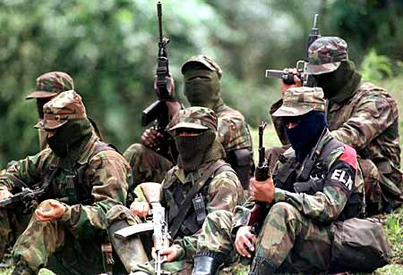

Slide 47
Guerrillas

Slide 48
a loosely organized fighting force that makes surprise attacks on enemy troops occupying its country

Slide 49
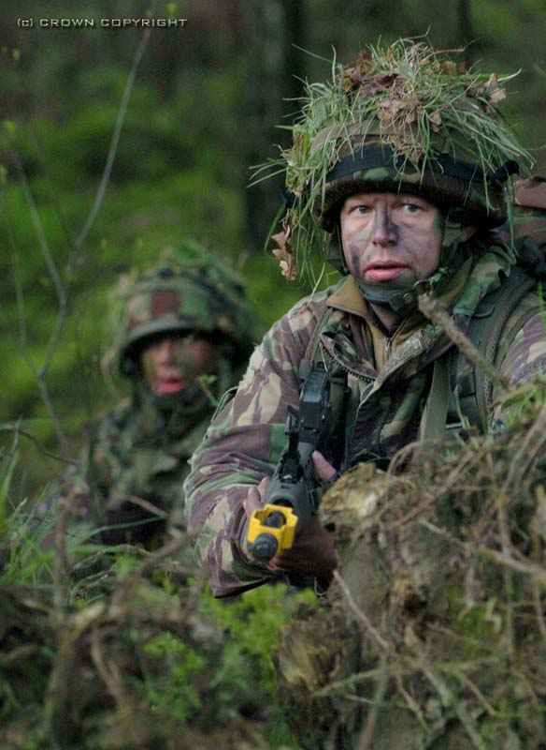

Slide 50
ambush

Slide 51
wait in hiding to attack

Slide 52
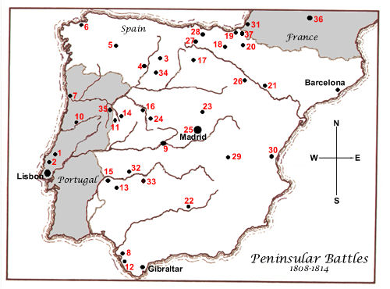

Slide 53
Peninsular War

Slide 54
a conflict from 1808-1813, in which Spanish rebels, with the aid of British forces, sought to drive Napoleon’s French troops out of Spain

Slide 55
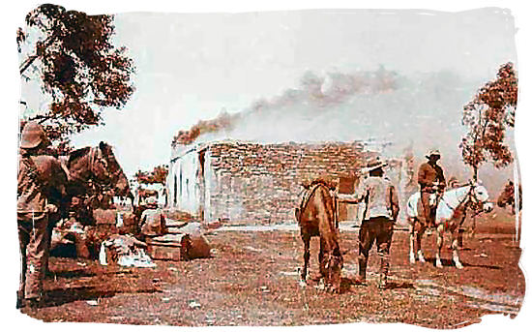

Slide 56
scorched-earth-policy

Slide 57
The burning of grain fields and slaughtering livestock so as to leave nothing that the enemy could eat

Slide 58
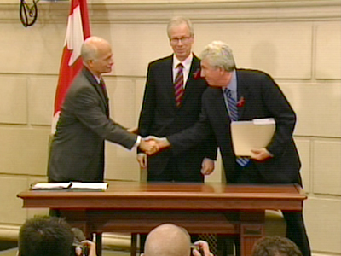

Slide 59
coalition

Slide 60
an alliance of several political parties

