Slide 1
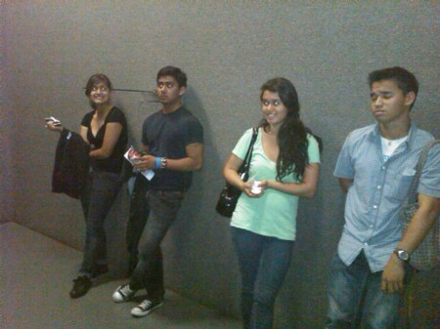
Hey, I don’t know you!
(Or I don’t know you very well)

Slide 2
Before We Begin
In order to get the class back in order quickly, I will do one of the following to get your attention:
  I might raise my hand. What should you do?
  I might ask you to clap once or twice. What should you do?
Let’s practice this right away with this activity

Slide 3
What to do:
1. Find someone in the room who you don’t know (or you don’t know well) and introduce yourself.
2. Person A: Ask 4-5 questions of Person B.
Say “I don’t know ____ about you” and ask questions such as: Where were you born? How many brothers and sisters do you have? What did you do this summer? Where do you want to go to college? What do you like to do in your spare time? What’s your favorite movie/book/restaurant? Etc.
3.Person B: Answer their questions.

Slide 4
What to do:
4. Switch roles so Person B asks questions of Person A.
5. Be prepared to share something you learned about your new acquaintance!

Slide 5
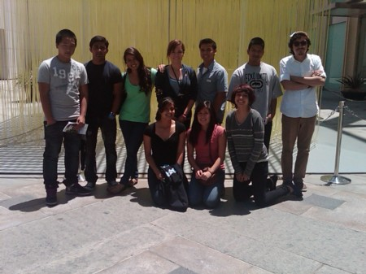
That’s better! Now get to know a second person!

