Slide 1
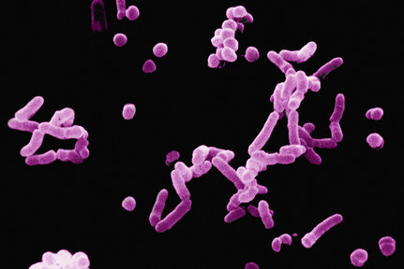
Defense Against Disease
CORE 6.3

Slide 2
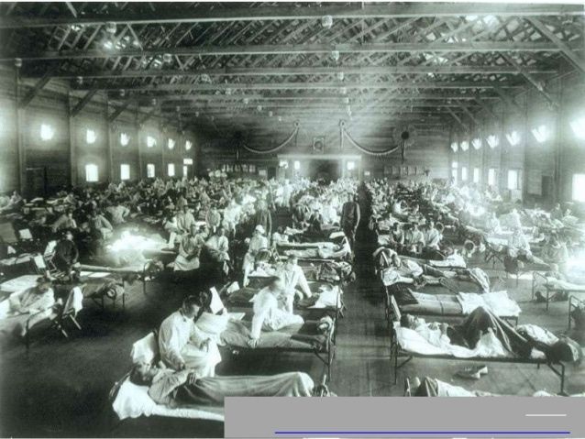
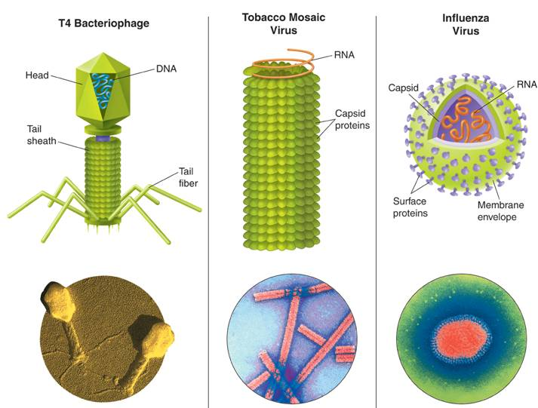
6.3.1 Define pathogen.
A pathogen is
Examples of organisms that cause disease:
Viruses
Not considered
Needs a
Causes:

Slide 3
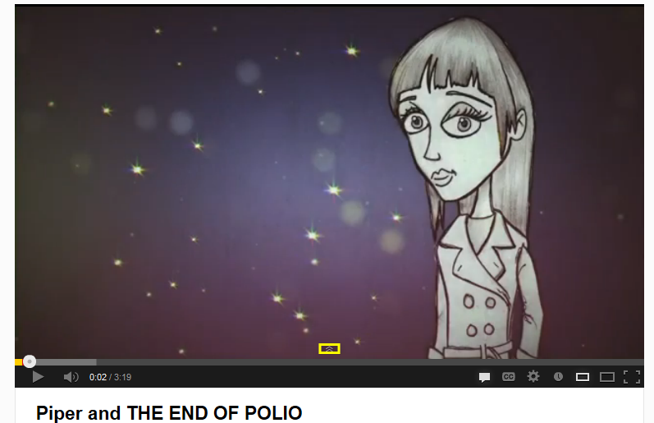

Slide 4
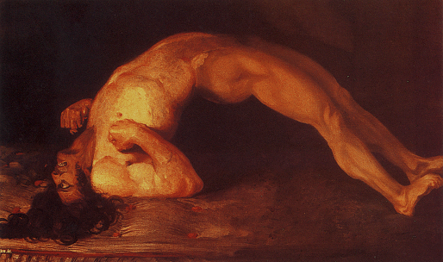
Bacteria
Prokaryote (lacks nucleus)
Divides by
Causes: (diarrhea), (sore throat, affects breathing), , , , (muscle spasms),
http://textbookofbacteriology.net/themicrobialworld/Tetanus.html

Slide 5
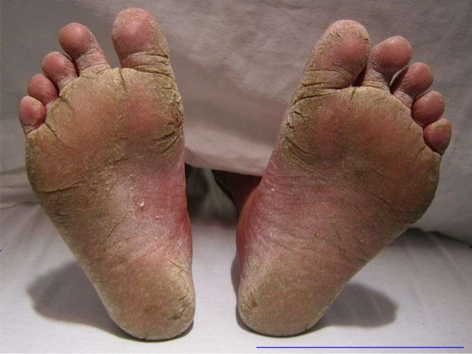
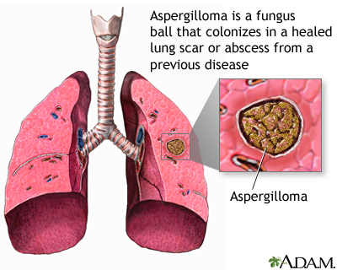
Fungi
Eukaryotes
Causes: , , (yeast infection, thrush), (allergic reaction to breathing moldy crop),
http://en.wikipedia.org/wiki/File:FeetFungal.JPG
http://www.ncbi.nlm.nih.gov/pubmedhealth/PMH0002302/

Slide 6
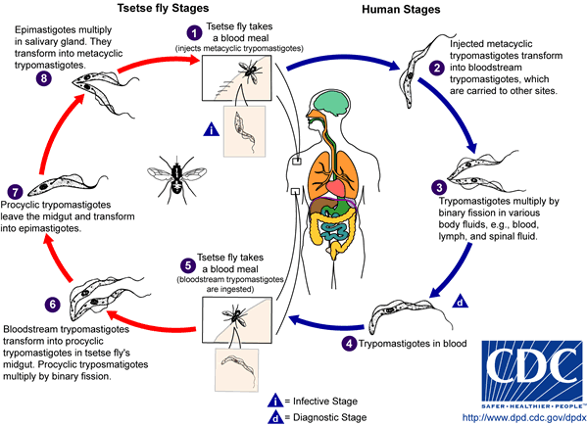
Protozoa
Animal-like protists
Causes: , (invades intestines, dysentery, diarrhea), (sleeping sickness)

Slide 7
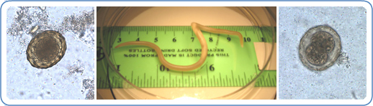
Roundworms
Causes: , ,
http://www.cdc.gov/parasites/ascariasis/index.html
Elephantiasis video clip:
http://animal.discovery.com/tv-shows/monsters-inside-me/videos/parasite-causes-elephantiasis.htm

Slide 8
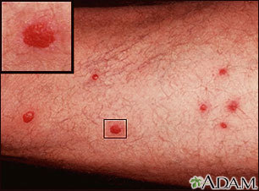
Flatworms
Pork and beef , , (bilharzias)
Schistosomiasis “swimmer’s itch” – initial invasion
http://www.ncbi.nlm.nih.gov/pubmedhealth/PMH0002298/

Slide 9
6.3.2 Explain why antibiotics are effective against bacteria but not against viruses.
Antibiotics
Some work to while others may
They are naturally occurring substances obtained mainly from fungi or bacteria
Antibiotics
Viruses are
Their reproduction relies on

Slide 10
Pathogens gain entry to the body using one of the following methods:
– diseases of the human respiratory system can be transmitted when an infected person coughs or sneezes out droplets containing pathogens, which are breathed in by an uninfected person
Ex.
– physical contact with an infected person carries the disease to an uninfected person through natural body openings (many diseases)

Slide 11
– pathogens in contaminated food or water enter the body through the digestive system
Ex.
– allows pathogen to gain entry to body
Ex.
– needle may contain pathogens in tiny drop of infected person’s blood left on needle; common mode of transmission in drug addicts
Ex.

Slide 12
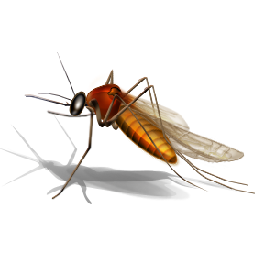
– only occurs if blood supply is contaminated with a disease such as AIDS
– sexually transmitted diseases gain entry through the soft mucous membranes of the penis and vagina during sexual intercourse
– blood-sucking insects inject their mouthparts through the skin and can transmit pathogens that they sucked out of an infected person
Ex.

Slide 13
6.3.3 Outline the role of skin and mucous membranes in defense against pathogens.
The human body has three lines of defense against microbial attack:
External barriers →
Intact skin acts
Dry, dead skin does necessary for microbial growth and most will be ejected when skin cells are constantly sloughed off
Skin is protected by

Slide 14
6.3.3 Outline the role of skin and mucous membranes in defense against pathogens.
Membranes (in respiratory and digestive tracts)
The mucus also that enter body through nose or mouth
on the membranes sweep up the mucus with microbes to be swallowed, coughed or sneezed out

Slide 15
6.3.4 Outline how phagocytic leucocytes ingest pathogens in the blood and in body tissues.
– effective against a – three categories:
Phagocytic cells and natural killer cells
(most important):
White blood cells that crawl around in the extracellular fluid (similar to how amoeba feed)
Also act as “ ” cells (present parts of microbe to other cells of immune system)
Phagocytosis animation: http://highered.mcgraw-hill.com/sites/0072495855/student_view0/chapter2/animation__phagocytosis.html

Slide 16
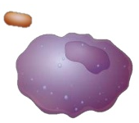
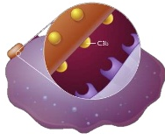
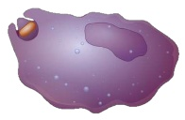
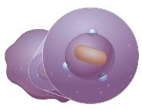
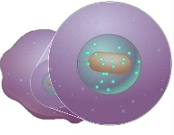

6.3.4 Outline how phagocytic leucocytes ingest pathogens in the blood and in body tissues.

Slide 17
6.3.4 Outline how phagocytic leucocytes ingest pathogens in the blood and in body tissues.
:
Another class of white blood cells
Do not directly attack microbes,
Also

Slide 18
(localized injury) – results from injury and large-scale breaches of the skin such as a cut
Inflammation occurs:
Injured area is walled off to isolate infected tissue:
Phagocytes & Killer cells are recruited:

Slide 19
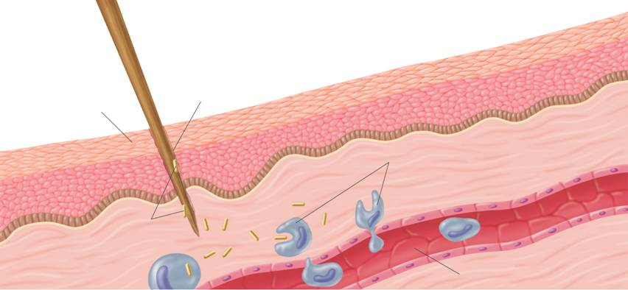
Inflammatory Response:
Wound
Skin
Phagocytes move into the area and engulf the bacteria and cell debris
Bacteria enter the wound
Capillary

Slide 20
– results when
Fever increases the
Fever
Fever also helps by increasing the production of (increases resistance of surrounding cells to viral attack)
For more info on interferons: http://pathmicro.med.sc.edu/mhunt/interferon.htm

