Slide 1
Warm-up #15
What do you know about Shakespeare’s play Romeo and Juliet?
Why do you think it is one of Shakespeare’s most popular plays?

Slide 2

Romeo and Juliet Summary

Slide 3
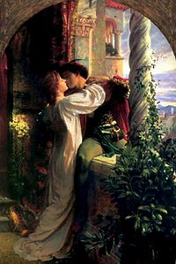
What are star-crossed lovers?
Two people whose relationship is doomed to fail are said to be “star-crossed”
William Shakespeare used the phrase to describe Romeo and Juliet.
Can you think of an examples of two types of people who might be star-crossed lovers?

Slide 4
Romeo and Juliet Balcony Scene

Slide 5
Video Clip #2

Slide 6
Your Turn
Pick two characters who might be “star-crossed” lovers.
In pairs complete the script for the balcony scene (the most famous in scene in Romeo and Juliet).
Practice performing your adaption of the scene with your partner.
You’ll get to perform for the class as well. ☺

Slide 7
Homework
Page 317 #3a and 3b.
Page 319 #1 and 2.

