Slide 1
Essential Question
First & Last Name
Class Title
Period
Date
Questions
Class Notes
2 1/2”
3 to 4 sentence summary across
the bottom of each page of notes
Notes:
CORNELL NOTE PAPER FORMAT
Stress that any sheet of paper can be turned into Cornell note paper - or - hand out paper and have participants set up sheet while working through slide.
The format causes students to process notes multiple times increasing memory, recall, and understanding.
Cornell Notes has 5 sections:
1. Heading
Name is imp. Because students exchange notes. Class & date helps keep notes organized in binder appropriately.
2. Topic
Focuses the content of the notes for the student.
3. Note section (rt. Side)
Where any info being presented in class is recorded.
4. Question Column
Students are responsible for completing after notes are taken.
5. Summary
Allows students to process notes in terms of big ideas.

Slide 2
Essential Question
Main focus of notes
At top of paper
Answered by the summary
Why is geography important to our study of history?

Slide 3
Cornell Notes: Format
Right side: The “information” side. It’s where you write information given to you in a lecture, video, text, etc.
Don’t copy word for word. You are encouraged to use:
Abbreviations
Phrases
Bullets
Pictures
Notes:
Review

Slide 4
Cornell Notes: Format
Left side: The “processing” side. This is where you analyze the notes and write questions that are answered by the information on the right side.
You can also write new questions, leaving the right side blank to be filled in when you ask your questions in class.
Key to remember: The left and right sides are related to each other.
Notes:
Quickly review

Slide 5

Geography Notes
Compass Rose - a picture that shows the four cardinal directions, north, south, east and west on a map.

Slide 6

Geography
Never
Eat
Shredded
Wheat

Slide 7
Geography: Definitions
Country – a group of political territories run by a single government.
City – a populated area (town) with an organized government.
State - one of the geographic and political units united under a government
Continent - One of the seven main land masses of the earth. (How many can you name?)

Slide 8
City
State
Country
Continent

Slide 9
Los Angeles
California
USA
North
America

Slide 10
Immigration
Take two minutes to brainstorm as many reasons as you can that someone would move to a new country.
Push-factors –things that force someone to leave their country.
Pull-factors – things that attract someone to a new country.

Slide 11
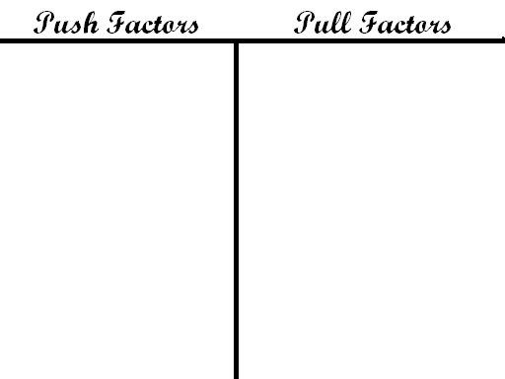
Create a T-Chart and group your immigration factors on your chart

