Slide 1
Ch. 5 Key Issue 2
Why is English related to other languages?
  Indo-European branches
  Origin and diffusion of Indo-European

Slide 2
Basic terms
Language Family: a collection of languages related through a common ancestral language that existed long before recorded history. Indo-European is the world’s most spoken language family- nearly 3 billion people speak an Indo-European language.
Language Branch: a collection of languages related through a common ancestral language that existed several thousand years ago. Differences are not extensive or as old as with language families.
Language Group: a collection of languages within a branch that share a common origin in the relatively recent past and display relatively few differences in grammar and vocabulary.

Slide 3
Indo-European Branches
8 branches:
  Indo-Iranian, Romance, Germanic, Balto-Slavic are spoken by large numbers of people.
    Indo-Iranian: clustered in South Asia
    Romance languages: southwestern Europe and Latin America
    Germanic: northwestern Europe and North America
    Balto-Slavic: Eastern Europe
  Less extensively used: Albanian, Armenian, Greek and Celtic.

Slide 4
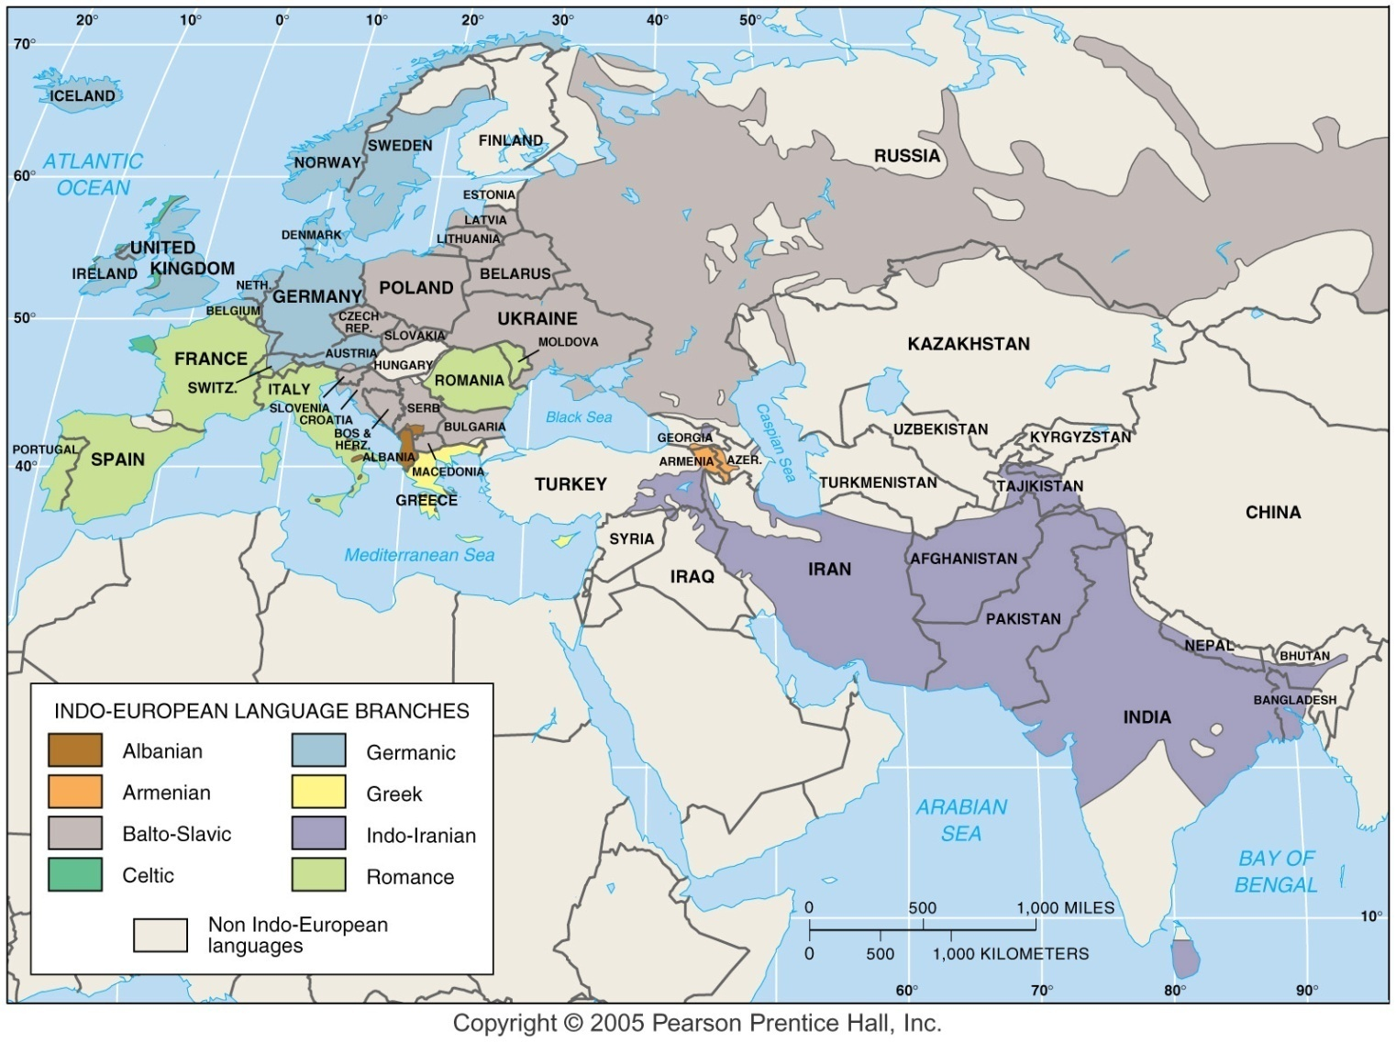
Indo-European Language Family
Fig. 5-5: The main branches of the Indo-European language family include Germanic, Romance, Balto-Slavic, and Indo-Iranian.

Slide 5
Germanic Branch
German and English both belong to the Germanic branch.
Structurally similar and have many common words.
North Germanic
  Swedish
  Danish
  Norwegian
  Icelandic
West Germanic branch: English belongs in.
  High Germanic: spoken in the southern mountains of Germany
  Low Germanic: English, Dutch, Flemish (dialect of Dutch in northern Belgium). Afrikaans- S. African version similar to Dutch due to colonization by the Dutch.

Slide 6
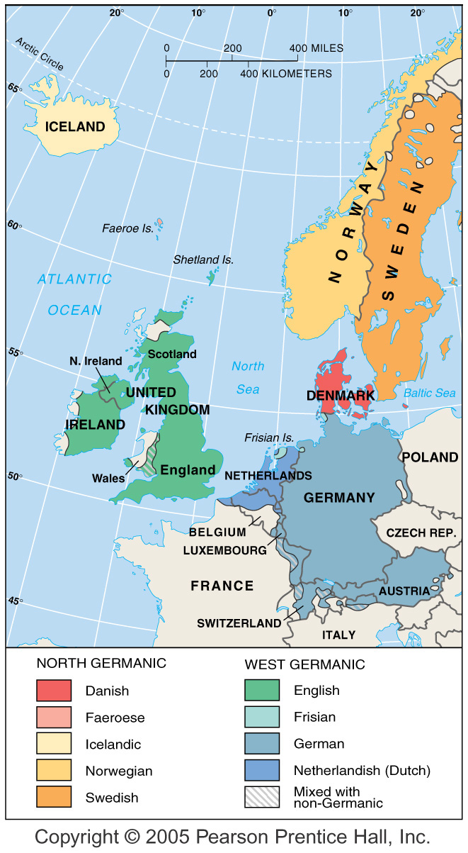
Germanic Branch of Indo-European
Fig. 5-6: The Germanic branch today is divided into North and West Germanic groups. English is in the West Germanic group.

Slide 7
Eastern: Indo-Iranian Branch of Indo-European
India:
  1/3 of Indians speak Hindi (connection to the Hindu religion)
  India has 4 important language families: Indo-European, Dravidian, Sino-Tibetan, Austro-Asiatic
  India’s constitution recognizes 18 official languages. English as the former colonial rulers languages is an “associate” language. Only 1%% of the Indian pop. can speak English.

Slide 8
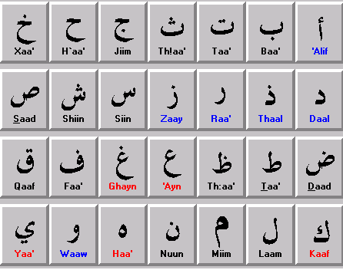
Western: Indo-Iranian Language Branch
Major Iranian group languages:
  Persian(Iran)
  Pashto (eastern Afghanistan and western Pakistan)
  Kurdish (western Iran, northern Iraq, eastern Turkey)
  These are all written in the Arabic alphabet.

Slide 9
East Slavic and Baltic Groups
Ukranian and Belarusan are 2 important East Slavic languages
Russian- spoken by 80% of Russian people
  Importance of Russian grew after WWII when the Soviet Union’s rise to power forced natives of other country’s to learn Russian as the Soviet Union language.

Slide 10
West and South Slavic Groups
Most spoken W. Slavic group is Polish then Czech then Slovak.
Czech and Slovak are very similar and they can understand one another.
S. Slavic spoken in Bosnia &Herzegovina, Croatia, Montenegro and Serbia

Slide 11
Romance Branch of Indo-European
Romance language evolved from the Latin language spoken by Romans 2,000 years ago.
4 most widely used:
  Spanish
  Portuguese
  French
  Italian
  Rugged mountains serve as boundaries among these 4 countries. (Pyrenees and Alps)
  5. Romanian: principle language of Romania and Moldova

Slide 12
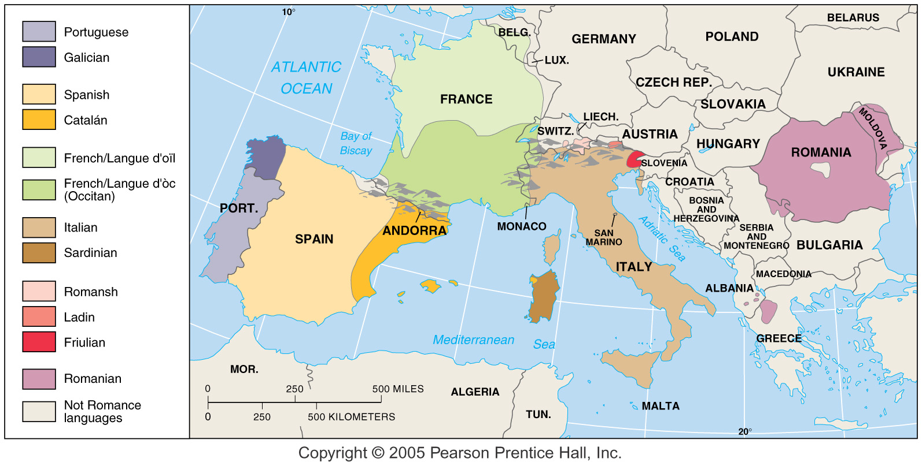
Romance Branch of Indo-European
Fig. 5-8: The Romance branch includes three of the world’s 12 most widely spoken languages (Spanish, French, and Portuguese), as well as a number of smaller languages and dialects.

Slide 13
Origin and Diffusion of Romance Languages
All developed from Latin, the “Romans’ Language”
The rise of the Roman Empire 2,000 years ago brought a diffusion of its Latin language.
Height of its empire in 2nd century AD the Roman Empire extended from the Atlantic Ocean to the Black Sea.
Languages of conquered natives were either extinguished or suppressed in favor of the conquerors language.
Latin was also integrated with the local languages spoken in the various regions conquered.
Vulgar Latin: the Latin that people in the regions learned was not the standard literary form but a spoken form. Vulgar refers to “the masses” and was introduced by the soldiers stationed throughout the empire.
Collapse of the Roman Empire in the 5th c. saw the decline in communication among empire regions, creating greater variation in the languages.

Slide 14
Romance Language Dialects
Most important dialect difference within France is between the north and south of France.
90% of Spanish and Portuguese speakers live outside Europe due to the colonization of Spain and Portugal in earlier centuries.
Spanish is the official language of 18 Latin American countries.
Romance languages spoken in former colonies can also be classified as separate languages because they differ substantially from the original language.
Creole or creolized language: defined as a language that results from the mixing of the colonizer’s language with the indigenous language of the people being dominated.
  A creolized language forms when the colonized group adopts the language of the dominant group but makes some changes, such as simplifying the grammar and adding words from their former language.

Slide 15
Origin and Diffusion of Indo-European
There are two theories about the diffusion of the language.
First is called the Kurgan theory named after the Kurgan people who lived in 4300 B.C. they came from the steppes near the boarder of Russia and Kazakhstan. They were nomads who domesticated the horse and cattle and moved west in search of grasslands. They used the horse as a weapon to conquer Southwest Asia and the Balkan peninsula.
The other theory is that it came from eastern Anatolia, or present day Turkey. This idea believes the language spread by agricultural practices through Greece, Italy, up into central and western Europe
We are not sure which is correct but both theories have valid points. One spread by military means, the other through contact of better agricultural practices.

Slide 16
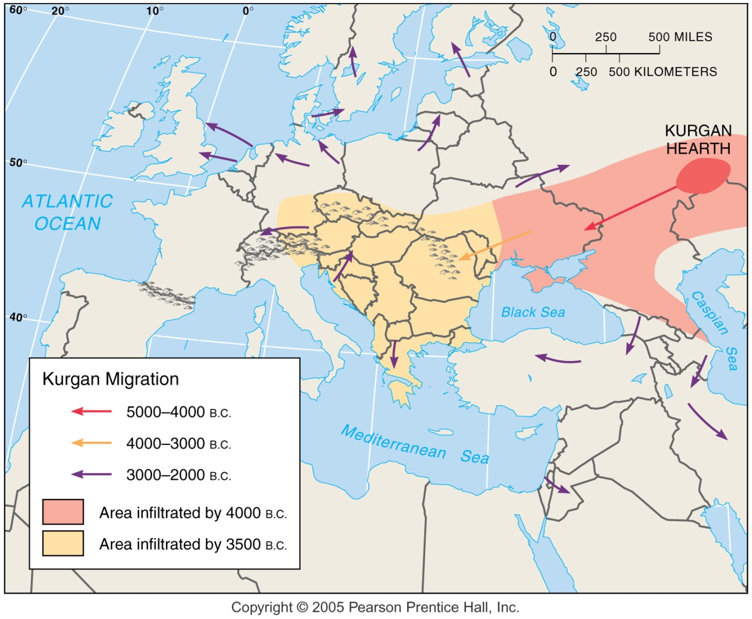
Kurgan Theory of Indo-European Origin
Fig. 5-9: In the Kurgan theory, Proto-Indo-European diffused from the Kurgan hearth north of the Caspian Sea, beginning about 7,000 years ago.

Slide 17
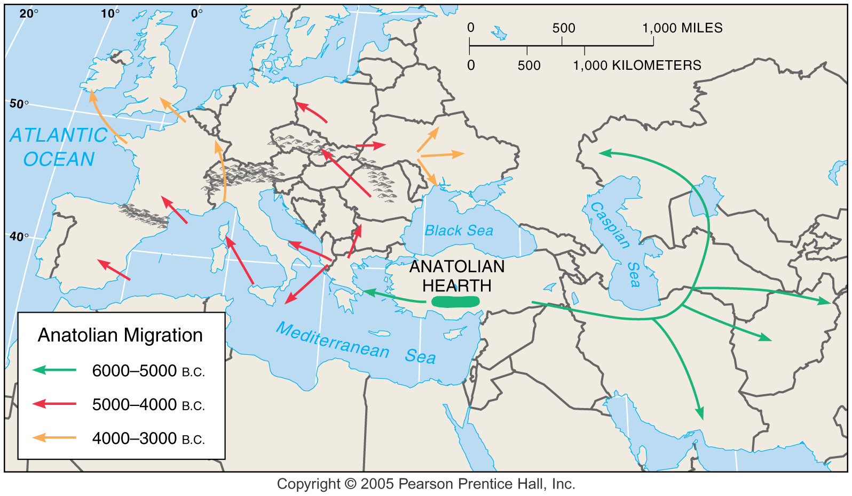
Anatolian Hearth Theory of Indo-European Origin
Fig. 5-10: In the Anatolian hearth theory, Indo-European originated in Turkey before the Kurgans and diffused through agricultural expansion.

