Slide 1
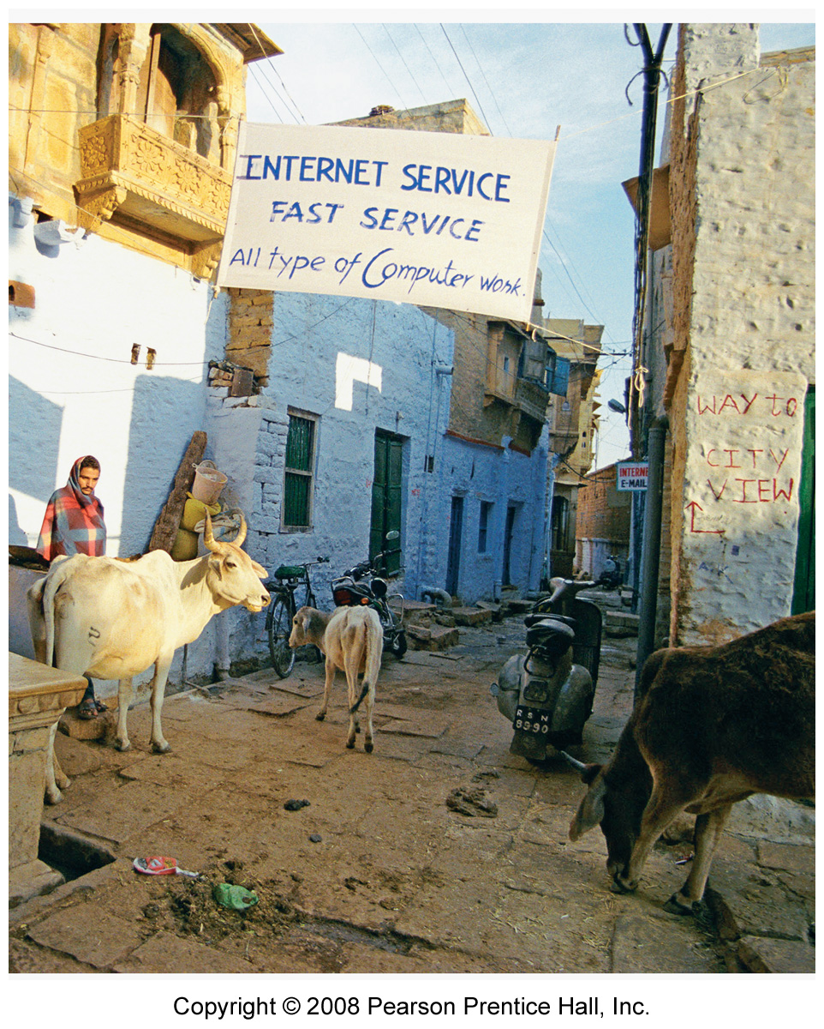
Where do folk and popular cultures originate and diffuse?
Ch. 4 Key Issue 1

Slide 2
Origin of Folk and Popular Cultures p. 115

Slide 3
Origin of Folk Music

Slide 4
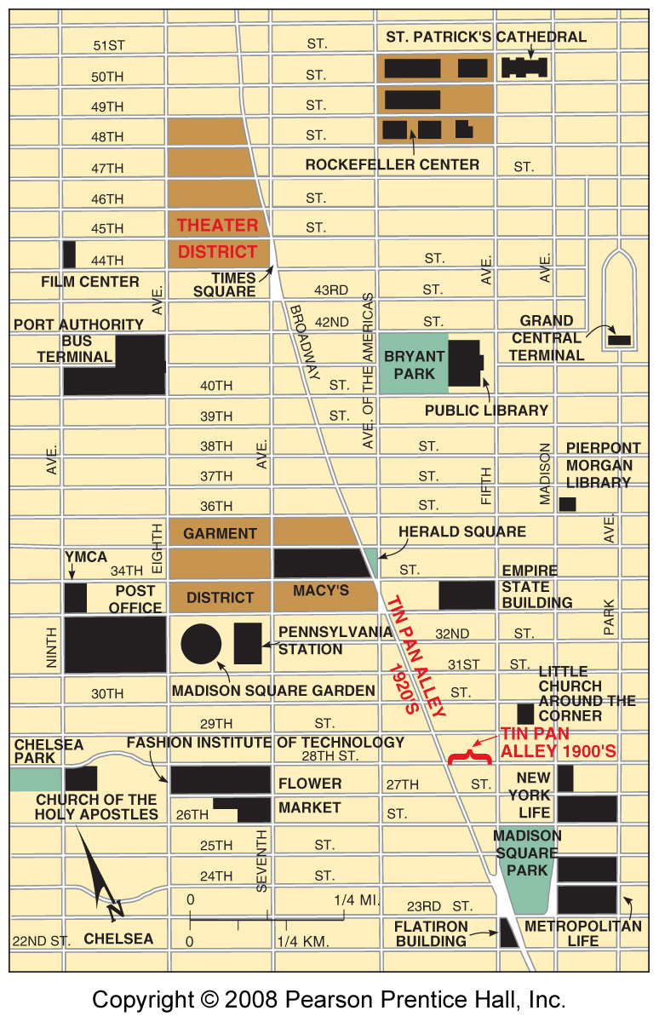
Tin Pan Alley & Popular Music p. 116
Fig. 4-1: Writers and publishers of popular music were clustered in Tin Pan Alley in New York in the early 20th c. The area later moved north from 28th St to Times Square.

Slide 5
Origin of Popular Music

Slide 6
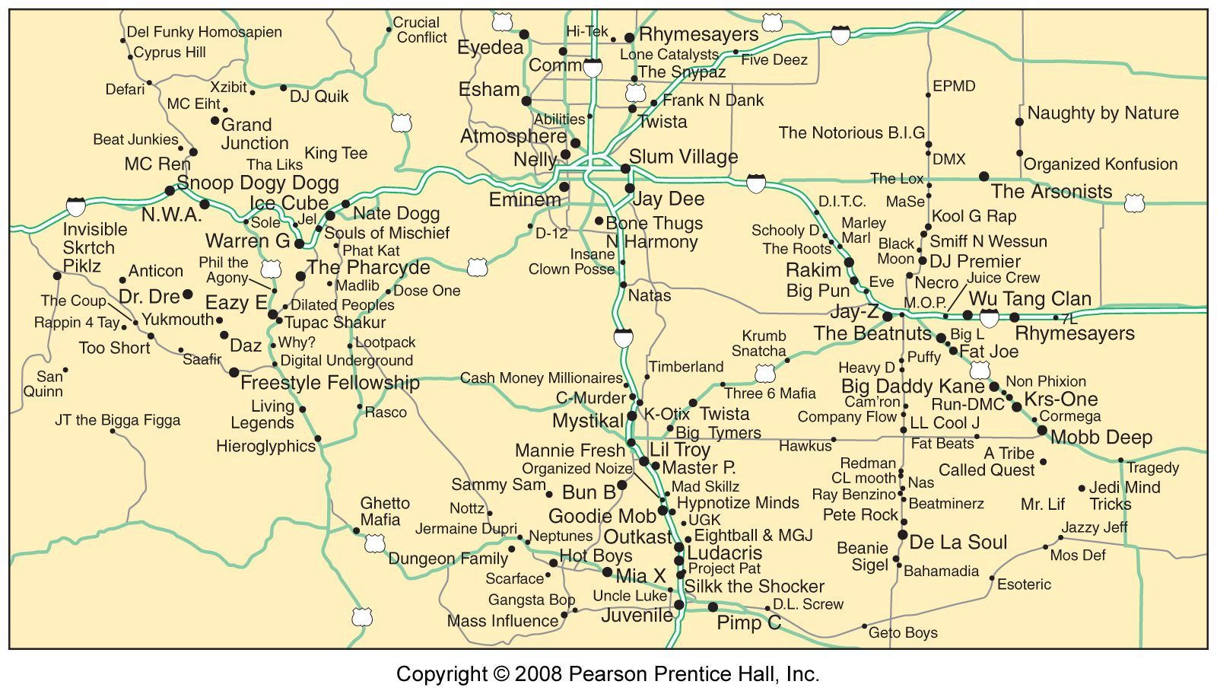
A Mental Map of Hip Hop
Fig. 4-2: This mental map places major hip hop performers near other similar performers and in the portion of the country where they performed.

Slide 7
Diffusion of Folk and Popular Cultures
The Amish: Relocation Diffusion of Folk Culture:

Slide 8
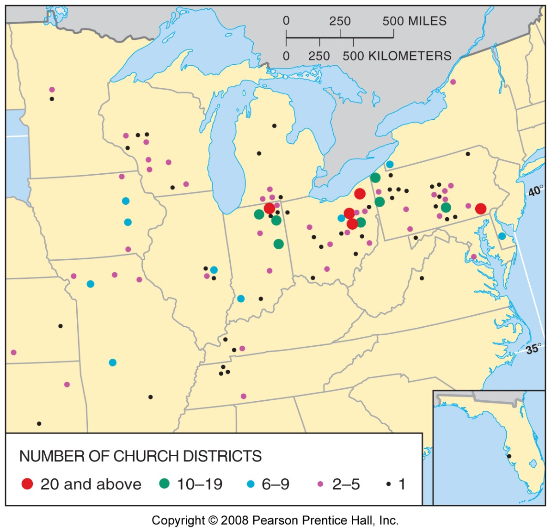
Amish Settlements in the U.S.
Fig. 4-3: Amish settlements are distributed through the northeast U.S.

Slide 9
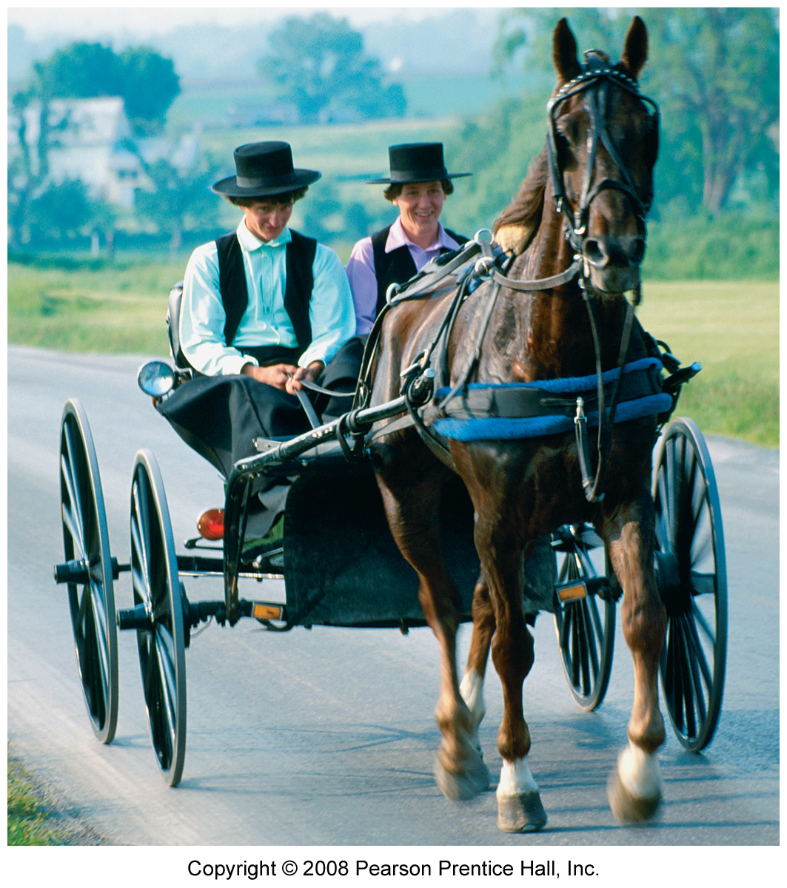
Notes:
Figure: 04-03r
Title:
Amish settlements are distributed throughout the northeastern United States.
Caption:
Amish buggies and motor vehicles must share the highway in the larger Amish settlements.

Slide 10
Sports: Hierarchical Diffusion of Popular Culture
Folk Culture Origin of Soccer:

Slide 11
Sports: Hierarchical Diffusion of Popular Culture
Globalization of Soccer:

Slide 12
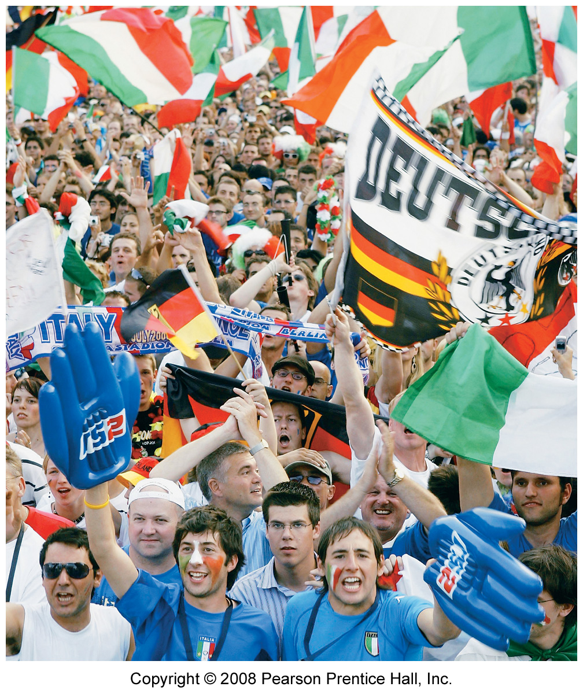
Notes:
Figure: 04-03-01UN
Title:
World Cup fans Germany 2006.
Caption:
French fans (foreground in blue), German fans (waving black, red, and yellow flags of Germany), and Italian fans (background waving green, white, and red flags of Italy) celebrate appearance of their teams in the world's most popular sporting event, the World Cup, played every four years, including in Germany in 2006. The Italian fans had the most to cheer: their team beat France to win the 2006 World Cup.

Slide 13
Sports: Hierarchical Diffusion of Popular Culture
Sports in Popular Culture

