Slide 1
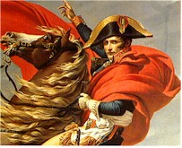
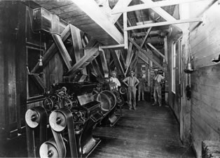
Chapter 23
Industrialization and Western Global Hegemony, 1750-1914

Slide 2
Forces of Change
Cultural:
  Enlightenment thinkers challenged regimes that did not grant religious freedom
    Call for popular government
    Jean-Jacques Rousseau calls for government based on general will
Economic:
  Businessmen, not just aristocrats gain new wealth
  New techniques to spur production clashes with old economic values

Slide 3

Forces of Change
Social:
  Population Revolution-
    Growing use of potato leads to better nutrition, which reduced death rate, and thus increased birth rate
    Population pressure pushes a lot of people into the working class (motive for protest)
    Proto-industrialization: full or part-time industrial workers working from home, but in a capitalist system (putting out system)
    Defiance of authority by youth, population upheaval and the spread of a property-less class fuels rebellion

Slide 4
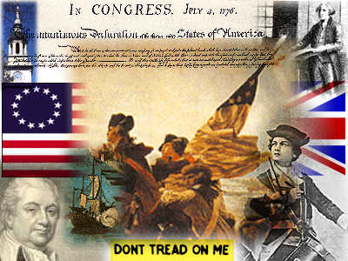
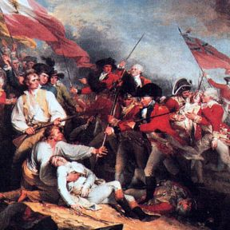
The American Revolution
“No Taxation without Representation!”
Declaration of Independence-1776
1789: new constitutional structure based on Enlightenment principles
  Checks and balances
  Formal guarantees of Civil
  Liberties

Slide 5
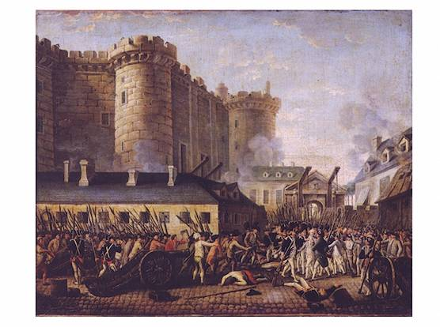
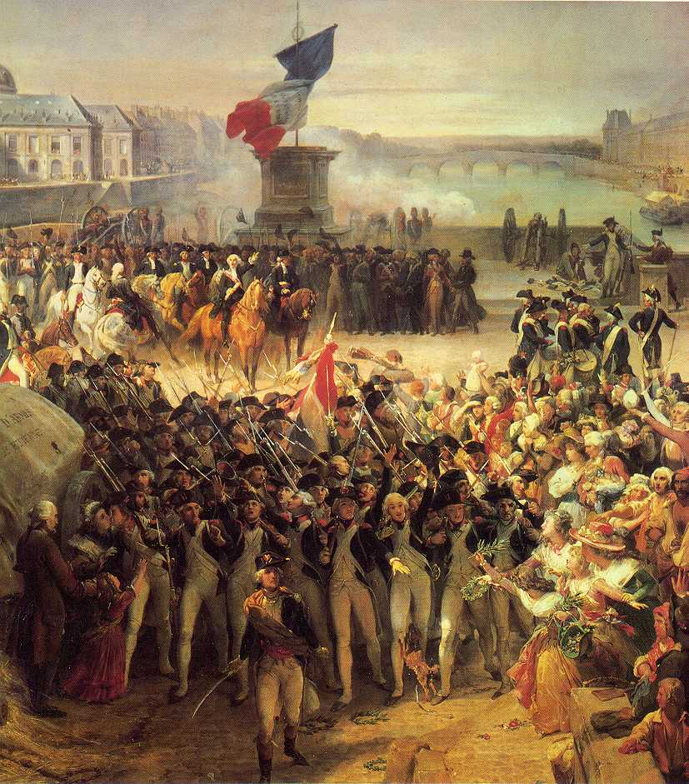
The French Revolution
Causes-typical example of causative change…
  Impact of Enlightenment thinkers on swaying ideological change
  Emerging middle-class desires greater political role
  Peasants want increased freedoms
  Government unable to reform, tightens grip on power
  1787-88: sharp economic slump from bad harvests

Slide 6
The French Revolution
Louis XVI summons the Estates General for tax-reform…
  Middle-class representatives (enlightenment ideals) want to turn body into a modern parliament.
  Declaration of the Rights of Man and the Citizen: enacted natural rights to “liberty, property, security, and resistance to oppression”
  July 14th, 1789: Storming of the Bastille-popular riot which becomes the symbol of the revolution

Slide 7
The French Revolution
Constitution of 1791
  Sets up a limited monarchy
  Proclaims individual rights-freedoms of religion, press, and property
  Places the church under state power
  Establishes a POWERFUL Legislative Assembly (parliamentary body)
  A moderate victory…the revolution could be over here, but…

Slide 8
The French Revolution-Radical
1792: Jacobins and other middle-class bourgeoisie push the revolution more towards radical change
  Civil war in France
  Intense opposition from Britain, Prussia, Austria-France moves towards war with Europe
Radicals abolish the monarchy
The guillotine decapitates Louis XVI and his wife, Marie Antoinette

Slide 9
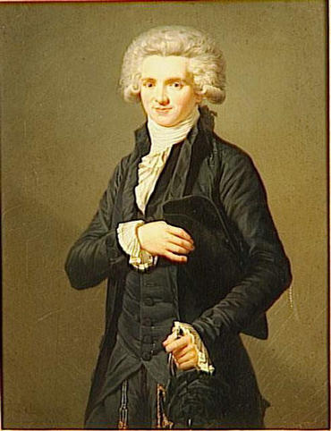
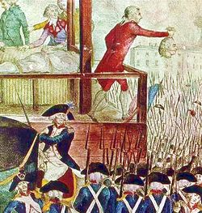
The French Revolution-Reign of Terror
Maximilien Robespierre-”the incorruptible”
  Leader of the radical days of revolution
  Worked to centralize the government by purging non-revolutionaries
  New constitution (not really practiced) proclaimed universal male suffrage
  The metric system
  Universal conscription
  A republic

Slide 10
The French Revolution-Reign of Terror
Popular spirit of NATIONALISM spread throughout the radical days of the revolution.
  First national anthem
  Nationalism could replace older loyalties to the church or locality
Robespierre is beheaded himself when he calls for another round-up of moderate leaders. Arrested, guillotined on the same day by the very people he carried to revolution.

Slide 11
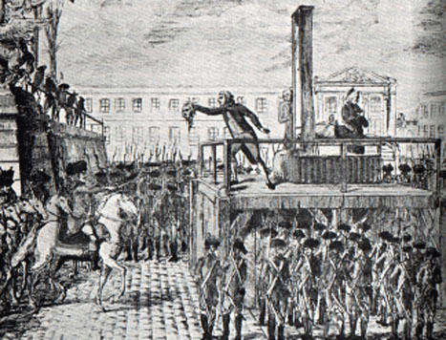
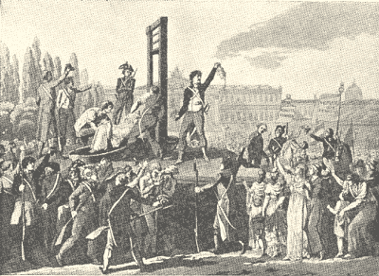
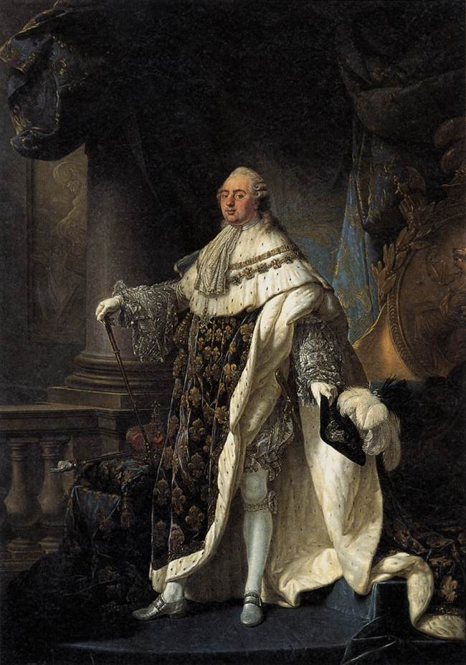
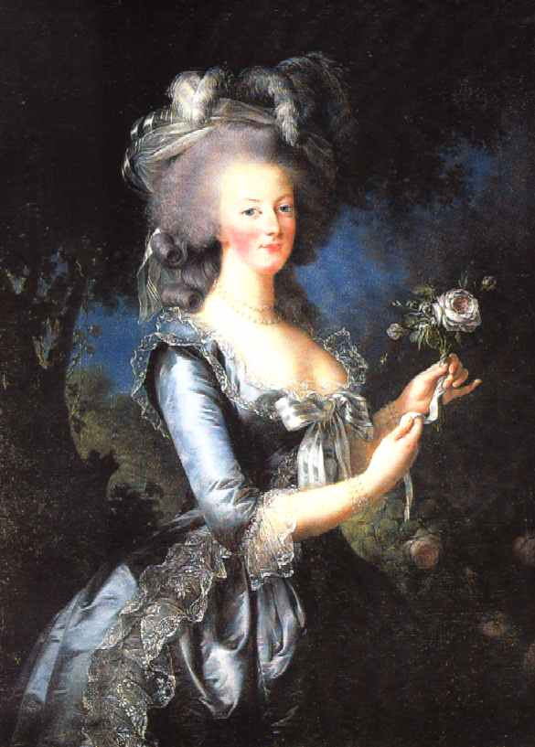
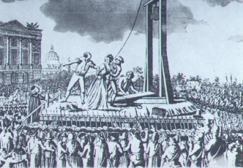

Slide 12
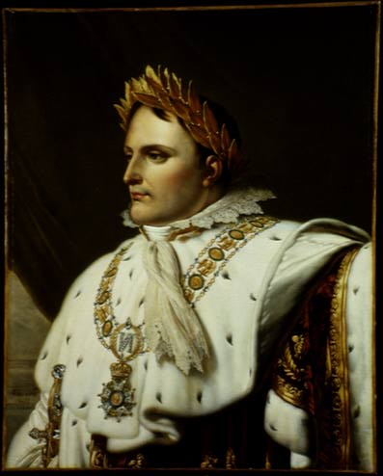
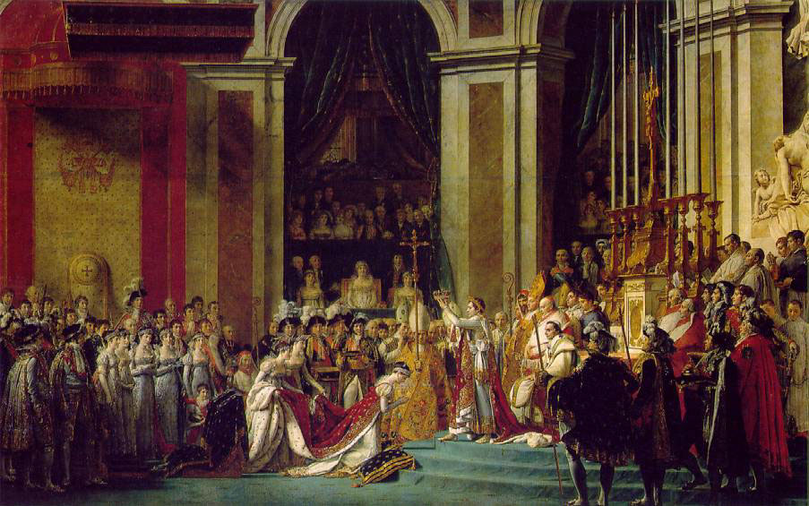
The French Revolution-backswing
The Directory: 5-man governing council, more moderate than Radical Days
1799-victory of Napoleon Bonaparte: a leading general who converted the revolutionary republic into an authoritarian empire.

Slide 13
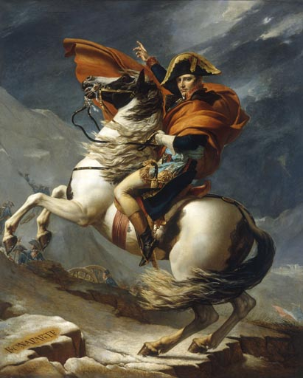
The French Revolution: Napoleon
Reduces role of Parliament
Police force limits freedom of expression
Liberal gains:
  Religious freedom
  Napoleonic Code of Law enacts equality of all men before the law
  Centralized schools and universities

Slide 14
The French Revolution: Napoleon and the French Empire
Insatiable ambition draws his attention to European expansion. France ends up at war with almost all of Europe, and Russia
1812: French Empire controls most of Western Europe
  The Russian campaign was a disaster
  Alliance system organized by Britain in 1814-1815
Napoleon’s Empire spread key revolutionary legislation…the idea of equality under law, and the attack on established institutions

Slide 15
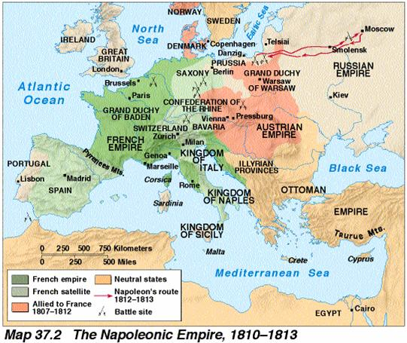
The French Revolution: The French Empire
The Revolution encourages widespread popular nationalism
French invasion made more people conscious of national loyalty…resistance to Napoleon caused final French defeat

Slide 16
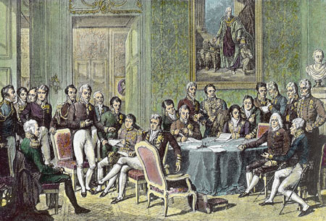
Congress of Vienna
Vienna, 1815:
  European balance of power should be restored
  Surround France with stronger nations
    Gains for Prussia, Britain, and Russia controlled Poland
  Restore Monarchy in France
  Dominated by conservatives, who were opposed to revolutionary change.

Slide 17
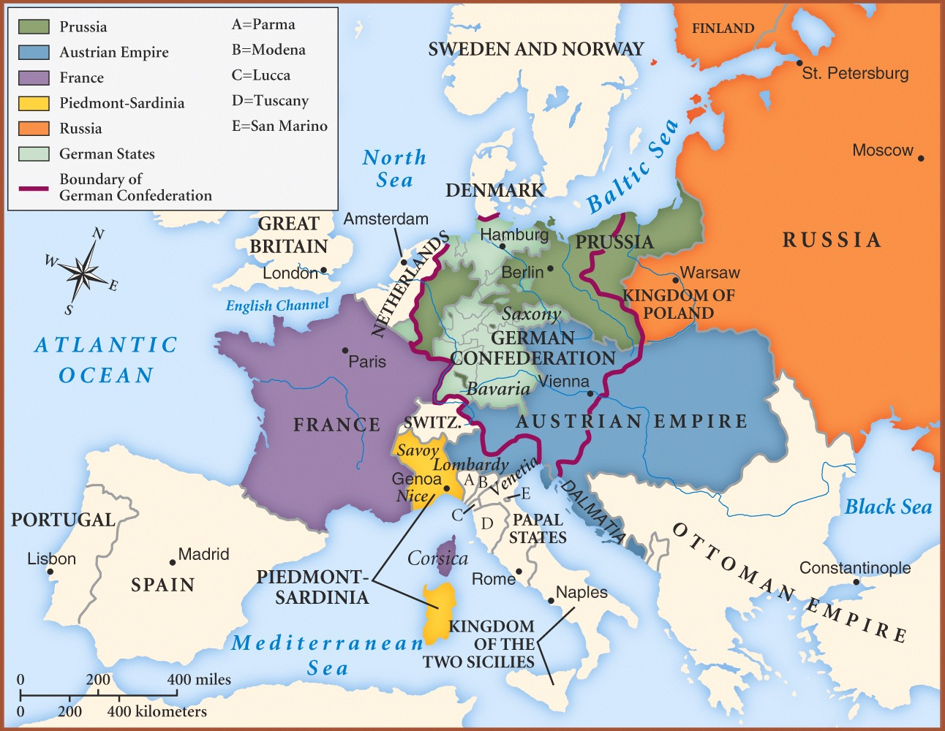

Slide 18
The Liberals
Look for ways to limit state interference in individual lives
Urged representation of propertied people in government
Importance of constitutional rule, protection of freedoms.
Represent the growing middle class

Slide 19
The Radicals
Wanted wider voting rights
Urge social reforms to benefit the lower classes.
Socialists launch political attack on private property in the name of equality…and end to capitalist exploitation of workers.
Nationalists urge the importance of national unity and glory.

Slide 20
Greek Revolution (and others)
1820 Greek revolt against Ottoman Rule-the beginning of the Ottoman End on the Balkan Peninsula.
1830 French Revolution II: more liberal monarchy
1830 Belgian Revolution: liberal regime

Slide 21
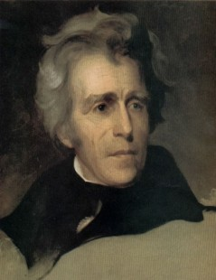
Other reforms/revolutions
US elects Andrew Jackson president in 1828
Britain Reform Bill of 1832 gives parliamentary vote to most middle-class men

Slide 22
1848
Most European nations and the US were fully invested in their Industrial Revolutions
  Unrest among factory workers
  Worry among artisans for the future of their craft
Chartist Movement: attempted to use the democratic process to regulate new technologies and promote popular education.
France, 1848-Monarchy is expelled, and democratic republic is established

Slide 23
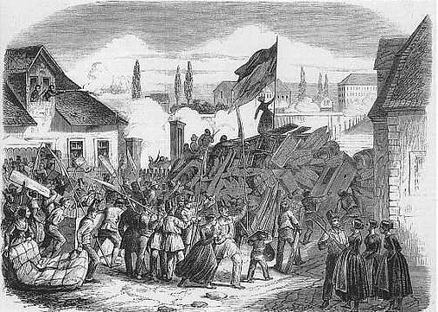
Revolution spread to Germany, Austria, Hungary.
Revolutions end quickly…
  Democracy in France for a little while, then Napoleon’s nephew replaces it.
Failures of 1848 revolutions draw the revolutionary age to a close

Slide 24
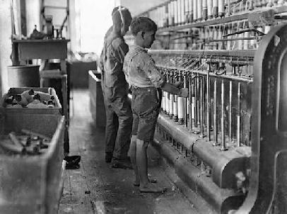
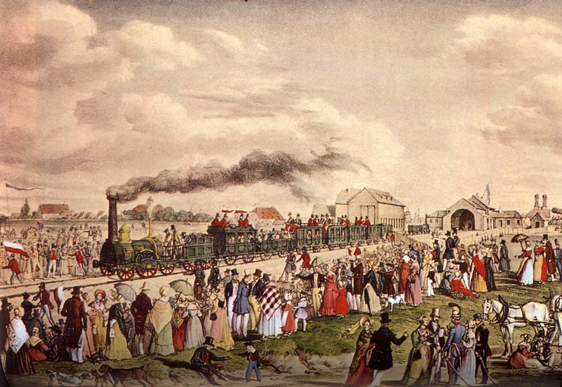
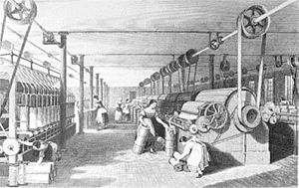
Industrialization-1850
Railroads and canals link cities across Europe encouraging industrialization
Urbanization continues
Sanitation improves
Death rates fall below birth rates.
More efficient police forces

Slide 25
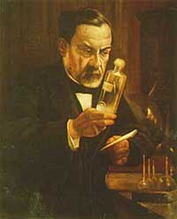
Industrialization-1850
2/3 Europeans lived above the subsistence level
Germ-Theory discovery by Louis Pasteur in 1880’s.
Corporations in Europe doubled between 1860-1873
Labor movements take shape amongst urban industrial workers

Slide 26
Political/social issues post-1848
Benjamin Disraeli: British conservative leader grants vote to working class men in 1867
Count Camillo di Cavour: Italian state of Piedmont, supported industrial development and extended parliamentary powers to satisfy liberals
Otto Von Bismarck: Prussian Prime Minister who worked to extend right to vote to all men.
Conservatives use nationalism to promote active foreign policy.

Slide 27
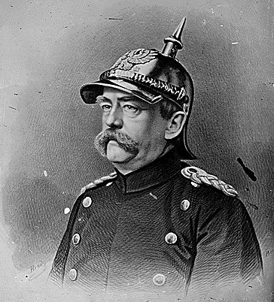
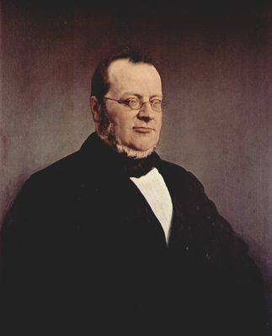
Italy and Germany
Cavour orchestrates a series of battles to consolidate an organized Italian state by 1861
Bismarck follows the example of Italy and uses his realpolitick policies and “blood and iron” to transform Prussian lands into a unified German Empire.

Slide 28
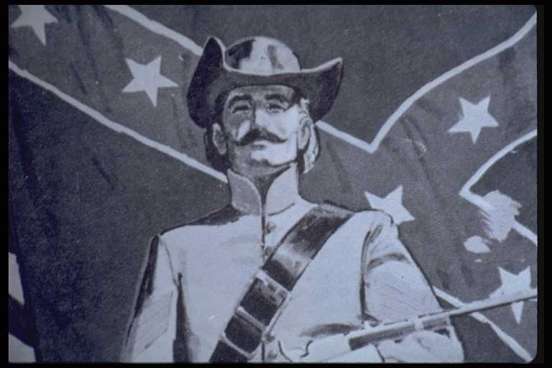
America and France…
American Civil War: 1861-1865; brought an end to the sectional differences between the north and south.
France overthrows the Napoleonic Echo Empire and establishes a conservative republic with universal male suffrage

Slide 29
Governmental Trends
Most western states had parliamentary governments by the 1870’s.
Civil Service Examinations were the standard
Government regulation increases
Schooling is expanded
Welfare measures increased
Constitutional crises are replaced by social issues

Slide 30
Socialism
Growth of socialism came about as a result of the grievances by the working class
Redefinition of Karl Marx’s theories
  Marx saw socialism as the final step in the inexorable march of history
  History is shaped by the availability of the means of production, and who owned them.
  Class struggle always pitted a group out of power with the group controlling the means of production.

Slide 31
Socialism
Who is the new class enemy?
  The property-less proletariat
    This class would grow uncontrollably until revolution was inevitable.
    The proletariat would win, forcing the old bourgeois order out, and…
    Transition to full freedom, where people would benefit equally from each others work. The state would cease to exist.

Slide 32
Socialism
Identified Capitalism’s evil
  Told workers that their low wages were unjust
  Revolution is inevitable-and necessary!
Germany takes the Socialist lead!
  Bismarck extends the vote throughout the 1870’s and 1880’s
  Socialist political parties capture the angst of the workers.
Western society feared socialism (red scare)

Slide 33
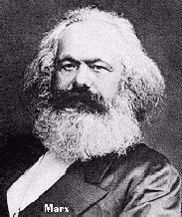
Socialism
Revisionism: revolution is not needed, but could be achieved through peaceful democratic means.

Slide 34
Feminism
By 1900, many feminist movements were active
  Sought equal access to jobs, equal pay, higher education, rights to vote (suffrage).
  Lots of support among middle class women (especially as family size declines)
Emmeline Pankhurst-radical feminist leader
  Worked for improvements in women’s property rights
  Formed a suffrage organization in 1903
  Planted a bomb in St. Paul’s cathedral…engaged in window smashing, arson, and hunger strikes.
  Participated in a huge strike in 1912

Slide 35
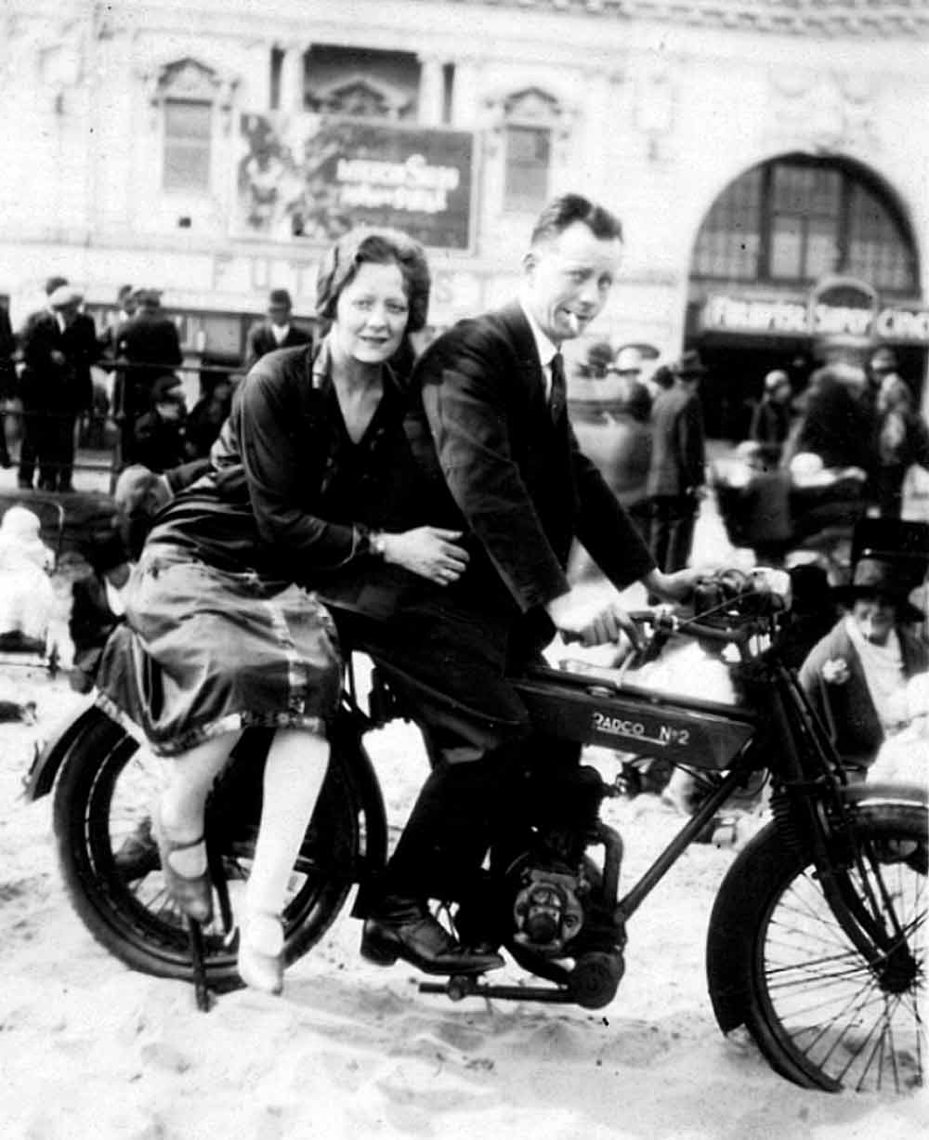
Western Mass-Culture
Middle class becomes more concerned with leisure as wages improve
Factories produce goods at such a rate that they must encourage mass consumption

Slide 36
Western Mass-Culture
Mass Leisure culture
  Popular newspapers
    Shock and entertainment more than appeal to reason
  Popular theater
  Comedy routines and musical revues
  Vacations (seaside resorts)
  Sports (Olympic games are reintroduced in 1896)
Growing secularism

Slide 37
Science
Charles Darwin in The Origin of the Species (1859) argues that all living species had evolved to its current form through the ability to adapt in a struggle for survival.
  Survival of the fittest
  Clashed with traditional Christian beliefs
Albert Einstein builds on Newton’s theories of Relativity.
Sigmund Freud argues that the human subconscious can be understood through rational discussion

Slide 38
Art
A sense of realism overtakes the artistic movements of the early 1800’s
  Charles Dickens portrays human problems trying to enact reform
  Building on scientific findings, Georges Seurat adopts pointillism based on research on how color interacts with our eyes
Romanticism: emotion and impression, not reason and generalization were the keys to human nature

Slide 39
Art: Romanticism
Portray passion, madness…not calm reflection
Move readers to tears, not debate
Painters saw empathy with natures beauties.
Post-Romanticism (after 1850) sought to deliberately violate traditional western standards
  Poetry didn’t need to rhyme
  Drama didn’t always have plot
  Painting was more evocative

Slide 40
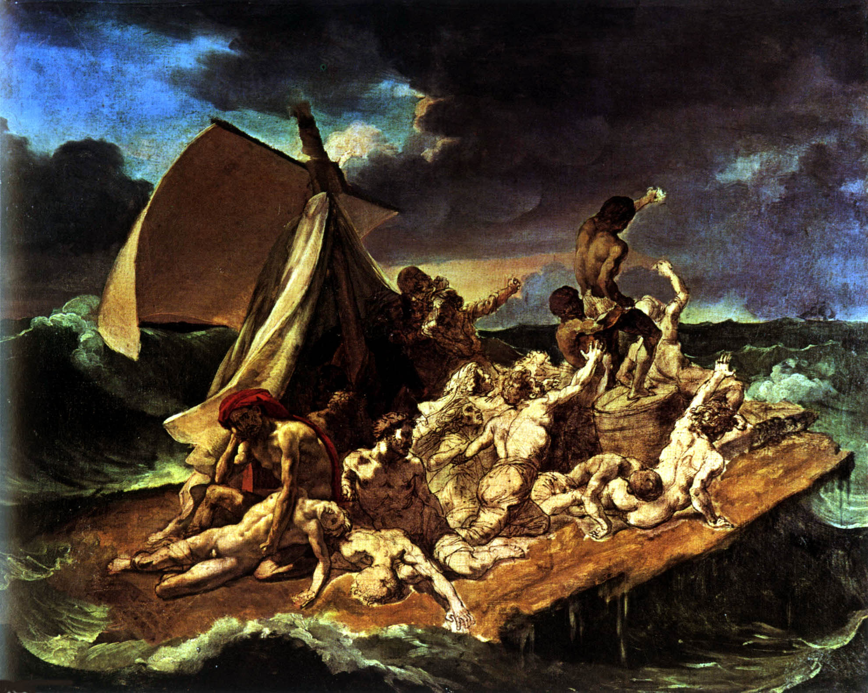
Gericault: “The Raft of the Medusa”

Slide 41
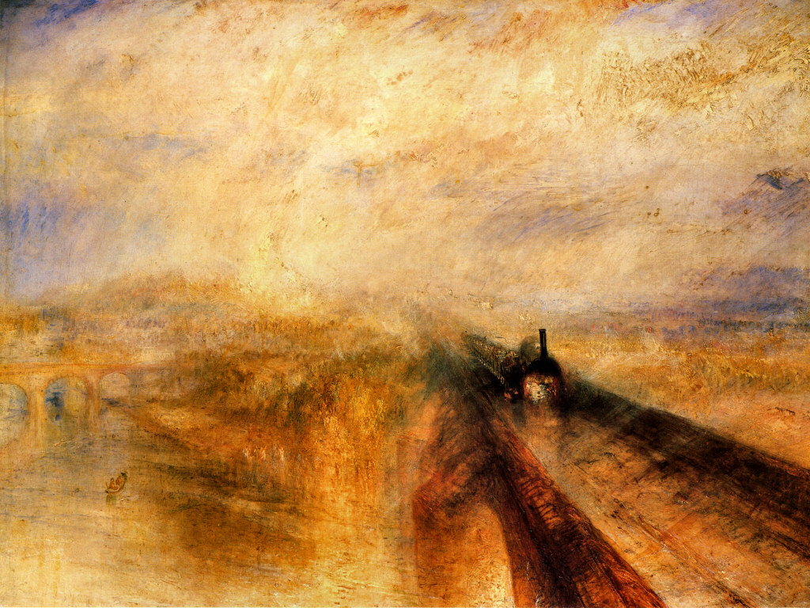
Turner, “Rain, Steam, and Speed”

Slide 42
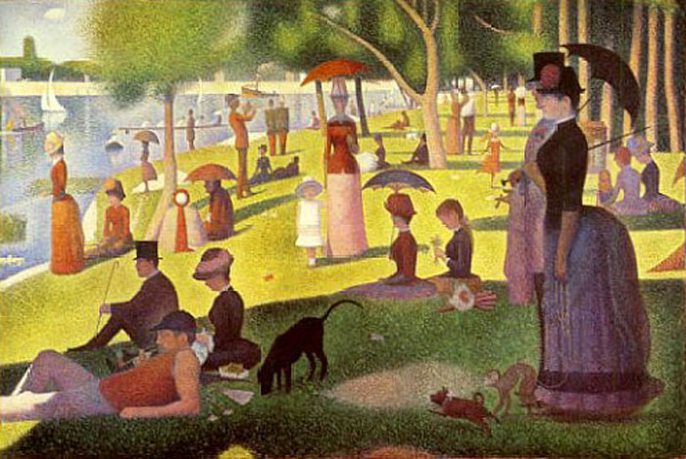
Seurat

Slide 43
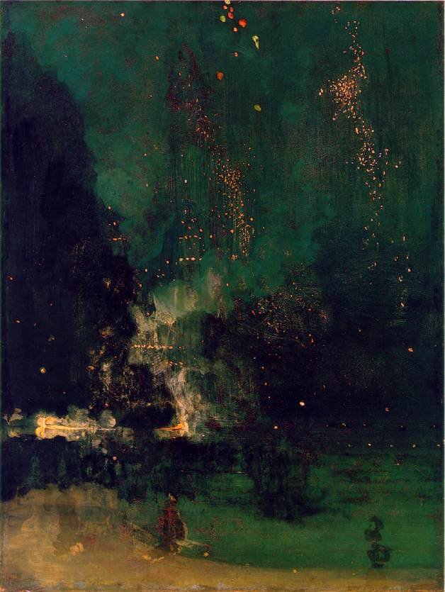
The Falling Rocket

Slide 44
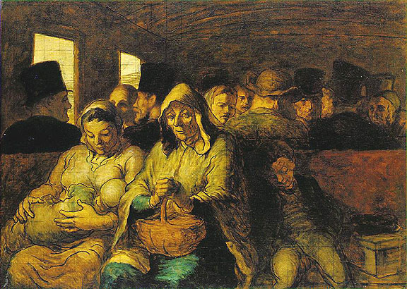
Daumier: Third Class Carriage

Slide 45
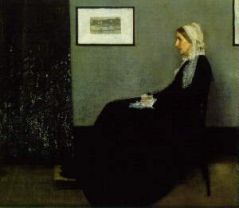
Whistler, “Arrangement in Gray and Black No. 1”

Slide 46
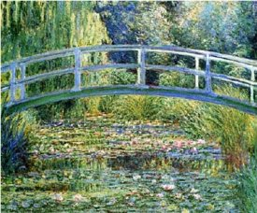
Monet (impressionism)

Slide 47
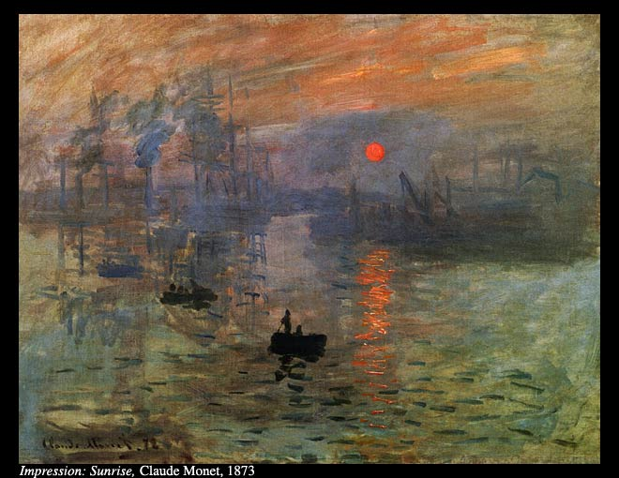
Monet

Slide 48
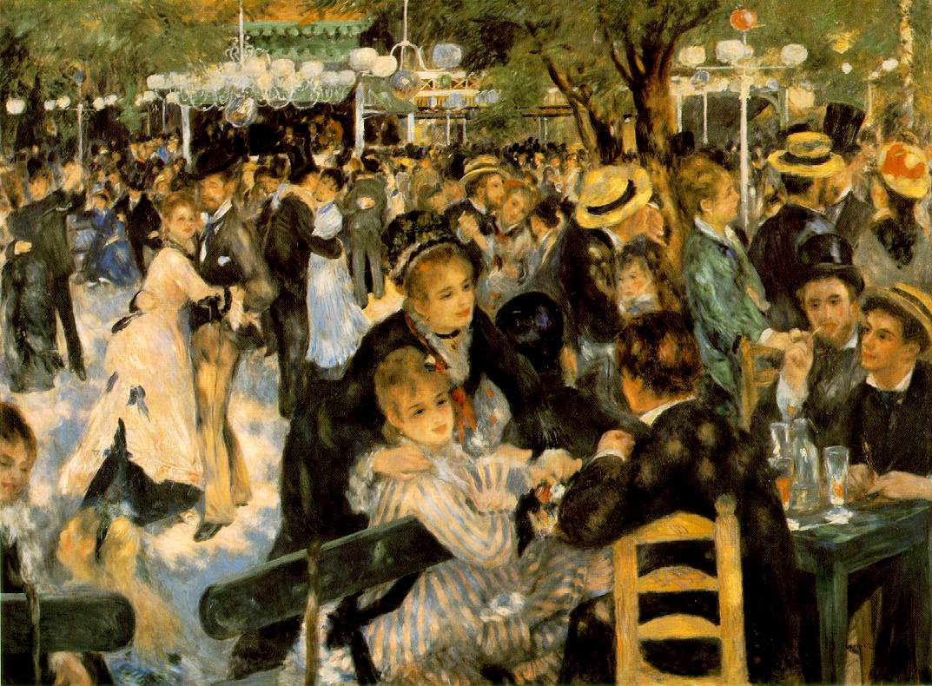
Renoir

Slide 49
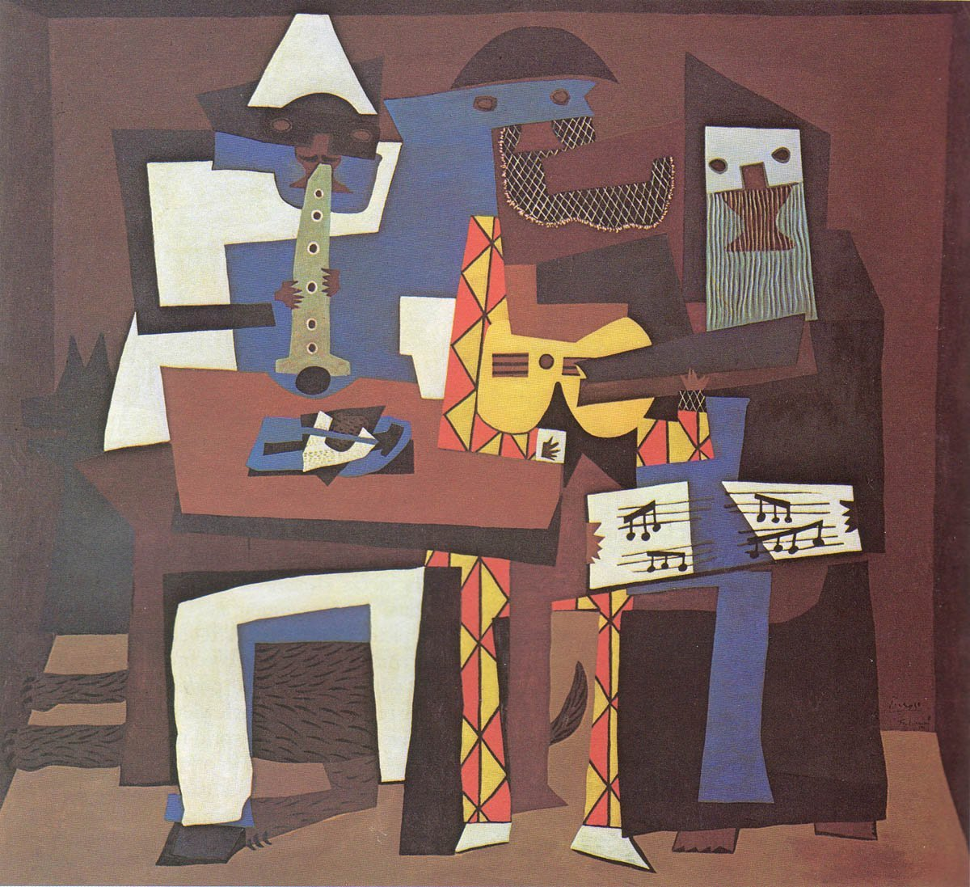
Picasso

Slide 50
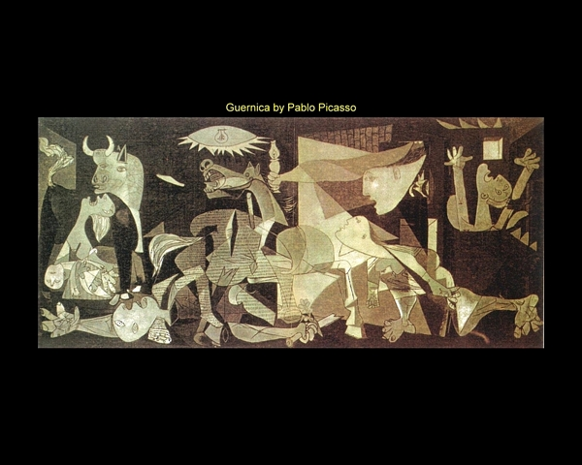
Picasso

Slide 51
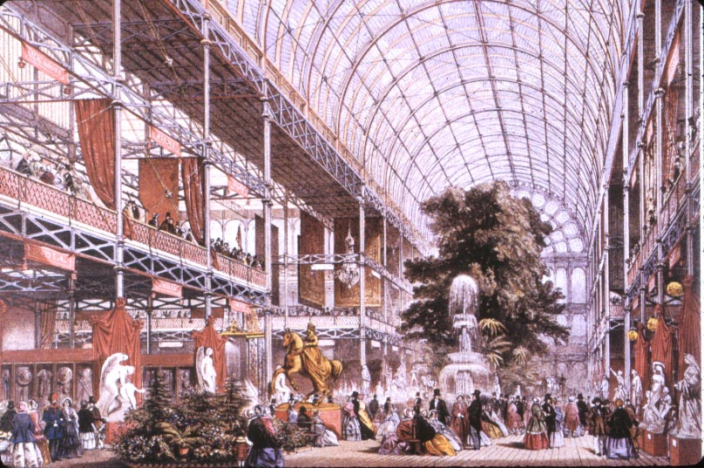
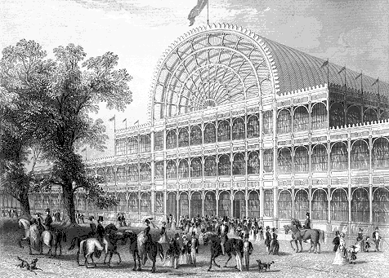
The Crystal Palace

Slide 52
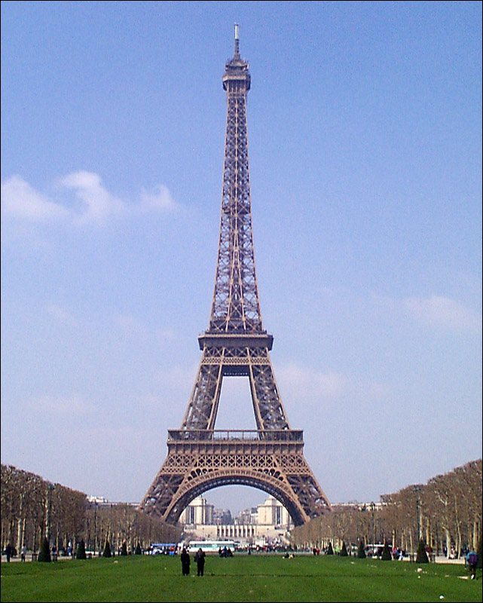
The Eiffel Tower

Slide 53
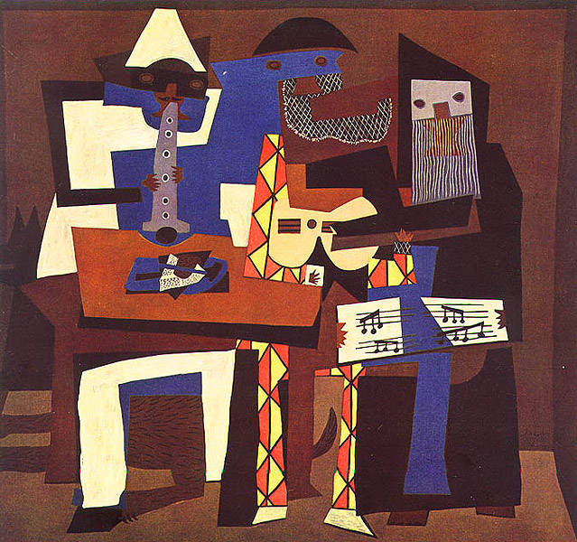
Art: Post-1900
Painters, sculptors, musicians were becoming increasingly abstract.

Slide 54
Western Settler Societies
Western powers pouring out tons of factory made goods needed new markets for sales, and raw materials.
Industrialization spurred western-led world economy, and the west’s military superiority.
  Steamships bring guns to more places
  Machine gun

Slide 55
Western Settler Societies
Reasons for European colonial competition:
  Nationalistic rivalry
  Business class sees new profit
  Missionaries see opportunity for conversion
Europeans emigrate throughout the world creating western settler societies across the globe

Slide 56
The Emerging United States
Monroe Doctrine (1823) warns against European colonization
Louisiana Purchase, acquisition of Texas, and California Gold Rush extends the US (manifest Destiny)
German and Irish immigration in 1840’s.

Slide 57
The US Civil War
1861-1865
  Industrial North vs. Agricultural slaveholding South.
  The south tried secession, and the north opposes, favoring national unity and an end to slavery
  Accelerated industrialization for the war effort.
  America becomes a major competitor worldwide after the civil war
  America was not a large contributor towards art, music, science, culture until after WWI

Slide 58
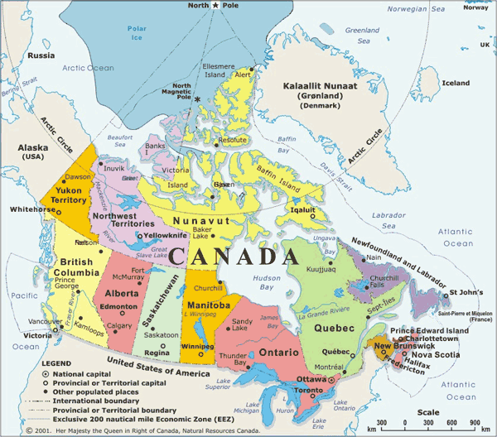
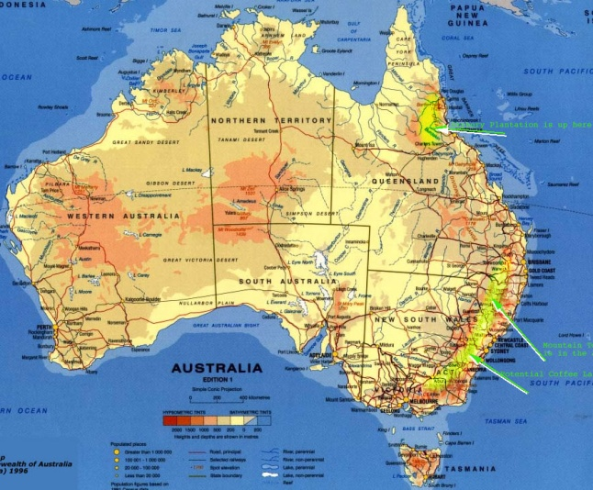
Canada, Australia, New Zealand
Immigrants from Europe set up Parliamentary legislatures and commercial economies often without regard to indigenous populations.
  Followed western cultural patterns.
  Part of the British empire, but with perceived autonomy

Slide 59
Canada
Won by the British from the French in 18th C.
Determined not to lose this colony (as it did with the US), the British grants increasing self-rule in 1839.
  Its own parliament and laws, but still attached to the British Empire.
Hostility between French Catholic Settlers and British settlers were solved somewhat by setting up Quebec, where the majority of French speaking citizens are located.
Railroads connect Canada to the west as it experiences large influx of southern and eastern European immigrants.

Slide 60
Australia
British colony since 1788 as a penal colony
The only other inhabitants were the aborigines.
Exportation of convicts ended in 1853
Population reaches 1 million by 1861
A unified federal government was proclaimed on the first day of the 20th century.
Industrialization, socialism, and a welfare state had already began to grow

Slide 61
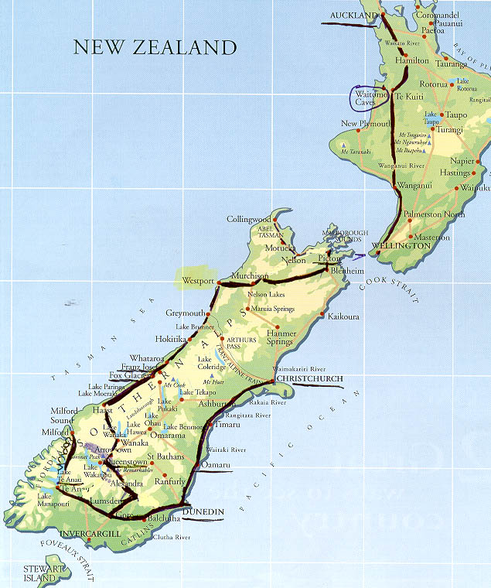
New Zealand
Receives British attention after 1814
  Maoris are converted to Christianity
  British take formal control in 1840; European immigration follows
Wars with the Maoris plague the 1860’s, but defeat was inevitable and relations improve afterwards. Some Maoris win parliamentary positions in New Zealand.

Slide 62
Diplomatic Tension
Unification of Germany alters the balance of power in Europe.
By 1900 there are few areas of the world left for colonization
  Latin America was independent (US influence)
  Africa was basically carved up
  The final lands available were the subject of increased furor by colonizing nations (Morocco, Tripoli (Libya))

Slide 63
Diplomatic Tension
Imperialist expansion causes rivalry
  Britain is concerned about Germany’s advances (navy)
  France was in constant worry about Germany
Alliance Systems
  Triple Alliance: Germany, Austria-Hungary, Italy
  Triple Entente: Britain, Russia, France
  Germany becomes worried about an east-west battle
Arms Race

Slide 64
Diplomatic Tension
Russia suffers from a revolution in 1905
Austria-Hungary is plagued by minority Slavic groups asserting their nationalism.
Balkan nations won their independence from the Ottomans throughout the 19th century. Balkan nationalism was a threat to Austria, with a large southern Slav population.
Austria grew nervous over Serbian gains in 1912-1913.

Slide 65
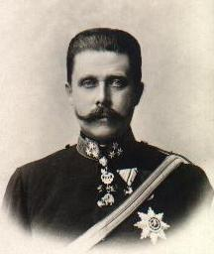
Diplomatic Tension
With the assassination of Austrian Archduke Franz Ferdinand by a Serbian Nationalist, the Balkan Peninsula is thrown into chaos.
The Alliance System is activated, and World War I was born

Slide 66
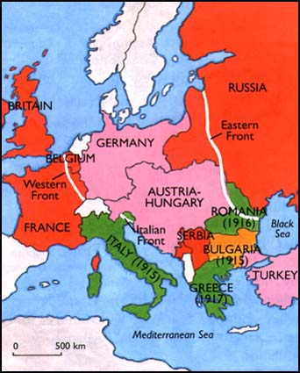
WAR!!!
Leaders depended on military buildup for economic purposes
Mass Newspapers fanned national pride
  Stories of conquest
  Tales of evil rival nations
War was seen as exciting, with quick victories
  Enthusiastic civilians
Within a couple of years, this attitude would change…drastically.

