Slide 1

Introduction to of mice and men
Notes to Guide your Understanding

Slide 2
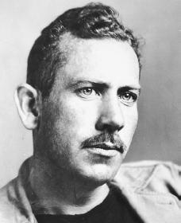

John Steinbeck
Born in Salinas California in 1902-1968
During the summers growing up, he worked as a hired hand on nearby ranches
Attended Stanford as an English major, but left to pursue his writing career

Slide 3
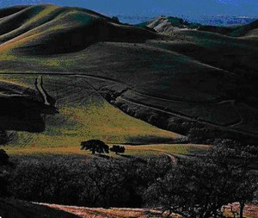
Life Continued…
Steinbeck's first three novels went unnoticed, but his humorous tale, Tortilla Flat (1935), was the turning point in his career
Grapes of Wrath (1939) won the Pulitzer Prize
During WWII, he was a correspondent for the NY Herald

Slide 4
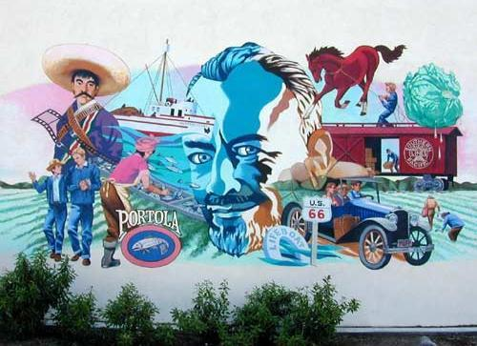
Continued…
Winner of the Nobel Prize in 1962 and was a leading writer of novels about the working class and was a major spokesman for the victims of the Great Depression
Was a private person who shunned publicity
Died 1968 (survived by his third wife (Elaine Scott), and son, Thomas)

Slide 5
Facts
Novel was written fast with very few changes made to it after the first draft
Novel is a microcosm- close up look at a large migrant community
Steinbeck gave names and faces to the otherwise “nameless victims”

Slide 6
Banned Book Alert!- no notes
Since its publication in 1937, Of Mice and Men has been one of America’s most challenged books
The novel was the second most frequently banned book in the 1990’s. It has been called “vulgar”, “offensive”, “blasphemous”, and “racist”
Steinbeck’s use of the words: “Jesus Christ”, “God”, and “N*****” have triggered many of the complaints
The nature of the central conflict and moral issue in the novel challenges society’s notion of murder and justice

Slide 7
Play-Like Reading- No notes
Written as a “play-novel”, or a cross between a novel and drama
  Every chapter opens with a description of the scene
  Each chapters the characters enter and exit the scene
  Large amount of dialogue
  Few characters in the novel
  Language is simple

Slide 8
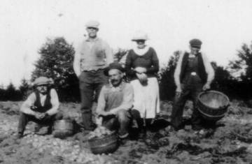
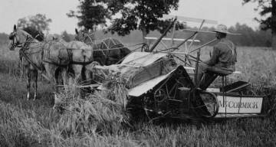
Historical context- no notes
The 1920’s and 1930’s brought challenges to many American Farmers
  After WWII, a recession led to a drop in crop prices= more product to make end’s meat
  Many farmers lost their jobs
  California had a 30% unemployment rate

Slide 9
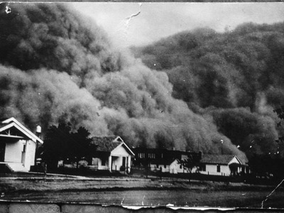
Feeling the economical strain- no notes
Increase in farming activity put a strain on the land + no conservation practices + 7 year drought in 1931 + dust storms in 1932 = “Dust Bowl” where farms literally dried away

Slide 10
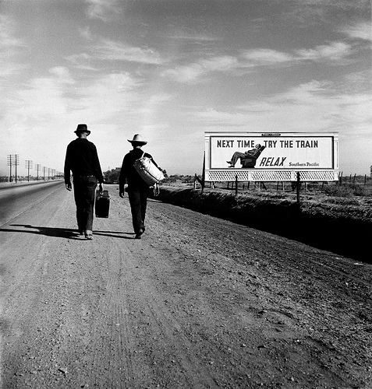
Early Californian migrant farmers- no notes
Thousands of farmers moved to California to find work due to nice climate
  Called “the promise land” by farmers
“Route 66” was formed, which provided a direct route to the south of the central valley

Slide 11
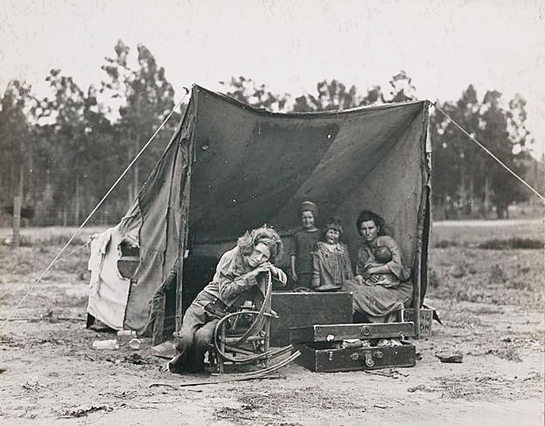
California- no notes
But California also had its problems
  Depression
  Overburdened with migrants- too many workers, not enough jobs
  Wages lowered (migrants could not support their families)
  Camps set up along ditches
To maintain a steady living, migrants had to follow the harvest around the state

Slide 12
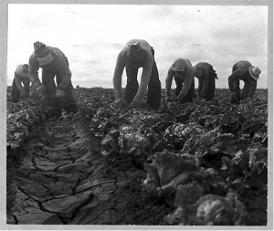
Salinas…one of these places
Produced artichokes, lettuce, strawberries and wine grapes
Features that make it ideal for farming: agricultural valley, Pacific Ocean, protected by mountains, Salinas River runs through the valley

Slide 13
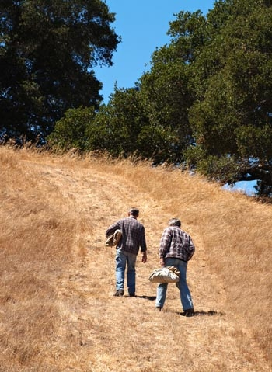
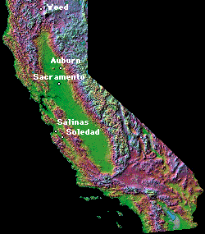
Pic of setting in book (map)

Slide 14
