Slide 1
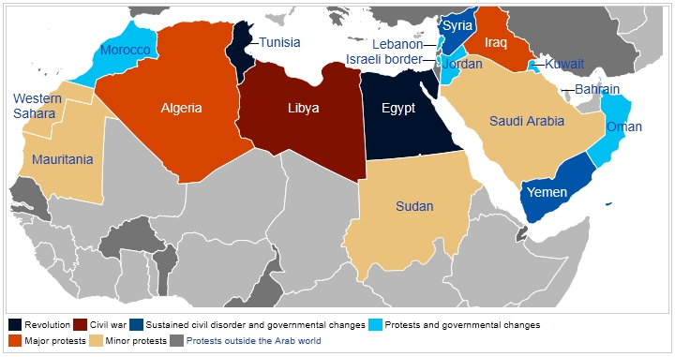
Warm Up
List everything you know about the Arab Spring? Why would the U.S. be interested in the Arab Spring?

Slide 2
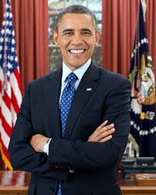
Barack Obama
2009-Present
(Democrat)

Slide 3
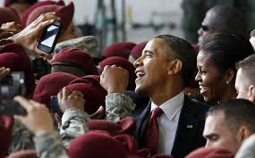
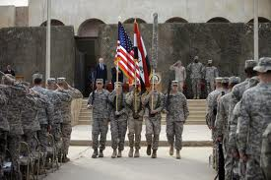
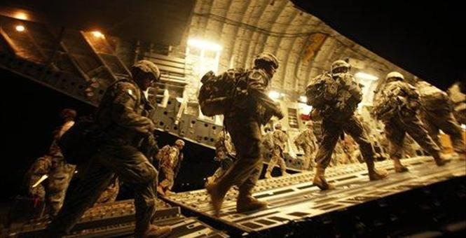
End of the War in Iraq (Now being called “Operation New Dawn”)
The U.S. completed its withdrawal of military personnel in December 2011. However, the Iraqi insurgency continues and caused thousands of fatalities in 2012.

Slide 4
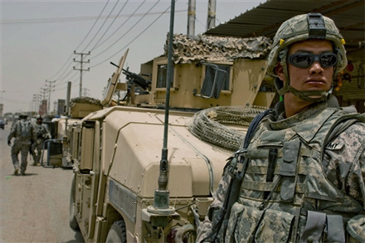
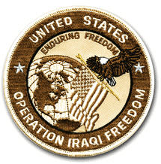
In late February 2009, newly elected U.S. President Barack Obama announced an 18-month withdrawal window for combat forces, with approximately 50,000 troops remaining in the country "to advise and train Iraqi security forces and to provide intelligence and surveillance". UK forces ended combat operations on 30 April 2009. Operation Iraqi Freedom is over, and the Iraqi people now have lead responsibility for the security of their country." Beginning 1 September 2010, the American operational name for its involvement in Iraq changed from "Operation Iraqi Freedom" to "Operation New Dawn".

Slide 5
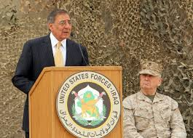
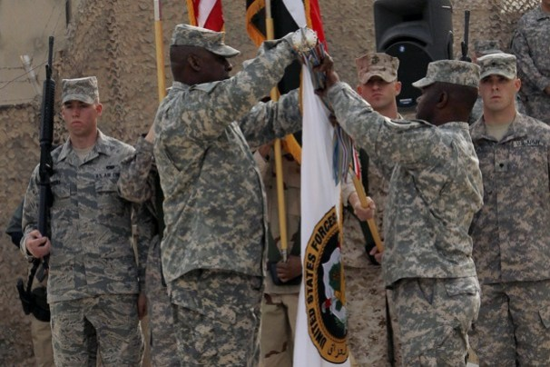
On 21 October 2011, President Obama announced that all U.S. troops and trainers would leave Iraq by the end of the year, bringing the U.S. mission in Iraq to an end. On 15 December 2011, U.S. Defense Secretary Leon Panetta officially declared the Iraq War over, at a flag lowering ceremony in Baghdad. The last U.S. troops left Iraqi territory on 18 December 2011 at 4:27 UTC.

Slide 6
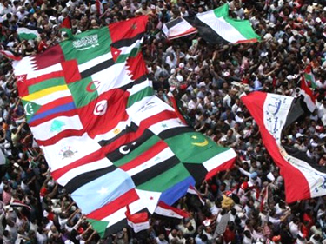
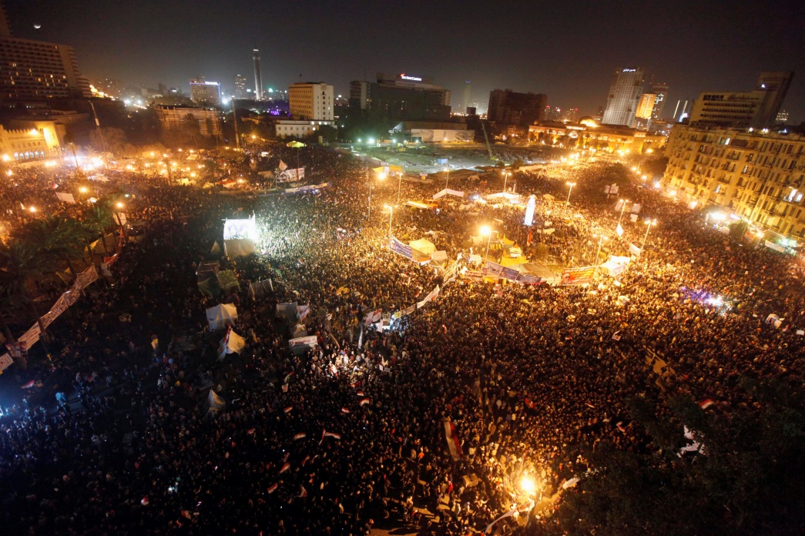
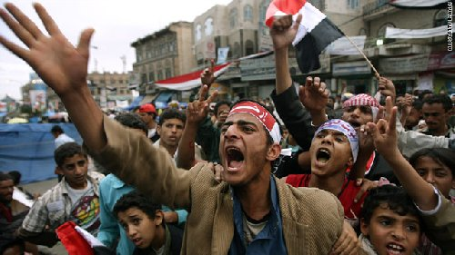
Arab Spring - is a term for the revolutionary wave of demonstrations and protests (both non-violent and violent), riots, and civil wars in the Arab world that began on 18 December 2010.

Slide 7
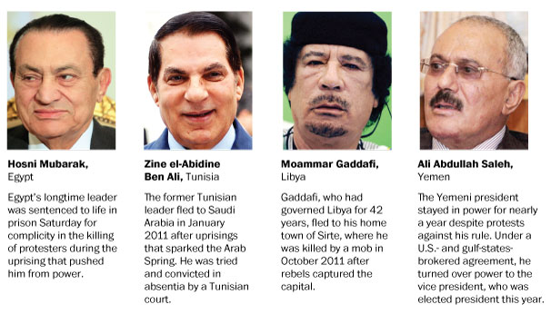
To date, rulers have been forced from power in Tunisia, Egypt (twice), Libya, and Yemen; civil uprisings have erupted in Bahrain and Syria; major protests have broken out in Algeria, Iraq, Jordan, Kuwait, Morocco, and Sudan; and minor protests have occurred in Mauritania, Oman, Saudi Arabia, Djibouti, Western Sahara, and the Palestinian Authority.
Protests in many countries affected by the Arab Spring have attracted widespread support from the international community, while harsh government responses have generally met condemnation.
Arab Leaders who have been overthrown. →

Slide 8
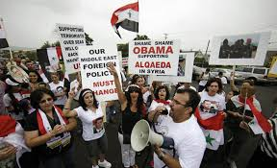
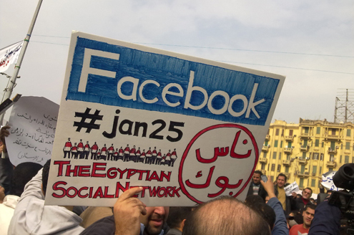
Some critics have accused Western governments and media, including those of France, the United Kingdom, and the United States, of hypocrisy in the way they have reacted to the Arab Spring. Noam Chomsky accused the Obama administration of endeavoring to muffle the revolutionary wave and stifle popular democratization efforts in the Middle East. Social Media has played a major role in the revolutions.

Slide 9
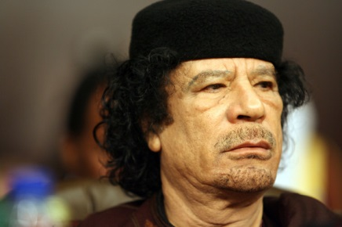
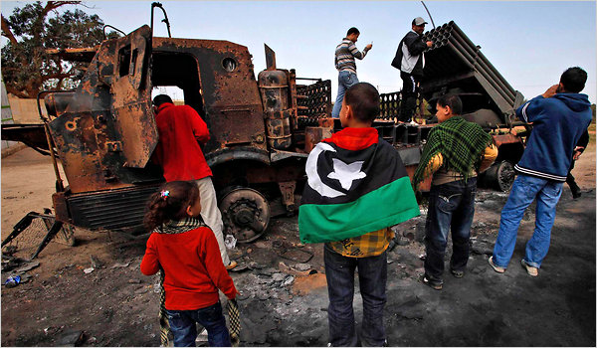
War in Libya - In March 2011, as forces loyal to Muammar Gaddafi advanced on rebels across Libya, calls for a no-fly zone came from around the world, including Europe, the Arab League, and a resolution passed unanimously by the U.S. Senate. In response to the unanimous passage of United Nations Security Council Resolution 1973 on March 17, Gaddafi—who had previously vowed to "show no mercy" to the rebels of Benghazi—announced an immediate cessation of military activities, yet reports came in that his forces continued shelling Misrata.

Slide 10
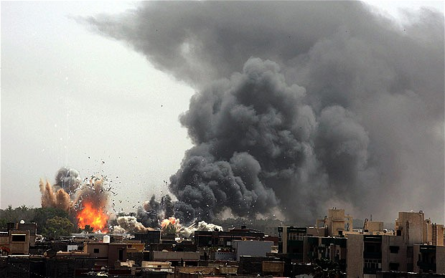
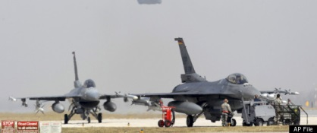
The next day, on Obama's orders, the U.S. military took part in air strikes to destroy the Libyan government's air defense capabilities to protect civilians and enforce a no-fly-zone, including the use of Tomahawk missiles, B-2 Spirits, and fighter jets. Six days later, on March 25, by unanimous vote of all of its 28 members, NATO took over leadership of the effort, dubbed Operation Unified Protector. Some Representatives questioned whether Obama had the constitutional authority to order military action in addition to questioning its cost, structure and aftermath.

Slide 11
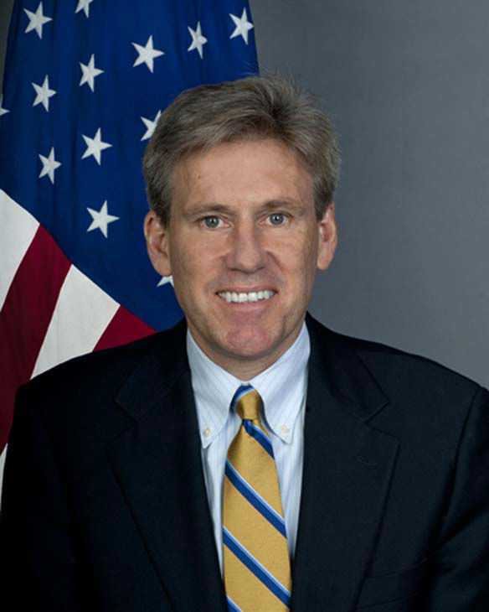
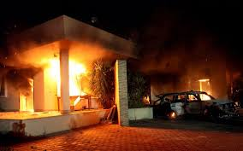
American Embassy Attacked in Libya - US relations with the new Libyan government were thrust into the spotlight on September 11, 2012 when gunmen attacked and firebombed the US liaison office/mission in Benghazi, killing 4 Americans including Ambassador J. Christopher Stevens. Libya's interim leader Mohammed Magarief quickly condemned the attack and apologized to the US, describing it as "cowardly" and pledging to bring the killers to justice.

Slide 12
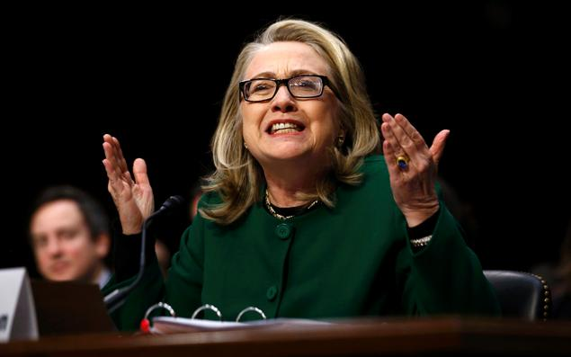
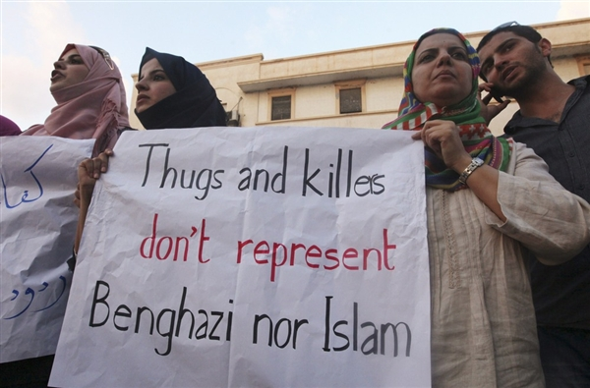
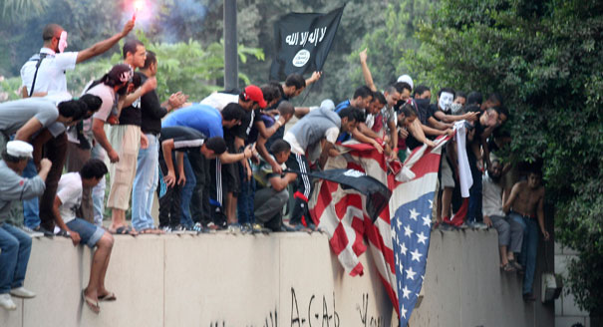
Demonstrations denouncing the attack and supporting the United States were held in Benghazi the next day, with protesters mourning Stevens and signs declaring him 'a friend to all Libyans'. Libya cooperated with the US to investigate the attack, closing Benghazi's airspace for several hours to allow US drone patrols over the city on September 14. Controversy surrounded how much the White House administration knew about the social unrest in Libya that lead to American deaths. Secretary of State Hilary Clinton was questioned before committee regarding the situation.

Slide 13
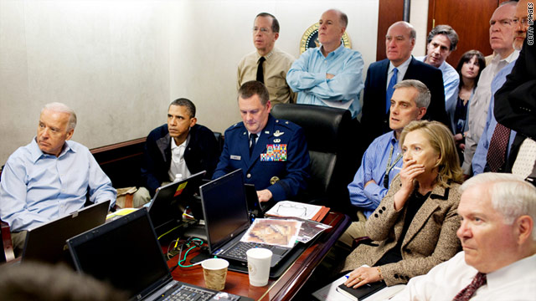
Osama bin Laden Death- Starting with information received in July 2010, intelligence developed by the CIA over the next several months determined what they believed to be the location of Osama bin Laden in a large compound in Pakistan. Meeting with his national security advisers over the course of the next six weeks, Obama rejected a plan to bomb the compound, and authorized a "surgical raid" to be conducted by United States Navy SEALs.

Slide 14
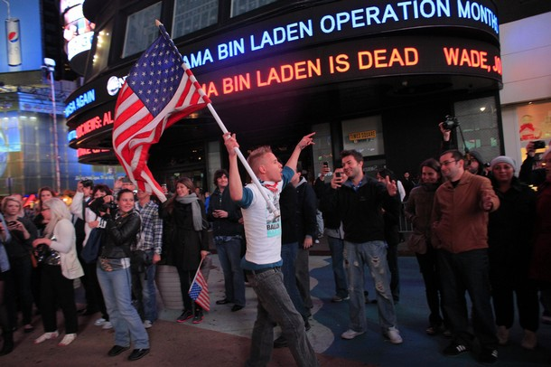
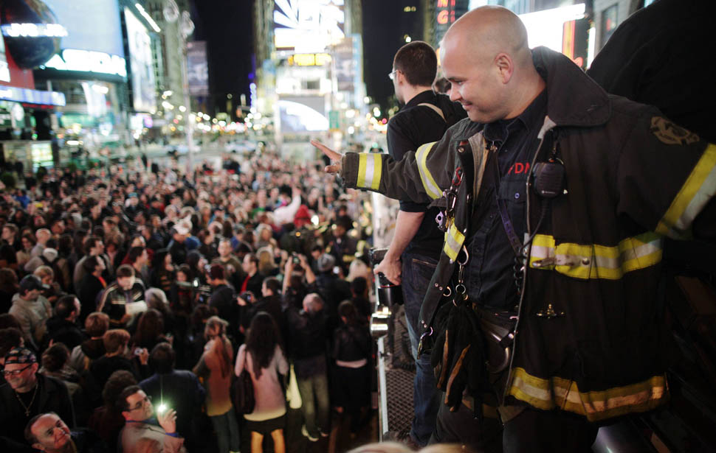
The operation took place on May 1, 2011, resulting in the death of bin Laden and the seizure of papers, computer drives and disks from the compound. DNA testing identified bin Laden's body, which was buried at sea several hours later. Within minutes of the President's announcement from Washington, DC, late in the evening on May 1, there were spontaneous celebrations around the country as crowds gathered outside the White House, and at New York City's Ground Zero and Times Square. Reaction to the announcement was positive across party lines, including from former presidents Bill Clinton and George W. Bush, and from many countries around the world.

