Slide 1
What is Ecology?
Ch. 24 – 1
EQ: What is the connection between the Biome and the individual?

Slide 2
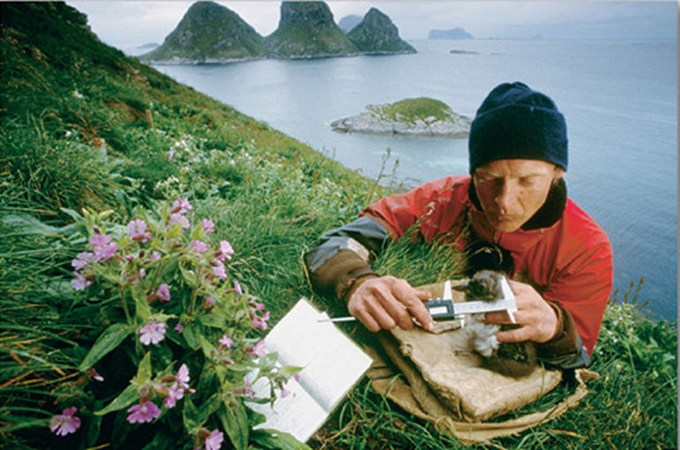
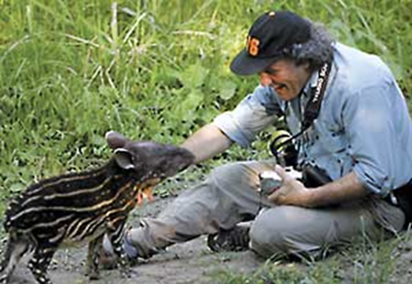
What is Ecology?
    Ecology - is the scientific study of interactions among organisms and between organisms and their environment, or surroundings.

Slide 3
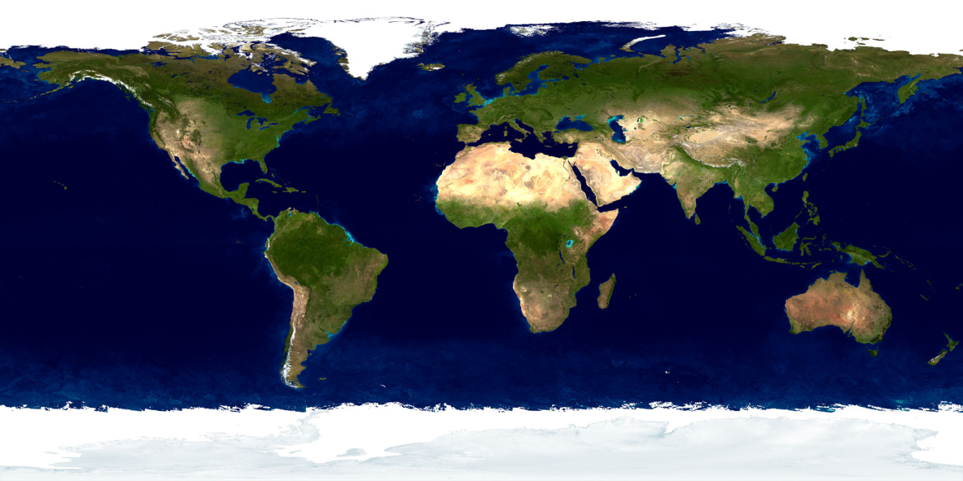
Where do we study Ecology?
The biosphere contains the combined portions of the planet in which all of life exists, including
  Land
  Water
  Air, or atmosphere

Slide 4
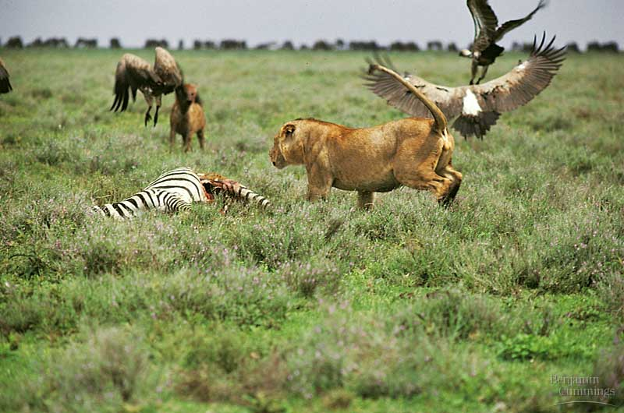
Levels of Organization
To understand relationships in the biosphere, ecologist ask questions about events and organisms that range in complexity from a single organism to the entire biosphere.
The levels of organization are:
  Individuals
  Populations
  Communities
  Ecosystems
  Biomes

Slide 5
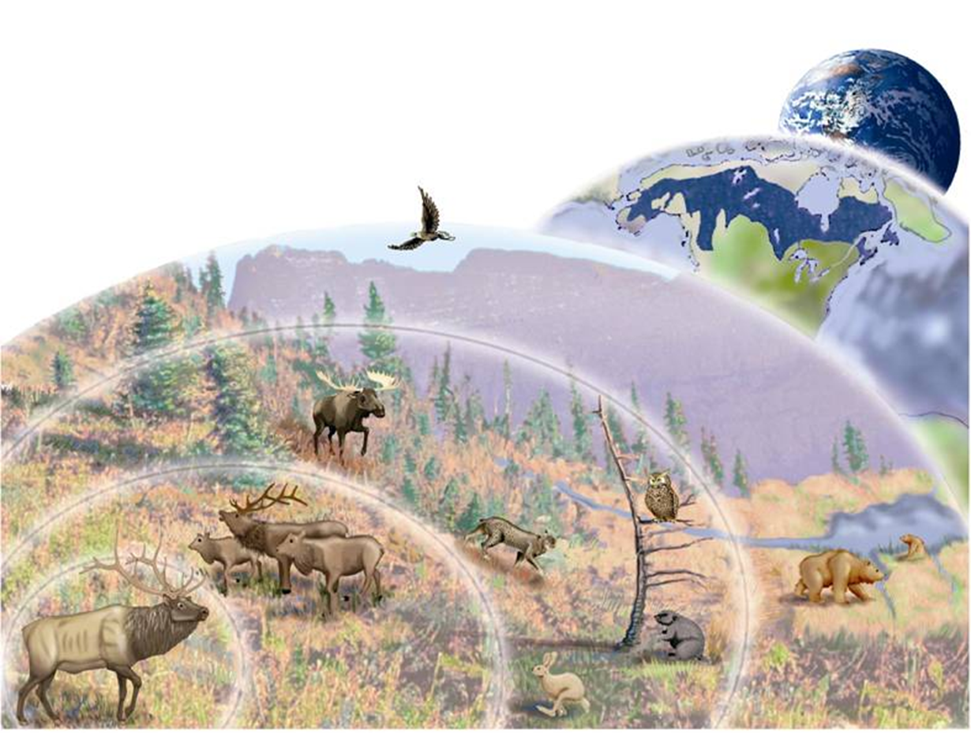
Biosphere
Biome
Ecosystem
Community
Population
Individual

Slide 6
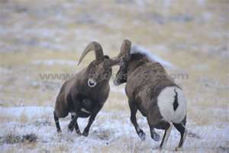
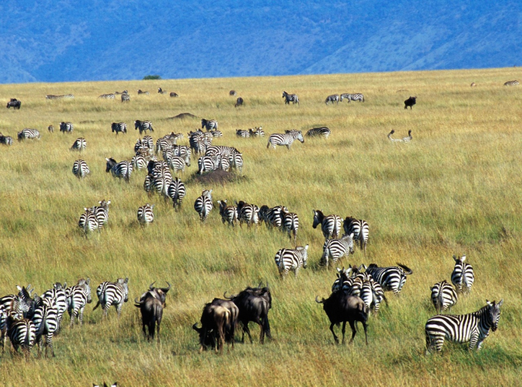
Levels of Organization
Species – organisms so similar to each other that they can breed and produce fertile offspring.
Population – groups of individuals that belong to the same species and live in the same area
Communities – are many different populations that live together in a defined area.
http://www.youtube.com/watch?v=S-EZHZpAsOI&feature=related

Slide 7
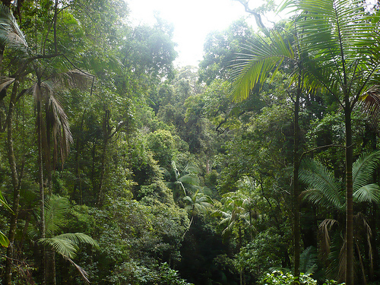
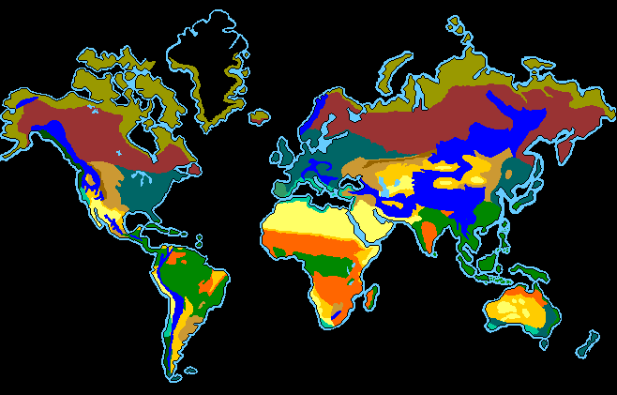
Levels of Organization
Ecosystem – collection of all the organisms that live in a particular place, together with their nonliving environment
Biome – group of ecosystems that have the same climate and similar dominant communities.

