Slide 1
Essay Writing 101
Or How Essays are Like Cars

Slide 2
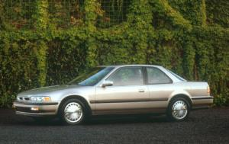
Basic

Slide 3

Timed Writing

Slide 4
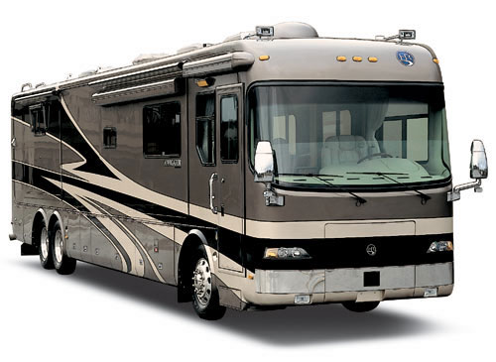
Autobiographical Incident

Slide 5
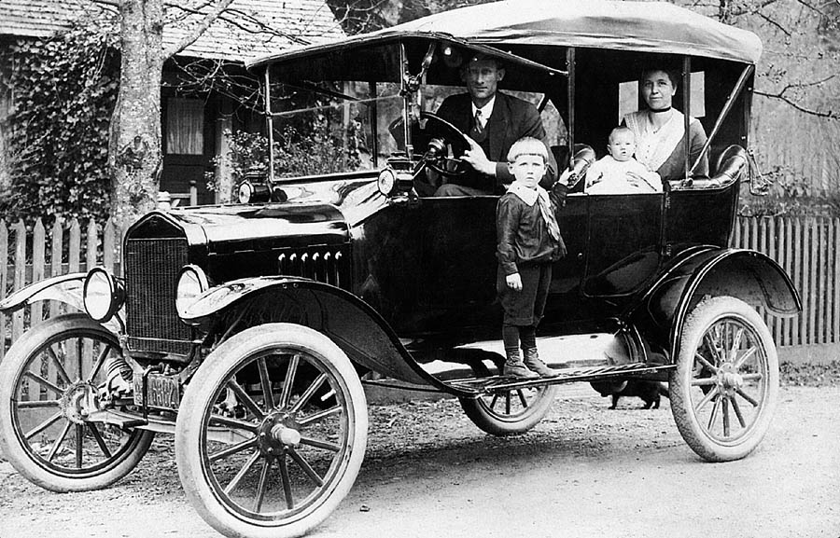
Research

Slide 6
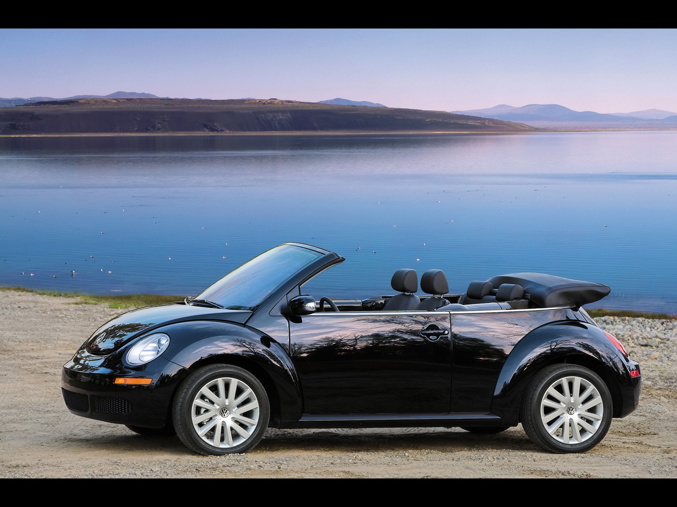
Response to Literature

Slide 7
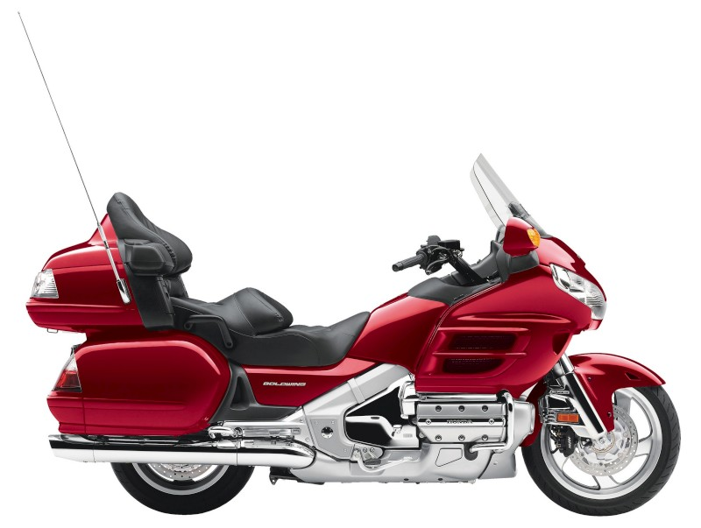
Business Letter

Slide 8
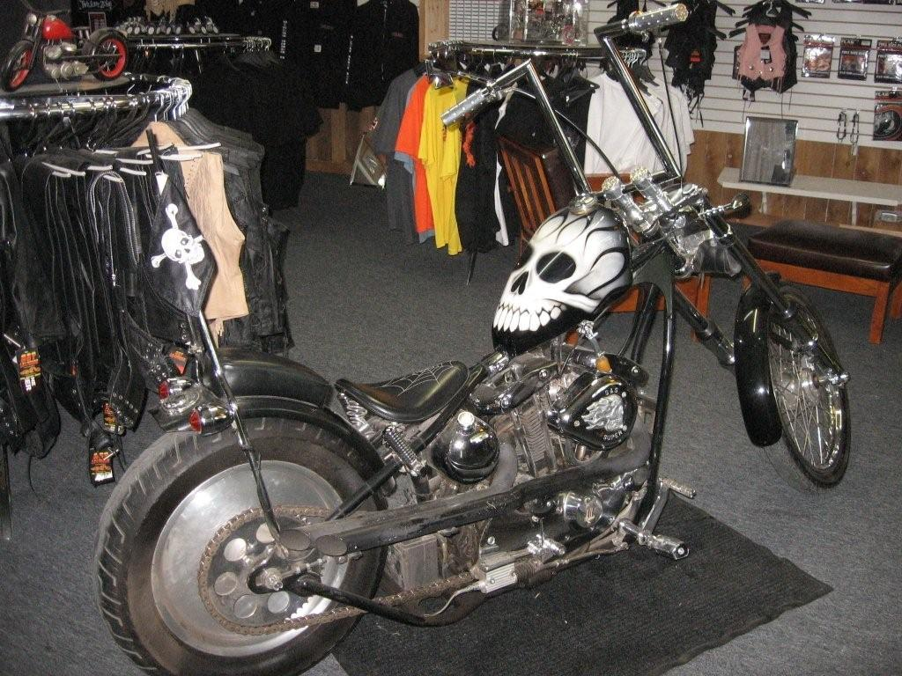
Personal/Friendly Letter

Slide 9
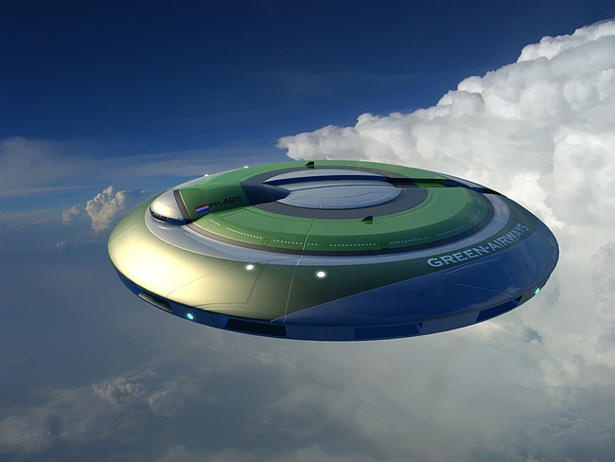
Reflective Essay

Slide 10
Introduction
Hook
Thesis Statement (What your paper is about)

Slide 11
Body Paragraph #1
Topic Sentence (What this paragraph is about)
Example
Explain the example
Another Example
Explain the example
Concluding Sentence

Slide 12
Body Paragraph #2
Topic Sentence (What this paragraph is about)
Example
Explain the example
Another Example
Explain the example
Concluding Sentence

Slide 13
Conclusion
Restate Thesis Statement
Memorable Closer

